Slide 1

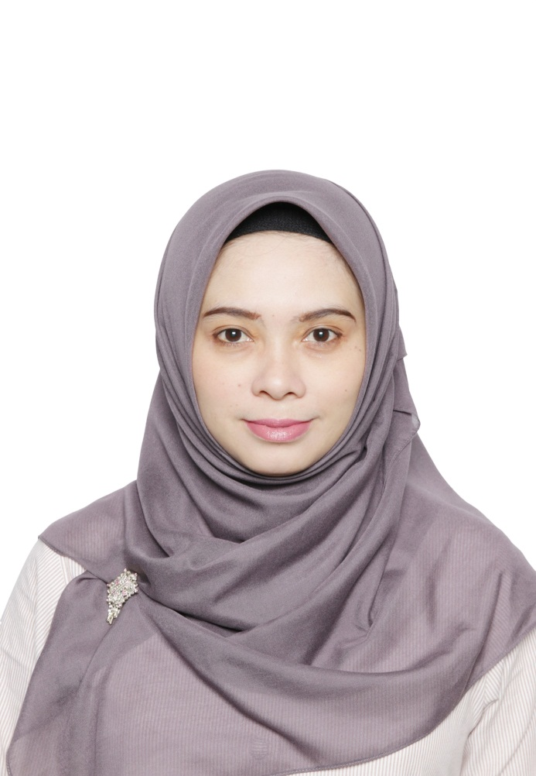
DHH1A3 – OPERASIONAL KANTOR DEPAN I
PRAKTIK RESERVASI KAMAR
ROOM RESERVATION PRACTISE
Ersy Ervina, MM.Par
Riza Taufiq, MM.Par
D3 PERHOTELAN - FAKULTAS ILMU TERAPAN

Slide 2
Praktik Reservasi Kamar
Practise Room Reservation
Mahasiswa Mampu Memahami Peralatan dan Formulir Kerja Reservasi
Mahasiswa Mampu Memahami Group Reservation
Students are able to understand the terms in Reservation
Students are able to understand Group Reservation
Student are able to Implement Sample of Room Reservation Conservation
Mahasiswa Mampu Melaksanakan Scoring Parameter
Students are able to understand the reservation tools and forms
Mahasiswa Mampu Memahami istilah-istilah dalam Reservasi
Students are able to carry out the scoring parameter
Mahasiswa Mampu Mengimplementasikan Contoh Percakapan Reseservation
Mahasiswa mampu memahami prosedur reservasi kamar
Students are able to understand room reservation procedures
LEARNING OBJECTIVE
CAPAIAN PEMBELAJARAN

Slide 3

PRACTISE ROOM RESERVATION
CONTENT
GLOSARIUM
PREPARE WORK AREA
RESERVATION PROCEDURE
GROUP RESERVATION
SAMPLE OF ROOM RESERVATION CONVERSATION
SCORING PARAMETER
Sumber Referensi: https://www.freepik.es/vector-gratis/mesas-madera_798193.htm

Slide 4

GLOSARIUM
No | Istilah | Penjelasan
1 | BAR | Best Available Rate
2 | Black listed guests | Tamu yang sudah tidak terdaftar lagi di hotel karena suatu tindakan yang tidak baik (masalah pembayaran, atau sikap yang buruk)
3 | Bumping guests | Pada saat hotel sudah penuh, hotel akan memindahkan tamu tersebut ke hotel lain
4 | Company Charge | Suatu pelayanan dimana akun/tagihan tamu dikirimkan ke perusahaan
5 | Confirmation Letter | Keterangan untuk mengkonfirmasi kepada tamu yang menjelaskan tentang reservasinya di hotel tersebut.
6 | Cross Selling | Teknik penjualan – dengan menawarkan produk lainnya dari hotel
7 | CRS | Computerised Reservation System
8 | Down-selling room | Mengganti kamar yang sudah di reservasi ke tipe kamar yang lebih rendah
Sumber Referensi: William Angliss Institutes, Trainee Manual Receive & Process Reservation, 2013

Slide 5
GLOSARIUM
No | Istilah | Penjelasan
9 | FIT (Free Individual Traveller) | Tamu hotel yang melakukan reservasi secara individual dan tidak terikat dalam suatu rombongan/ grup
10 | Guaranteed reservation | Reservasi yang sudah diterima dan reservasi tersebut sudah pasti
11 | OTA (Online Travel Agent) | Travel-travel yang melayani reservasi dengan online
12 | Overbooked | Penjualan produk kamar maupun service melebihi ketersediaan hotel. Hotel tidak dapat melayani kecuali terdapat no-show
13 | Packages | Paket – paket yang merupakan kombinasi dari produk dan service dengan harga special
14 | Pick Up Transport Service | Pelayanan yang diberikan dari hotel untuk penjemputan dari suatu tempat ke hotel
15 | Pro-Forma Invoice | Bill atau tagihan tamu yang dikeluarkan di awal
16 | No Show | Tamu yang sudah membuat reservasi tapi tidak datang ke hotel atau restoran
Sumber Referensi: William Angliss Institutes, Trainee Manual Receive & Process Reservation, 2013

Slide 6
GLOSARIUM
No | Istilah | Penjelasan
17 | On Hold | Penelpon dalam kondisi menunggu , biasanya disuguhkan music promosi dari hotel saat penelpon menunggu
18 | Peak Period | Waktu atau bulan tertentu dalam satu tahun dimana tingkat hunian hotel tinggi
19 | Special Requests | Dimana tamu membuat permintaan khusus ketika melakukan reservasi atau saat check-in . beberapa permintaan tersebut dikenakan biaya dan ada pula yang free contohnya non smoking room, champagne in room
20 | Speed Dial | Pre Program Number- No tujuan telepon yang disetting secara otomatis melalui handset telepon untuk mempercepat panggilan
21 | Telephone | Point to point Communication – sistem komunikasi yang melibatkan 2 orang atau lebih melalui suara dan jarak
22 | Transfer Call | Transfer telepon untuk antar departemen atau dari departemen lain untuk telepon keluar
23 | Wake Up Call | Telepon yang bertujuan membangunkan Tamu
Sumber Referensi: William Angliss Institutes, Trainee Manual Receive & Process Reservation, 2013

Slide 7

PREPARE RESERVATION WORK AREA
EQUIPMENT & FORMS
Peralatan dan Formulir
https://unsplash.com/collections/303884/background

Slide 8
EQUIPMENT
Alat Kerja
1
TELEPHONE
2
KOMPUTER
(Aplikasi Front Office)
3
RESERVATION
CHART BOARD
4
5
RESERVATION
RACK
PEN & NOTE
Sumber Referensi: http://www.contohURL.com

Slide 9
Forms
Formulir Kerja
01
02
03
RESERVATION FORM
CONFIRMATION LETTER
PRO-FORMA INVOICE
Merupakan Formulir yang wajib diisi oleh bagian reservation ketika menerima pesanan kamar
Adalah Formulir atau surat yang merupakan bukti bahwa pesanan kamar sudah di terima dan disetujui
Merupakan faktur yang di siapkan sebelum menyediakan barang dan jasa
04
05
06
FORM PICK UP / DROP OFF TRANSPORT
RESERVATION CHANCE/CANCELL FORM
RESERVATION CHECKLIST FORM
Adalah formulir yang di gunakan untuk menjemput tamu hotel
Adalah formulir untuk mencatat informasi pembatalan dan perubahan pemesanan kamar
Suatu form untuk mendata kelengkapan proses reservasi
Notes:
Reservation Form
Formulir ini berisikan detail tentang reservation tamu seperti nama, Tanggal kedatangan dan keberangkatan, tipe kamar, jumlah kamar, jenis pembayaran, special request tamu dan lain – lain
2. Confirmation letter
Confirmation Letter ini dibuat oleh pihak hotel sebagai balasan atas pesanan yang telah dilakukan oleh tamu. Confirmation pada saat ini adalah banyak menggunakan email.
3 PRO-FORMA INVOICE
Fungsi dari proforma invoice diantaranya untuk memberikan layanan kepada tamu atas transaksi yang dilakukan. Selain itu memungkinkan tamu dalam memperkiraan biaya transaksi yang harus dibayar untuk produk yang dibeli, biaya pengiriman dan biaya pemrosesan. Proforma invoice juga dikenal sebagai jenis faktur sementara, yang diberikan sebelum penyerahan barang/fasilitas dilakukan secara keseluruhan.

Slide 10

MANNER RECEIVING RESERVATION
Sikap menerima Reservation
Caring
Memperhatikan, mendengarkan dan mencatat semua isi pembicaraan
Commited
Merasa terikat dengan organisasi / perusahaan tidak melemparkan masalah kepada orang lain atau bebas tanggung jawab
Confident
Penuh keyakinan dalam mengatasi persoalan yang timbul. Operator telepon tidak perlu merendahkan diri sendiri
https://www.blackwellmansion.com/product/phone-reception-service/
Notes:
https://www.amazon.com/Simulation-Bonsai-Flowers-Artificial-

Slide 11

MANNER RECEIVING RESERVATION
Sikap Menerima Reservation
Considerate:
Memiliki sikap bersahabat dan menjaga emosi penelepon
Controlled
Mampu menjaga dan mengontrol emosi pada saat penelepon marah/kecewa pada hotel anda
Contagious
Selalu memelihara keakraban, kegembiraan dan kedamaian
https://www.silkandivy.com/
Notes:
https://harthomedecor.com/product/rome-city-map-art-print/

Slide 12

MANNER RECEIVING RESERVATION
https://www.ikeahackers.net/2014/04/spring-faux-flower-decoration.html
Creative
Kemampuan dalam menemukan cara efektif dalam bekerja, seperti mencatat dan menyimpan sesuai abjad nama -nama relasi dan nomor telepon penting, membuat kode petunjuk wilayah telkom baik untuk SLJJ dan SLI

Slide 13

RESERVATION PROCEDURES
Step (s) | The Procedures
1 | Greeting Offering Help
2 | Asking the Arrival Date and Departure Date
3 | Asking The Type Room
4 | Consulting The Reservation Plan to make sure the room is available
5 | If the Room is available say “good news” and offering the room by explaining the facilities first then the room rate per night, if the room is unavailable say “sorry” then offering the other type available for the period reserved.
6 | Asking the agreement, then bloking the room
7 | Asking the :
 | a. | Complete Name of the guest, the spell the name by using international Spelling Board
 | b. | Asking the contact person the guest does not make reservation for him/her self
 | c. | Complete Address and Telephone Number
 | d. | Account Settlement
 |  | If the Account is invoiced to the company , ask the company ask the company name, contract person and number
 | e. | Asking the arrival detail (time, flight etc)

Slide 14
RESERVATION PROCEDURE
Step (s) | The Procedures
8 | Repeating the Reservation data :
 | a. | Name Of the Guest
 | b. | Type Of Room
 | c. | Arrival and Departure Date
 | d. | Room Rate per Night
 | e. | Account Settlement
9 | Offering Special Request If Possible
10 | Last Greeting
Sumber Referensi : Modul Praktikum Reservation, Telkom University 2016

Slide 15
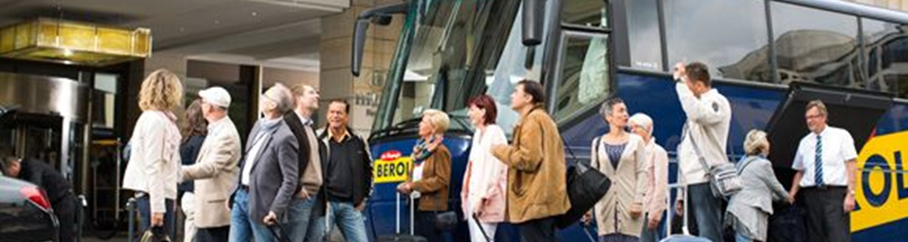
GROUP RESERVATION
https://www.firestarterbrands.com/
Tamu Group tidak memiliki jumlah minimum orang yang spesifik. Biasanya tamu dapat dikatakan sebagai group dengan setidaknya berjumlah sepuluh orang atau lebih. Pemesanan kamar tamu group dapat ditangani langsung oleh bagian front Office ataupun bagian sales marketing hotel. Berikut beberapa hal yang perlu di pertimbangkan saat menangani tamu group :
Jumlah orang dalam Group
Jumlah Volume bisnis yang sudah ada dan yang diharapkan akan datang
Hubungan antara hotel dengan pihak lain
Perlu diingat dengan menerima tamu grup, hotel harus membuat konfirmasi atas pesanan kamar setidaknya 15 hari di muka dan pemberitahuan apabila terjadi cancellation.
Sumber Referensi : https://www.hospitality-school.com/hotel-guest-reservation-procedure/
Notes:
http://consistentclients.club/hotel-switchboard-operator-cover-letter/hotel-switchboard-operator-cover-letter-call-centre-cover-letter-template-hotel-telephone-operator-cover-letter/

Slide 16
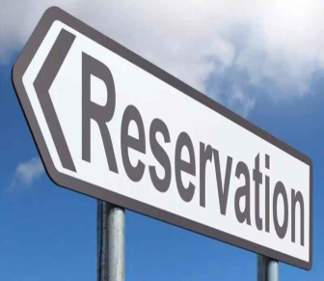
GROUP RESERVATION CONSIDERATION
Know the Group Profile, Including its cancellation, no show and last minute reservation history
Review all relevant hotel Reservation policies with convention planner
Be Sure reservation agent are aware the convention has been scheduled
Produce regulary scheduled report to update the status of convention block
Confirm resservation from attendees as soon as possible
Disribute final rooming list to hotel and convention planner
https://www.thehansindia.com/andhra-pradesh/high-level-committee-meeting-over-implementation-of-ews-reservation-527955
Sumber Referensi : AHMA, Front Office Management, 1988

Slide 17
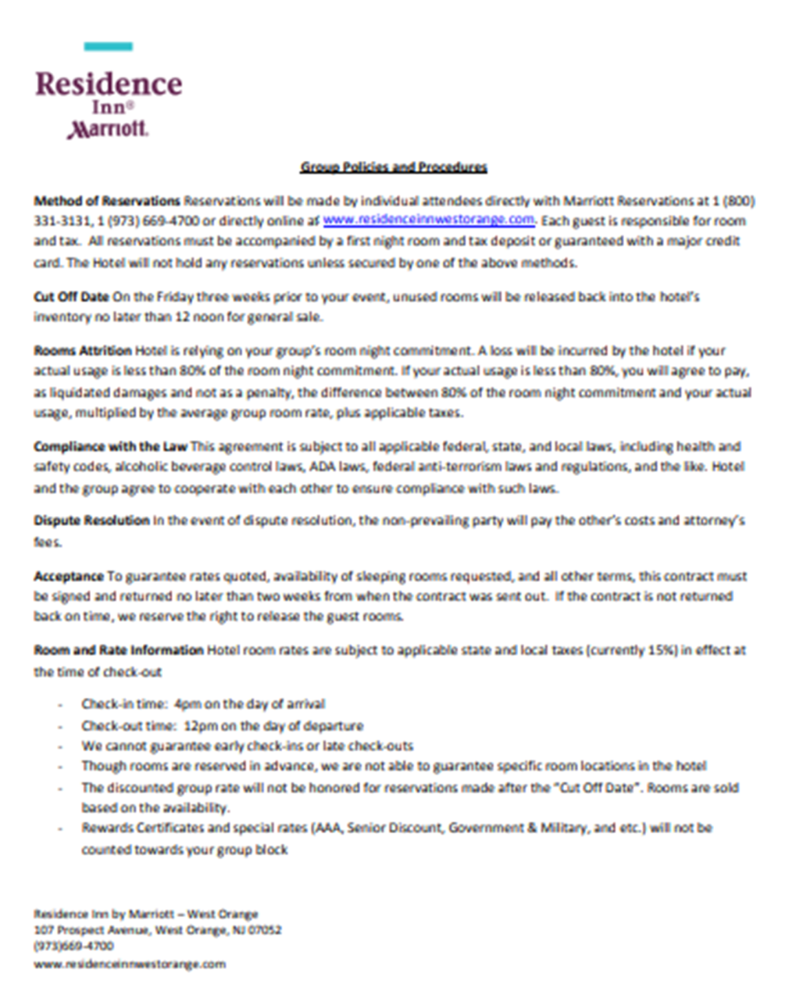
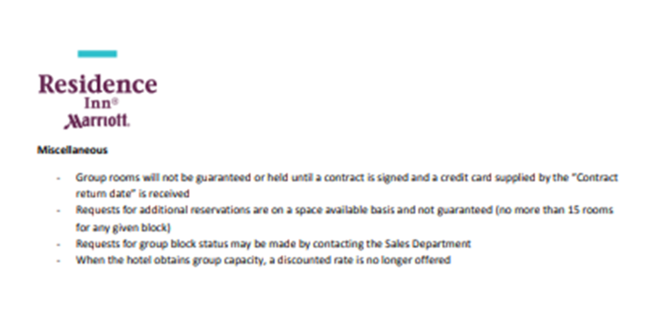
SAMPLE OF GROUP RESERVATION PROCEDURE
Sumber Referensi : https://www.marriott.com/hotelwebsites/us/e/ewrog/ewrog_pdfs/Group_Policies_and_Procedures.docx2.pdf

Slide 18
SAMPLE OF RESERVATION CONVERSATION I
Name | Dialog | To Do | Not To Do
Reservation | Good Morning, Telkom Hotel, This is Reservation Section With Andrew, may i help you ? | Greeting Clear Intonation Offering help
Guest | I Would Like To Reserve a Room
Reservation | Yes Sir, May I know what type of room would you like, and for how many person, sir ? | Friendly Talky
Guest | I Like one suite room, Please. Just For me
Reservation | May I Know When will you be arriving ?
Guest | I Will be arriving on September, 19 th 2019
Reservation | How about your departure ?
Guest | On September, 22 nd 2019
Reservation | Allright miss, may I Know Your name ?
Guest | My name Is Karine
Reservation | Alright Miss, I will spell your name. K for kilo, A for Alpha, R for Romeo, I For India, N for November, and E for echo. Is that Correct, Miss ? | Spelling Guest Name
Guest | Yes

Slide 19
SAMPLE OF RESERVATION CONVERSATION I (Continue)
Name | Dialog | To Do | Not To Do
Reservation | Just a Moment Ms. Karine, I will Check available room for that Period | Check Room Available on System | Too Long
Guest | Yes Please
Reservation | Good News Sir, because there’s one suite room still available for you, and May i explain about your room facilities | Excuse Your Self
Guest | Yes, Please
Reservation | The Room Facilities such as private balcony, living room, small kitchen, mini bar, television, telephone, air conditioner, bath room complete with shower, bath tub and hot + cold running water well, the room rate is Rp. 1.350.000,00/ninght net include breakfast. Do you want to reserve now, Sir ? | Explain about room facilities
Guest | Yes
Reservation | May I repeat your reservation, Miss ? |  | Not to Rush
Guest | Yes, Sure
Continue

Slide 20
SAMPLE OF RESERVATION CONVERSATION I (Continue)
Name | Dialog | To Do | Not To Do
Reservation | Well, Ms Karine, You’d like reserve on suite room,, and the rate is Rp. 1,350,000,00/night net + Break fast, You will be arriving on September 19 th 2019 Until September 22 nd 2019, and do you have any request ? | Repeat reservation
Guest | No thanks
Reservation | Thank you very much for your reservation. Looking forward for you coming to our hotel. Have you any cancellation about your reservation, please inform as soon as possible | Lat Greeting
Guest | Thank Your Vey Much for your service
Reservation | Your Welcome

Slide 21
SAMPLE OF ROOM RESERVATION CONSERVATION II
Name | Dialog | To Do | Not To Do
Reservation | Good Morning Telkom Hotel My Name Is Tiffany. May I assist you ? | Greeting Offering Help Clear Information
Guest | Hi, good Morning. I’d like to make a reservation for the third weekend in December
reservation | Yes mam, we have several rooms available for that particular weekend. What is exact date of your arrival ? And how long you be staying ?
Guest | The 23rd . And I’ll be staying for two night
Reservation | Allright, please be wait for a while i wanna check it first. Good news, Mam. Superior room for 23rd still available and may i explain About your room facilities ? | Check room avalaibible on system
Guest | Yes
Reservation | The room facilities such as television, telephone, air conditioner, bath room complete with shower, bath tub, and hot + cold running water Well, the room rate is Rp. 875,500,00/night net include breakfast. Do you want to reserve now, Mam ? | Explain room facilities clear intonation
Continue

Slide 22
SAMPLE OF ROOM RESERVATION CONSERVATION II (continue)
Name | Dialog | To Do | Not To Do
Guest | Yes
Reservation | May I know your telephone number , Mam?
Guest | 081145623411 that’s my number
Reservation | Alright Mam. May I know about settle the payment ?
Guest | I will pay by cash upon check in
Reservation | When You will arrive to our hotel ?
Guest | I will coming to hotel arround 3 PM
Reservation | Allright mam Zara, I will repeat your reservation is 1 Superior room start from 23rd Until 25th December. Your telephone number is 081145623411. And you will pay by cash upon check in. That’s correct, Mam ? | Repeat Reservation
Guest | Yes
Reservation | Any special Request, mam ? | Offering Help
Guest | No Thanks
Reservation | Thank You very much for your reservation. Looking forward for your coming to our hotel.. Have you any cancellation about your reservation, please inform as soon as posible | Last Greeting

Slide 23
SAMPLE OF ROOM RESERVATION CONSERVATION III
Name | Dialog | To Do | Not To Do
Reservation | Thank you for calling Telkom Hotel. This is with reservation, jimmy Speaking, How may i assist you ? | Greeting Offering Help Clear Intonation Smile | Flat Intonation
Guest | Hi good morning. I need hotel room. I’am Nadya Lee From Kuala Lumpur
Reservation | Allright Ms. Nadya, May I Know when you will be arriving and how many night do you plan to say | Frienldy talky
Guest | On November 2 nd, 2019 its for four night, for period 2 until 6 November
Reservation | Would you care to reserve our suite room, in our special tower or in deluxe room Mrs. Nadya ?
Guest | I Would prefer to choose 1 Deluxe room with double bed, i stayed there on my last visit
Reservation | Owh i see... How many part of you
Guest | Its Only me with husband
Continue….
Notes:
I would prefer to choose 1 Deluxe room with double bed, i Stayed there on my last visit

Slide 24
SAMPLE OF ROOM RESERVATION CONSERVATION III (Continue)
Name | Dialog | To Do | Not To Do
Reservation | All right maam, could you wait for a moment i will check our system. ****** (Reservation Check The System and History Record) Good news Ms. Nadya 1 Deluxe for 2 period 2 until 6 November still available. Do you want me to book it now ? | Check Room Available room on System | Too Long
Guest | Yes Please
reservation | Do You any special Request, such as non smoking room ?
Guest | Yes I think i’d like that
Reservation | Allright Mrs Nadya, for reservation under name for Mrs. Nadya your reservation is on Behalf your self Nadya,... Its N For November, A For Alpha, D For Delta, Y for Yankee, A for Alpha,. And your phone number is 60-333-123 is that’s correct, Mrs. Nadya ?? | Spelling Guest Name | Speak to Loud
Guest | Yes that Correct

Slide 25
SAMPLE OF ROOM RESERVATION CONSERVATION III (Continue)
Name | Dialog | To Do | Not To Do
Reservation | May i have your flight number and your arrival time | Repeat reservation
Guest | Sure, Of Course It with Malaysian Air line MH 123, i’ll be arrive on Nov 2nd at 17,50 PM
Reservation | Since you Will be arriving after 14.00 PM, you might wish to make guaranteed reservation with credit card to ensure the room will be held, may i have your credit card number Mrs Nadya ? | Ask Detail Payment
Guest | Sure, do you take Visa Card
Reservation | Yes we do, and we also need the expired date | Check The Card Name
Guest | Its The Card Number 1234-5678-000, and the expired date is 12/22
Continue….

Slide 26
SAMPLE OF ROOM RESERVATION CONSERVATION III
Name | Dialog | To Do | Not To Do
Reservation | Fine , Your guaranted reservation is confirmed for non smoking Deluxe Double room in Telkom Hotel, the arriving date on Nov 2nd and departure date on Nov 6, 2019. Your Reservation Confirmation is 1234 TX. My name is Jimmy we will send the confirmation letter to your email. If you plan to Change your reservation or any cancellation please our hotel before 6 PM, Do have any guestion Mrs. Nadya ?
Guest | No, I think that enough
Reservation | Thank You very much your reservation. We looks Forwar to see you, Have a Nice day Mrs Nadya | Smile, Last Greeting. Put the handset Carefully | Drop the Handset

Slide 27

SCORING PARAMATER
Penilaian Praktikum Reservasi kamar dilakukan dengan metoda simulasi dan role play. Tiap – tiap mahasiswa akan secara bergiliran mencoba menangani reservasi kamar sesuai dengan prosedur yang telah ditetapkan
Penilaian terdiri dari
Kelengkapan urutan kerja,
penggunaan bahasa inggris,
Ketepatan Pertanyaan dan Jawaban
Kecepatan
Sumber Gambar : https://www.123rf.com/photo_15117922_3d-people-men-person-and-a-graph-arrow-business-partners-.html

Slide 28
SCORING PARAMETER
Telkom Unversity
Telkom Applied Science Shool
Reservation by Phone
Evaluation Sheet
Name:
Step | Descriptions |  | Yes | No | Score | Comment
1 | Greeting and Offering Help
2 | Asking the Arrival Date and Departure Date *)
3 | Asking the type of Room *)
4 | Consulting the Reservation Plan to make sure the room is available
5 | If the room is available say "good news" and offering the room by explaining the facilities first the the room rate per night, if the room is unavailable say "sorry" then offering the other type available for the periode reserved.
6 | Asking the agreement, then blocking the room
7 | Asking the:
 | a. | Complete Name of the guest, the spell name by using International Spelling Board
 |  | Asking the contact person if the guest does not make reservation for him/herself
 | b. | Complete Address and Telephone Number
 | c. | Account Settlement
 |  | If the Account is invoiced to the company, asking the company’s name, contact person and number
 | d. | Asking the arrival detail (time, flight etc.)
Sumber Referensi : Modul Praktikum Reservation, Telkom University 2016

Slide 29
SCORING PARAMETER
8 | Repeating the reservation data:
 | a. | Name of the guest
 | b. | Type of room
 | c. | Arrival and Departure Date
 | d. | Room rate per Night
 | e. | Account Settlement
9 | Offering Special request if possible
10 | Last Greeting
Total Score
Date :
Instructor :
Signed
Sumber Referensi : Modul Praktikum Reservation, Telkom University 2016

Slide 30

PRACTISING ROOM RESERVATION Improve Your Skill
Carilah Seorang Teman Anda
Buatlah Suatu Kasus Pemesanan Kamar
Buatlah percakapan Room Reservation Dalam Bahasa Inggris
Ikutilah sesuai prosedur yang telah di jelaskan
Latihlah Berulang-ulang hingga lancar
Selamat Mencoba
https://www.dreamstime.com/stock-photo-receptionist-phone-front-desk-hotel-image52565624

Slide 31

POINT OF ASSESMENT
No | Item | Grade
 |  | A | B | C | D
1 | Courtesy | All Item | Need improvement | Flat | Do Not Speak up
 | Polite
 | Friendly
 | Intonation
 | Nervous
2 | Relevance | Detail Answer | General | Not Relevance | Do not Speak up
 | Connection between question & Answer
3 | Duration | 30’ | 30’- 60’ | + 60’ | +120’
 | Time due to spesific Question
4 | Speaking English | Fluent | Average | Effort | Do not Speak up
Grade :
A = 80 - 100
B = 60 - 79
C = 40 - 59
D = 20 - 39
Sumber Referensi : Modul Praktikum Reservation, Telkom University 2016

Slide 32
EMAIL
ersy@tass.telkomuniversity.ac.id
CONTACT US
OFFICE
D3 Perhotelan
Fakultas Ilmu Terapan Telkom University
Jalan Telekomunikasi No 1 Terusan Buah Batu Kab. Bandung
www.telkomuniversity.ac.id

