Slide 1
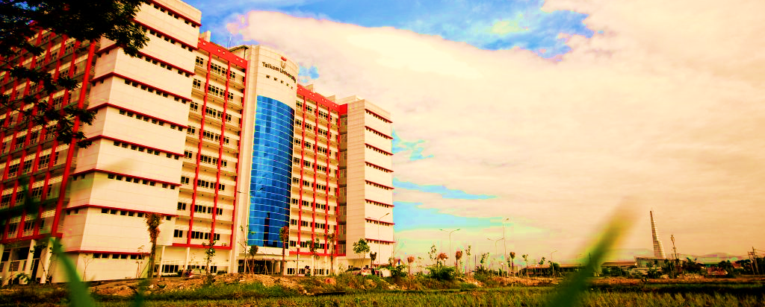


RUANG VEKTOR HASIL KALI DALAM
MUH1G3/ Matriks dan ruang vektor
FAKULTAS INFORMATIKA
Center of learning & open education Telkom university

Slide 2
Ruang Vektor Hasil Kali Dalam (R. HKD)
  Sub Pokok Bahasan
  Definisi Ruang Hasil Kali Dalam
  Himpunan Orthonormal
  Koordinat Relatif
  Proses Gramm Schmidt
Beberapa Aplikasi RHKD
Metode Optimasi seperti metode least square dalam peminimumam error dalam berbagai bidang rekayasa

Slide 3
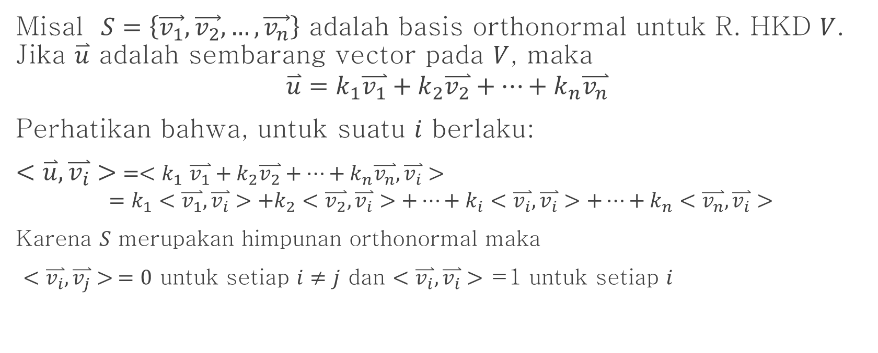
Koordinat Vektor Relatif terhadap Basis Orthonormal
Misal $S=\left\{\vec{v_{1}},\vec{v_{2}},…,\vec{v_{n}}\right\}$ adalah basis orthonormal untuk R. HKD $V$. Jika $\overset{⃑}{u}$ adalah sembarang vector pada $V$, maka
$$\overset{⃑}{u}=k_{1}\overset{⃑}{v_{1}}+k_{2}\overset{⃑}{v_{2}}+…+k_{n}\overset{⃑}{v_{n}}$$
Perhatikan bahwa, untuk suatu $i$ berlaku:
$<\overset{⃑}{u},\overset{⃑}{v_{i}}>$ $={<k}_{1}\overset{⃑}{v_{1}}+k_{2}\overset{⃑}{v_{2}}+…+k_{n}\overset{⃑}{v_{n}},\overset{⃑}{v_{i}}>$
$$=k_{1}<\overset{⃑}{v_{1}},\overset{⃑}{v_{i}}>+k_{2}<\overset{⃑}{v_{2}},\overset{⃑}{v_{i}}>+…+k_{i}<\overset{⃑}{v_{i}},\overset{⃑}{v_{i}}>+…+k_{n}<\overset{⃑}{v_{n}},\overset{⃑}{v_{i}}>$$
Karena $S$ merupakan himpunan orthonormal maka
$<\overset{⃑}{v_{i}},\overset{⃑}{v_{j}}> =0$ untuk setiap $i≠j$ dan $<\overset{⃑}{v_{i}},\overset{⃑}{v_{i}}>$ =1 untuk setiap $i$

Slide 4
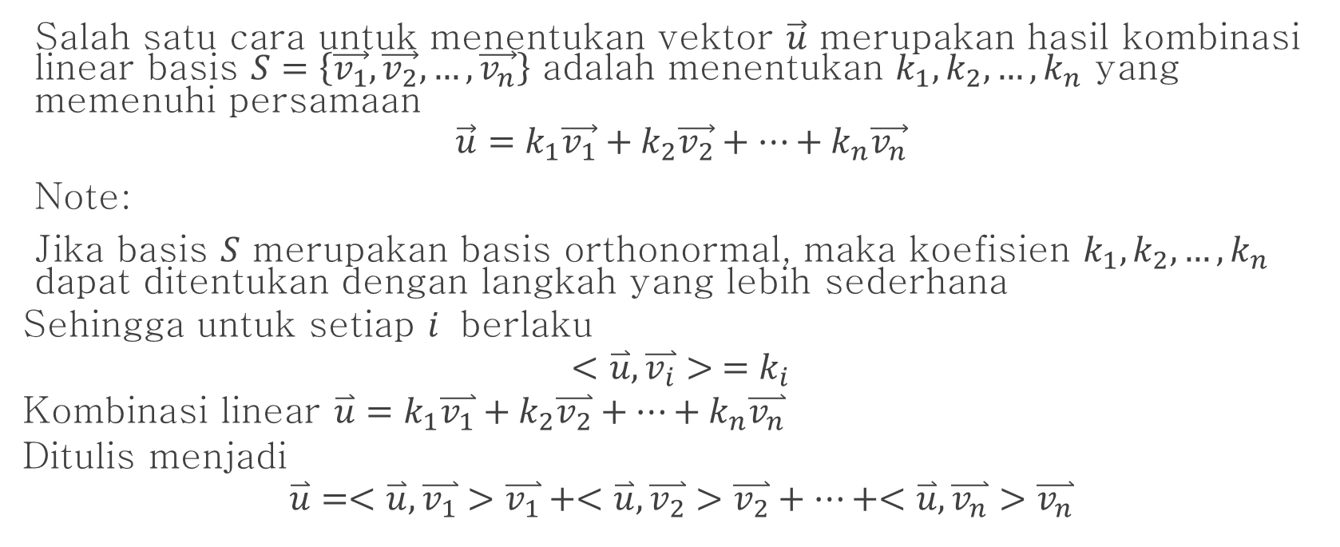
Koordinat Vektor Relatif terhadap Basis Orthonormal(2)
Salah satu cara untuk menentukan vektor $\vec{u}$ merupakan hasil kombinasi linear basis $S=\left\{\vec{v_{1}},\vec{v_{2}},…,\vec{v_{n}}\right\}$ adalah menentukan $k_{1},k_{2}, …, k_{n}$ yang memenuhi persamaan
$$\vec{u}=k_{1}\vec{v_{1}}+k_{2}\vec{v_{2}}+…+k_{n}\vec{v_{n}}$$
Note:
Jika basis $S$ merupakan basis orthonormal, maka koefisien $k_{1},k_{2},…, k_{n}$ dapat ditentukan dengan langkah yang lebih sederhana
Sehingga untuk setiap $i$ berlaku
$$<\overset{⃑}{u},\overset{⃑}{v_{i}}> =k_{i}$$
Kombinasi linear $\overset{⃑}{u}=k_{1}\overset{⃑}{v_{1}}+k_{2}\overset{⃑}{v_{2}}+…+k_{n}\overset{⃑}{v_{n}}$
Ditulis menjadi
$$\overset{⃑}{u}=<\overset{⃑}{u},\overset{⃑}{v_{1}}>\overset{⃑}{v_{1}}+<\overset{⃑}{u},\overset{⃑}{v_{2}}>\overset{⃑}{v_{2}}+…+<\overset{⃑}{u},\overset{⃑}{v_{n}}>\overset{⃑}{v_{n}}$$

Slide 5
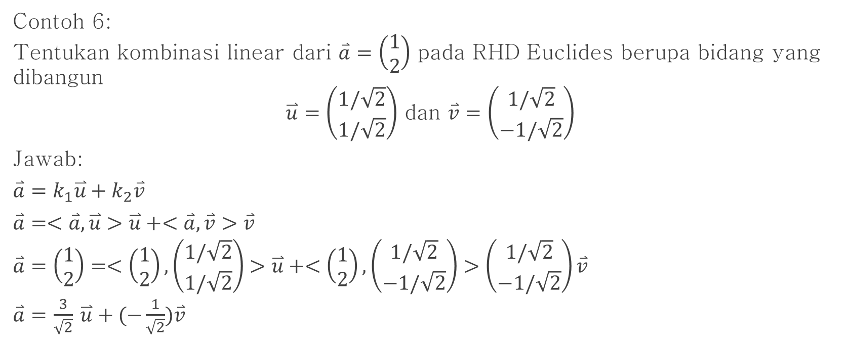
Koordinat Vektor Relatif terhadap Basis Orthonormal(3)
Contoh 6:
Tentukan kombinasi linear dari $\overset{⃑}{a}=\left(\begin{matrix}1 \\ 2\end{matrix}\right)$ pada RHD Euclides berupa bidang yang dibangun
$\overset{⃑}{u}=\left(\begin{matrix}1/\sqrt{2} \\ 1/\sqrt{2}\end{matrix}\right)$ dan $\overset{⃑}{v}=\left(\begin{matrix}1/\sqrt{2} \\ −1/\sqrt{2}\end{matrix}\right)$
Jawab:
$\overset{⃑}{a}=k_{1}\overset{⃑}{u}+k_{2}\overset{⃑}{v}$
$\overset{⃑}{a}=<\overset{⃑}{a}, \overset{⃑}{u}>\overset{⃑}{u}+<\overset{⃑}{a}, \overset{⃑}{v}>\overset{⃑}{v}$
$\overset{⃑}{a}=\left(\begin{matrix}1 \\ 2\end{matrix}\right)=<\left(\begin{matrix}1 \\ 2\end{matrix}\right),\left(\begin{matrix}1/\sqrt{2} \\ 1/\sqrt{2}\end{matrix}\right)>\overset{⃑}{u}+<\left(\begin{matrix}1 \\ 2\end{matrix}\right),\left(\begin{matrix}1/\sqrt{2} \\ −1/\sqrt{2}\end{matrix}\right)>\left(\begin{matrix}1/\sqrt{2} \\ −1/\sqrt{2}\end{matrix}\right)\overset{⃑}{v}$
$\overset{⃑}{a}=$ $\frac{3}{\sqrt{2}}$ $\overset{⃑}{u}+(−\frac{1}{\sqrt{2}})\overset{⃑}{v}$

Slide 6
Proses Gramm Schmidth
Basis bagi Suatu RHD V
$$S=\left\{\overset{⃑}{c_{1}},\overset{⃑}{c_{2}},…,\overset{⃑}{c_{n}}\right\}$$
Basis bagi Suatu RHD V
𝑆={(𝑐_1 ) ⃑,(𝑐_2 ) ⃑,…,(𝑐_𝑛 ) ⃑ }
Basis Orthonormal bagi V
$$B=\left\{\overset{⃑}{w_{1}},\overset{⃑}{w_{2}},…,\overset{⃑}{w_{n}}\right\}$$
Basis Orthonormal bagi V
𝐵={(𝑤_1 ) ⃑,(𝑤_2 ) ⃑,…,(𝑤_𝑛 ) ⃑ }

Slide 7

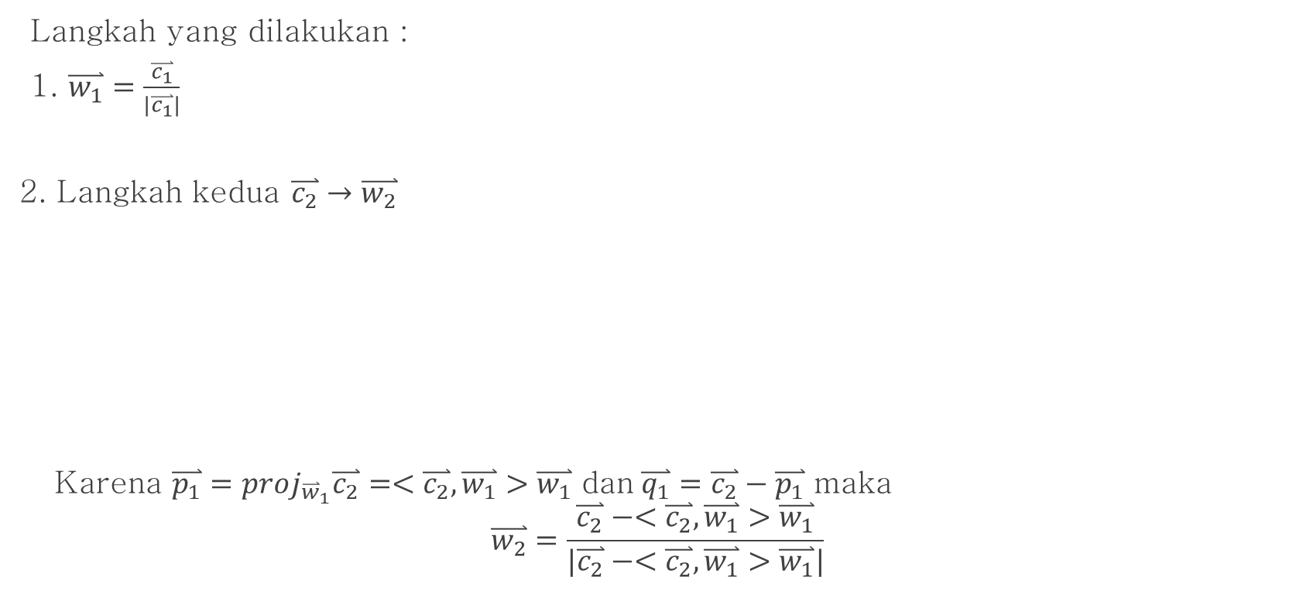





Proses Gram Schmidt $R^{2}$
Langkah yang dilakukan :
1. $\overset{⃑}{w_{1}}=\frac{\overset{⃑}{c_{1}}}{|\overset{⃑}{c_{1}}|}$
2. Langkah kedua $\overset{⃑}{c_{2}}→\overset{⃑}{w_{2}}$
Karena $\overset{⃑}{p_{1}}=proj_{{\overset{⃑}{w}}_{1}}\overset{⃑}{c_{2}}=<\overset{⃑}{c_{2}},\overset{⃑}{w_{1}}>\overset{⃑}{w_{1}}$ dan$\overset{⃑}{q_{1}}=\overset{⃑}{c_{2}}−\overset{⃑}{p_{1}}$ maka
$$\overset{⃑}{w_{2}}=\frac{\overset{⃑}{c_{2}}−<\overset{⃑}{c_{2}},\overset{⃑}{w_{1}}>\overset{⃑}{w_{1}}}{|\overset{⃑}{c_{2}}−<\overset{⃑}{c_{2}},\overset{⃑}{w_{1}}>\overset{⃑}{w_{1}}|}$$
$$\overset{⃑}{c_{2}}$$
$$\overset{⃑}{q_{1}}$$
$$\overset{⃑}{w_{2}}$$
$$\overset{⃑}{w_{1}}$$
$$\overset{⃑}{p_{1}}$$

Slide 8
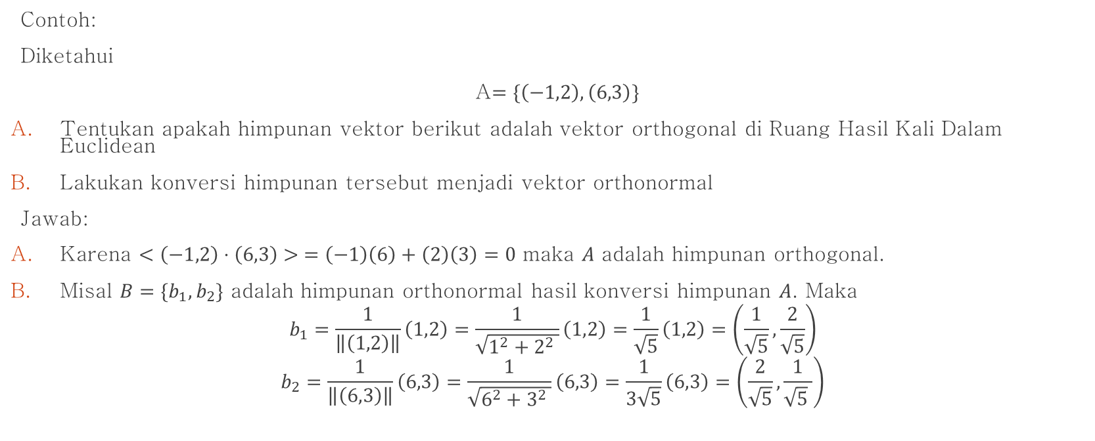

Proses Gram Schmidt $R^{2}$(2)
Contoh:
Diketahui
A$=\{\left(−1,2\right), \left(6,3\right)\}$
Tentukan apakah himpunan vektor berikut adalah vektor orthogonal di Ruang Hasil Kali Dalam Euclidean
Lakukan konversi himpunan tersebut menjadi vektor orthonormal
Jawab:
Karena $<\left(−1,2\right)⋅\left(6,3\right)> =\left(−1\right)\left(6\right)+\left(2\right)\left(3\right)=0$ maka $A$ adalah himpunan orthogonal.
Misal $B=\{b_{1}, b_{2}\}$ adalah himpunan orthonormal hasil konversi himpunan $A$. Maka
$$b_{1}=\frac{1}{\left\|\left(1,2\right)\right\|}\left(1,2\right)=\frac{1}{\sqrt{1^{2}+2^{2} }}\left(1,2\right)=\frac{1}{\sqrt{5}}\left(1,2\right)=\left(\frac{1}{\sqrt{5}},\frac{2}{\sqrt{5}}\right)$$
$$b_{2}=\frac{1}{\left\|\left(6,3\right)\right\|}\left(6,3\right)=\frac{1}{\sqrt{6^{2}+3^{2} }}\left(6,3\right)=\frac{1}{3\sqrt{5}}\left(6,3\right)=\left(\frac{2}{\sqrt{5}},\frac{1}{\sqrt{5} }\right)$$

Slide 9

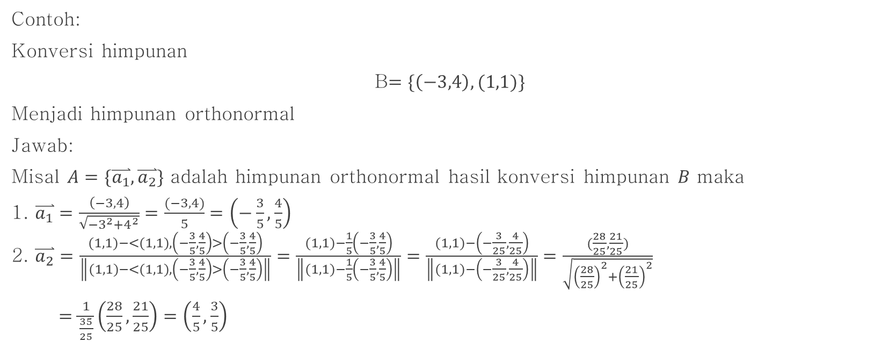
Proses Gram Schmidt $R^{2}$(3)
Contoh:
Konversi himpunan
B$=\{\left(−3,4\right), (1,1)\}$
Menjadi himpunan orthonormal
Jawab:
Misal $A=\{\overset{⃑}{a_{1}},\overset{⃑}{a_{2}}\}$ adalah himpunan orthonormal hasil konversi himpunan $B$ maka
1. $\overset{⃑}{a_{1}}=\frac{\left(−3, 4\right)}{\sqrt{{−3}^{2}+4^{2}}}=\frac{(−3,4)}{5}=\left(−\frac{3}{5},\frac{4}{5}\right)$
2. $\overset{⃑}{a_{2}}=\frac{(1,1)−<(1,1),\left(−\frac{3}{5},\frac{4}{5}\right)>\left(−\frac{3}{5},\frac{4}{5}\right)}{\left\|(1,1)−<(1,1),\left(−\frac{3}{5},\frac{4}{5}\right)>\left(−\frac{3}{5},\frac{4}{5}\right)\right\|}=\frac{(1,1)−\frac{1}{5}\left(−\frac{3}{5},\frac{4}{5}\right)}{\left\|(1,1)−\frac{1}{5}\left(−\frac{3}{5},\frac{4}{5}\right)\right\|}=\frac{(1,1)−\left(−\frac{3}{25},\frac{4}{25}\right)}{\left\|(1,1)−\left(−\frac{3}{25},\frac{4}{25}\right)\right\|}=\frac{(\frac{28}{25},\frac{21}{25})}{\sqrt{{\left(\frac{28}{25}\right)}^{2}+{\left(\frac{21}{25}\right)}^{2}}}$
$=\frac{1}{\frac{35}{25}}\left(\frac{28}{25},\frac{21}{25}\right)=\left(\frac{4}{5},\frac{3}{5}\right)$

Slide 10

Proses Gram Schmidt $R^{3}$
Langkah yang dilakukan :
1. $\overset{⃑}{w_{1}}=\frac{\overset{⃑}{c_{1}}}{|\overset{⃑}{c_{1}}|}$
2. Langkah kedua $\overset{⃑}{c_{2}}→\overset{⃑}{w_{2}}$
Karena $\overset{⃑}{p_{1}}=proj_{{\overset{⃑}{w}}_{1}}\overset{⃑}{c_{2}}=<\overset{⃑}{c_{2}},\overset{⃑}{w_{1}}>\overset{⃑}{w_{1}}$ dan$\overset{⃑}{q_{1}}=\overset{⃑}{c_{2}}−\overset{⃑}{p_{1}}$ maka
$$\overset{⃑}{w_{2}}=\frac{\overset{⃑}{c_{2}}−<\overset{⃑}{c_{2}},\overset{⃑}{w_{1}}>\overset{⃑}{w_{1}}}{|\overset{⃑}{c_{2}}−<\overset{⃑}{c_{2}},\overset{⃑}{w_{1}}>\overset{⃑}{w_{1}}|}$$
$$\overset{⃑}{c_{2}}$$
$$\overset{⃑}{q_{1}}$$
$$\overset{⃑}{w_{2}}$$
$$\overset{⃑}{w_{1}}$$
$$\overset{⃑}{p_{1}}$$

Slide 11







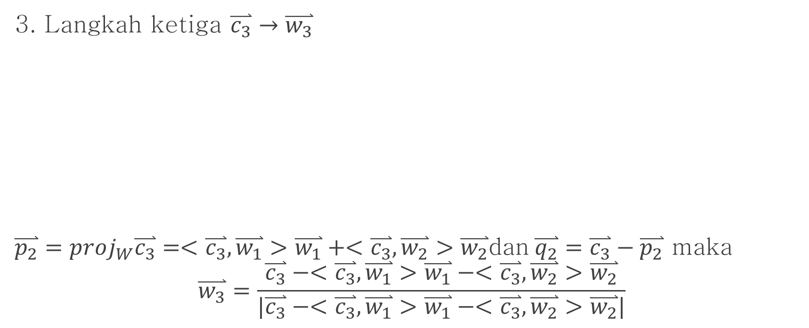
Proses Gram Schmidt $R^{3}$(2)
3. Langkah ketiga $\overset{⃑}{c_{3}}→\overset{⃑}{w_{3}}$
$\overset{⃑}{p_{2}}=proj_{W}\overset{⃑}{c_{3}}=<\overset{⃑}{c_{3}},\overset{⃑}{w_{1}}>\overset{⃑}{w_{1}}+<\overset{⃑}{c_{3}},\overset{⃑}{w_{2}}>\overset{⃑}{w_{2}}$dan$\overset{⃑}{q_{2}}=\overset{⃑}{c_{3}}−\overset{⃑}{p_{2}}$ maka
$$\overset{⃑}{w_{3}}=\frac{\overset{⃑}{c_{3}}−<\overset{⃑}{c_{3}},\overset{⃑}{w_{1}}>\overset{⃑}{w_{1}}−<\overset{⃑}{c_{3}},\overset{⃑}{w_{2}}>\overset{⃑}{w_{2}}}{|\overset{⃑}{c_{3}}−<\overset{⃑}{c_{3}},\overset{⃑}{w_{1}}>\overset{⃑}{w_{1}}−<\overset{⃑}{c_{3}},\overset{⃑}{w_{2}}>\overset{⃑}{w_{2}}|}$$
W

Slide 12

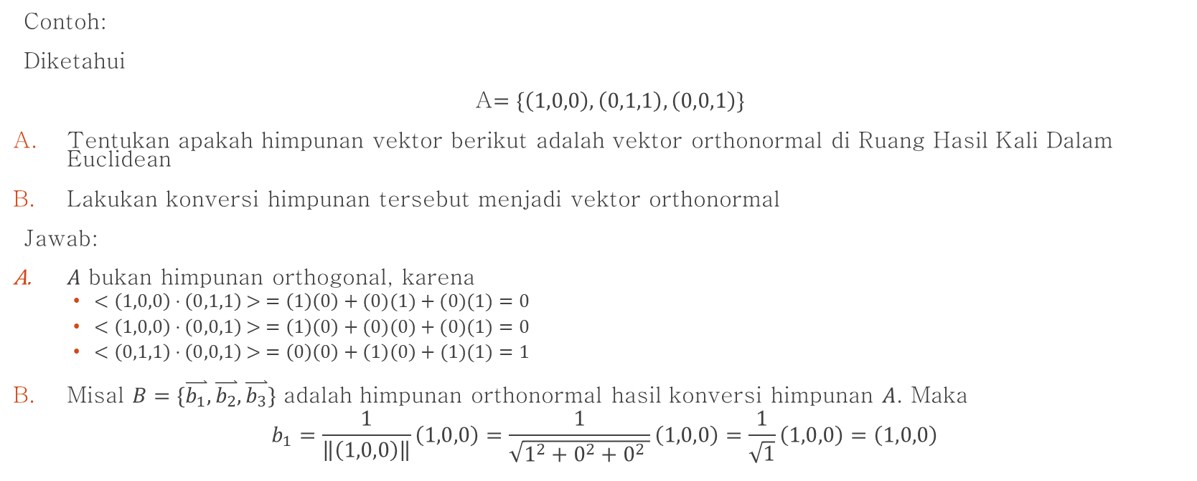
Proses Gram Schmidt $R^{3}$(3)
Contoh:
Diketahui
A$=\{\left(1,0,0\right),\left(0,1,1\right),\left(0,0,1\right)\}$
Tentukan apakah himpunan vektor berikut adalah vektor orthonormal di Ruang Hasil Kali Dalam Euclidean
Lakukan konversi himpunan tersebut menjadi vektor orthonormal
Jawab:
$A$ bukan himpunan orthogonal, karena
  $<\left(1,0,0\right)⋅\left(0,1,1\right)> =\left(1\right)\left(0\right)+(0)(1)+(0)(1)=0$
  $<\left(1,0,0\right)⋅\left(0,0,1\right)> =\left(1\right)\left(0\right)+(0)(0)+(0)(1)=0$
  $<\left(0,1,1\right)⋅\left(0,0,1\right)> =\left(0\right)\left(0\right)+\left(1\right)\left(0\right)+(1)(1)=1$
Misal $B=\{\overset{⃑}{b_{1}},\overset{⃑}{b_{2}},\overset{⃑}{b_{3}}\}$ adalah himpunan orthonormal hasil konversi himpunan $A$. Maka
$$b_{1}=\frac{1}{\left\|\left(1,0,0\right)\right\|}\left(1,0,0\right)=\frac{1}{\sqrt{1^{2}+0^{2}+0^{2} }}\left(1,0,0\right)=\frac{1}{\sqrt{1}}\left(1,0,0\right)=\left(1,0,0\right)$$

Slide 13

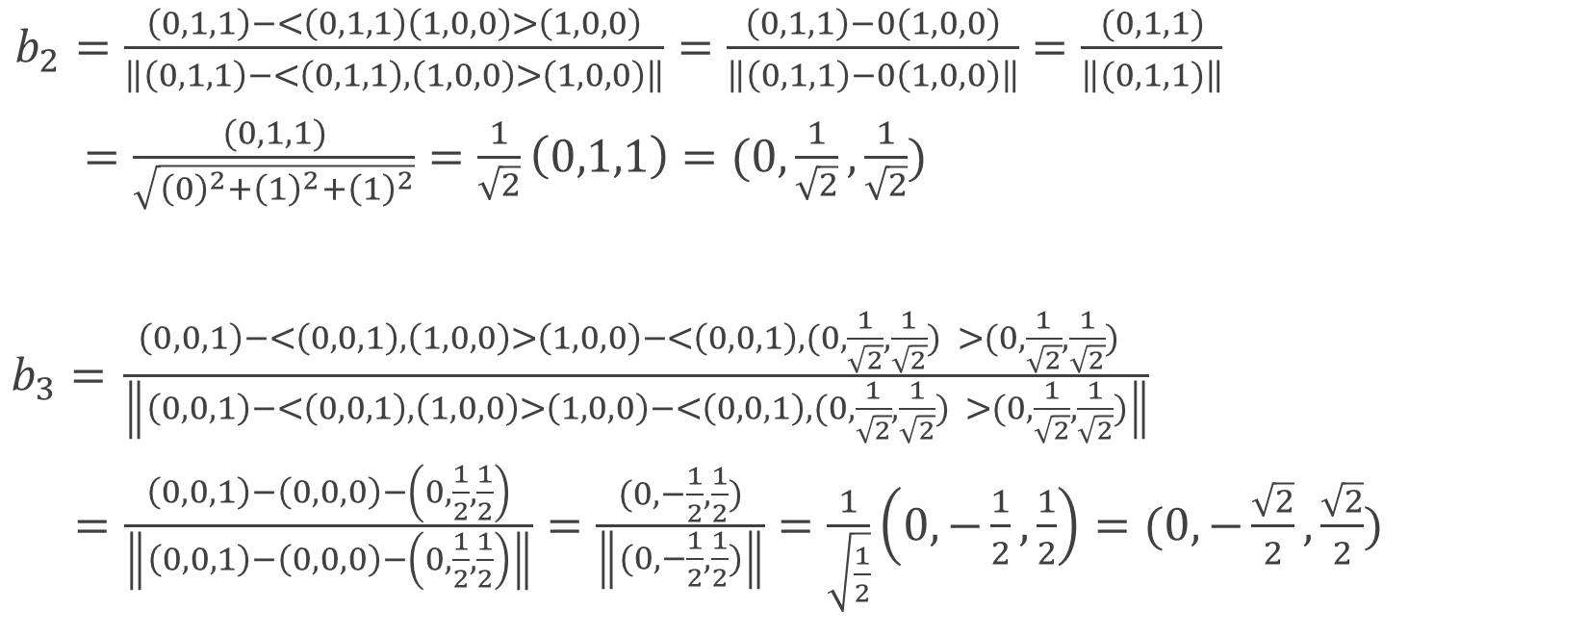
Proses Gram Schmidt $R^{3}$(4)
$b_{2}=\frac{\left(0,1,1\right)−<\left(0,1,1\right)\left(1,0,0\right)>\left(1,0,0\right)}{\left\|\left(0,1,1\right)−<\left(0,1,1\right),\left(1,0,0\right)>\left(1,0,0\right)\right\|}=\frac{\left(0,1,1\right)−0\left(1,0,0\right)}{\left\|\left(0,1,1\right)−0\left(1,0,0\right)\right\|}=\frac{(0,1,1)}{\left\|(0,1,1)\right\|}$
$=\frac{(0,1,1)}{\sqrt{{\left(0\right)}^{2}+{\left(1\right)}^{2}+{\left(1\right)}^{2}}}=\frac{1}{\sqrt{2}}\left(0,1,1\right)=(0,\frac{1}{\sqrt{2}},\frac{1}{\sqrt{2}})$
$b_{3}=$ $\frac{\left(0,0,1\right)−<\left(0,0,1\right),\left(1,0,0\right)>\left(1,0,0\right)−<\left(0,0,1\right),(0,\frac{1}{\sqrt{2}},\frac{1}{\sqrt{2}}) >(0,\frac{1}{\sqrt{2}},\frac{1}{\sqrt{2}}) }{\left\|\left(0,0,1\right)−<\left(0,0,1\right),\left(1,0,0\right)>\left(1,0,0\right)−<\left(0,0,1\right),(0,\frac{1}{\sqrt{2}},\frac{1}{\sqrt{2}}) >(0,\frac{1}{\sqrt{2}},\frac{1}{\sqrt{2}})\right\|}$
$=\frac{\left(0,0,1\right)−\left(0,0,0\right)−\left(0,\frac{1}{2},\frac{1}{2}\right)}{\left\|\left(0,0,1\right)−\left(0,0,0\right)−\left(0,\frac{1}{2},\frac{1}{2}\right)\right\|}=\frac{(0, −\frac{1}{2},\frac{1}{2})}{\left\|(0, −\frac{1}{2},\frac{1}{2})\right\|}=\frac{1}{\sqrt{\frac{1}{2}}}\left(0,−\frac{1}{2},\frac{1}{2}\right)=(0,−\frac{\sqrt{2}}{2},\frac{\sqrt{2}}{2})$

Slide 14
THANKYOU

