Slide 1


Internasionalization and Accessibility
D1H1C3 Perancangan antarmuka aplikasi
D3 Teknik informatika
Fakultas ilmu terapan
Telkom university

Slide 2
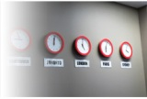
Internasionalization
Today the Internet and the market for software are global. They cross endless cultural and language boundaries, each with its own requirements, conventions, customs, and definitions of acceptability.
Comprehension and recall can be enhanced when presented information is culturally appropriate (Spyridakis and Fukuoka, 2002).
To make a product acceptable worldwide, it must be internationalized. A system must also be designed to be usable by an almost unlimited range of people, being accessible to anyone who desires to use it. The design concepts used to achieve these goals are called internationalization and accessibility.

Slide 3
Today’s Topics
International considerations
Localization
Writing text
Accessibility considerations
Types of disabilities
Designing for accessibility
Cultural considerations
Using images and symbols

Slide 4
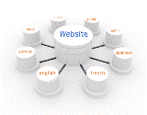
Localization
When to do it:
When the market includes few or no English speakers.
When translation is required by law or by custom.
When the widest possible market is desired.
When not to do it:
When the audience already reads English.
When the cost of retrofitting or rewriting the software is prohibitive.

Slide 5

Cultural Considerations
Hofstede (1980, 1997, 2001) has derived and validated five independent dimensions along which cultures vary:
Power distance is the degree of acceptance of inequality of power and authority
Individualism (vs. collectivism) reflects how well integrated a person is into the larger group.
Masculinity (vs. femininity) is the balance between assertiveness or toughness and supportiveness or caring.
Uncertainty avoidance is the level of discomfort with unstructured and potentially unpredictable conditions.
Long-term orientation (vs. short term) is the trade-off between long-term reward and immediate recognition.

Slide 6
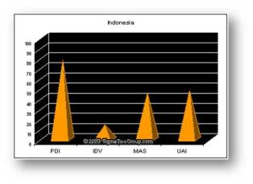
Indonesia
PDI(78)→ a high level of inequality of power and wealth within the society.
UAI(48) → more moderated influence of this Dimension within the Indonesian society. In an effort to minimize or reduce this level of uncertainty, strict rules, laws, policies, and regulations are adopted and implemented.
IDV (14) → the Indonesian society is Collectivist as compared to Individualist.
Notes:
Indonesia has Power Distance (PDI) as its highest ranking Hofstede Dimension at 78. The high Power Distance (PDI) is indicative of a high level of inequality of power and wealth within the society. This condition is not necessarily forced upon the population, but rather accepted by the society as part of their cultural heritage. The average Power Distance for the greater Asian countries is 71.
The second highest Hofstede ranking for Indonesia is Uncertainty Avoidance (UAI) at 48, compared to the greater Asian average of 58 and a world average of 64. This reflects a more moderated influence of this Dimension within the Indonesian society. Generally, a high Uncertainty Avoidance (UAI) indicates the society’s low level of tolerance for uncertainty. In an effort to minimize or reduce this level of uncertainty, strict rules, laws, policies, and regulations are adopted and implemented. The ultimate goal of this population is to control everything in order to eliminate or avoid the unexpected. As a result of this high Uncertainty Avoidance characteristic, the society does not readily accept change and is very risk adverse.
Indonesia has one of the lowest world rankings for Individualism with a 14, compared to the greater Asian rank of 23, and world rank of 43. The score on this Dimension indicates the Indonesian society is Collectivist as compared to Individualist. This is manifest in a close long-term commitment to the member 'group', is that a family, extended family, or extended relationships. Loyalty in a collectivist culture is paramount, and over-rides most other societal rules and regulations. The society fosters strong relationships where everyone takes responsibility for fellow members of their group

Slide 7

Words and Text
Use very simple English
Avoid
Acronyms and abbreviations
Slang or obscure phrasing
Local or computer jargon
A telegraphic/ over friendly writing style
Culturally specific examples.
Adhere to local user language idioms and cultural contexts
Keep the original term for words that cannot be translated
Allow additional screen space for the translation
Position icon captions outside of the graphic
Modify mnemonics for keyboard access
Adhere to local formats for date, time, money, measurements, addresses, and telephone numbers

Slide 8
Images and Symbols
Adhere to local cultural and social norms
Use internationally accepted symbols
Develop generic images
Be particularly careful with
Religious symbols (crosses and stars)
The human body
Women
Hand gestures
Flags
Controversial geographic maps
The cross and check for check boxes
Review proposed graphical images early in the design cycle

Slide 9

Color, Sequence, and Functionality
Adhere to local color connotations and conventions
Provide the proper information sequence
Provide the proper functionality
Remove all references to features not supported

Slide 10
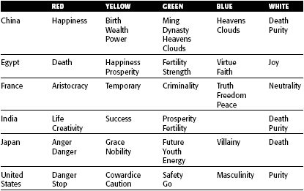
Cultural Color Associations

Slide 11

Requirements Determination and Testing
Establish international requirements at the beginning of product development
Establish a relationship within the target culture
Test the product as if it were new

Slide 12
Accessibility
Accessibility means a system must be usable by an almost unlimited range of people
Design objectives in creating accessibility for users with disabilities are:
Minimize all barriers that make a system difficult, or impossible, to use.
Provide compatibility with installed accessibility utilities.
Types of disabilities:
Visual → reduced visual acuity to total blindness.
Hearing → inability to detect certain sounds to total deafness.
Physical movement → difficulties in, or an inability to, perform certain physical tasks such as moving a mouse, or accurately striking a single keyboard key.
Speech or language → difficult to read and write
Cognitive → memory impairments and perceptual problems.
Seizure disorders → sensitive to visual flash rates, certain rates triggering seizures.

Slide 13

Accessibility Design
Consider accessibility issues during system planning, design, and testing.
Provide compatibility with installed accessibility utilities.
Provide a customizable interface.
Follow standard Windows conventions.
Use standard Windows controls.
Assure online forms can be easily completed.

Slide 14
Visual Disabilities
Ensure compatibility with screen-review utilities and screen-enlargement utilities
Screen components:
Include meaningful screen and window titles.
Provide associated captions or labels for all controls, objects, icons, and graphics.
Include graphical menu choices.
Provide a textual summary for each statistical graphic.
Allow for screen element scalability.
Support system settings for high contrast for all user interface controls and client area content.
When a high contrast setting is established, hide any images drawn behind the text to maintain screen information legibility.
Avoid displaying or hiding information based on the movement of the pointer. Exception: Unless it’s part of the standard interface (example: ToolTips).

Slide 15
Visual Disabilities ..
Keyboard:
Provide a complete keyboard interface.
Provide a logical order of screen navigation.
Color:
Use color as an enhancing design characteristic.
If used, considers
color combinations
lightness contrast between foreground and background color
lightness contrast between colors in the color spectrum (blues and reds)
Avoid combining dark colors from the middle of the spectrum with light colors from either end of the spectrum
Do not define specific colors
Use tools to verify what colors will look like when seen by color-deficient people

Slide 16
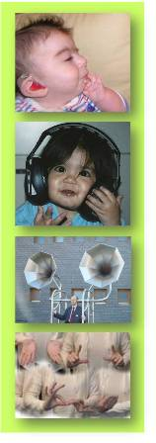
Hearing Disabilities
Provide captions or transcripts of important audio content.
Provide an option to display a visual cue for all audio alerts.
Provide an option to adjust the volume.
Use audio as an enhancing design characteristic.
Provide a spell-check or grammar-check utility.

Slide 17
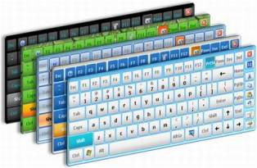
Physical Movement Disabilities
Provide voice-input systems
Provide a complete and simple keyboard interface
Provide a simple mouse interface
Provide on-screen keyboards
Provide keyboard filters

Slide 18

Cognitive Disabilities
Permit modification and simplification of the interface.
Limit the use of time-based interfaces.
Do not briefly display critical feedback or messages and then automatically remove them.
Provide an option to permit the user to adjust the length of the time-out.

Slide 19
Seizure Disorders
Use elements that do not blink or flicker at rates
between frequency ranges of 2 Hz and 55 Hz.
Minimize the area of the screen that is flashing.
Avoid flashing that has a high level of contrast
between states.
Provide an option to enable users to slow down or
disable screen flashing.

Slide 20
Web Page Accessibility Design
WWW Consortium Accessibility Guidelines:
Provide equivalent alternatives to auditory or visual content
Don’t rely on color alone. Image should be understandable
Use markup and style sheets and do so properly
Clarify natural language usage
Create tables that transform gracefully
Pages featuring new technologies transform gracefully
Ensure user control of time-sensitive content changes
Ensure direct accessibility of principles of embedded interfaces
Design for device-independence
Use interim solutions
Use W3C technologies and follow accessibility guidelines
Provide context and orientation information
Provide clear navigation mechanisms
Ensure that documents are clear and simple

Slide 21
Usability for Lower-Literacy People
Prioritize information
Avoid moving or changing text
Streamline the page design
Simplify navigation
Optimize search

Slide 22
Usability for Senior Citizens
Provide large targets to make selection easier
To reduce the number of selections or clicks,
Do not require double-clicks or pull-down menus
Do not have a deep page hierarchy.
Concentrate important information at the top of pages.
Avoid the need to scroll to find information.
Put most links in a bulleted, not tightly clustered, list.
Provide differentiation between visited and non-visited links.
Use few colors, and avoid using blue and green tones.
For text to be read or scanned, use
12 to 14 point sans serif font (Helvetica, Arial).
Black text on a white background, left justification.
Increased spacing (leading) between lines.
Sentence style mixed-case letters rather than all capital letters.
Appropriate large headings in a 14 to 16 point sans serif font.

Slide 23
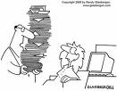

Documentation
Provide documentation on all accessible features
Provide documentation in alternate formats
Provide online documentation for people who have difficulty reading or handling printed material
Testing
Test all aspects of accessibility as part of the normal system testing process

Slide 24
