Slide 1


Week 3 Strategic Management
Strategic Management Process &
Environmental Analysis
Dodie Tricahyono, Ph.D.

Slide 2

Factors Shaping the Choice of Company Strategy
Social, political, regulatory and community factors
Competitive conditions and industry attractiveness
Company opportunities and threats to company’s well-being
⬅ External Factors
Determine relevance of internal and external factors
Identify and evaluate alternatives
Craft
the
strategy
Company’s Strategic Situation
Resource strengths, capabilities, and weaknesses
Influences of key executives
Shared values and company culture
⬅ Internal Factors
2

Slide 3
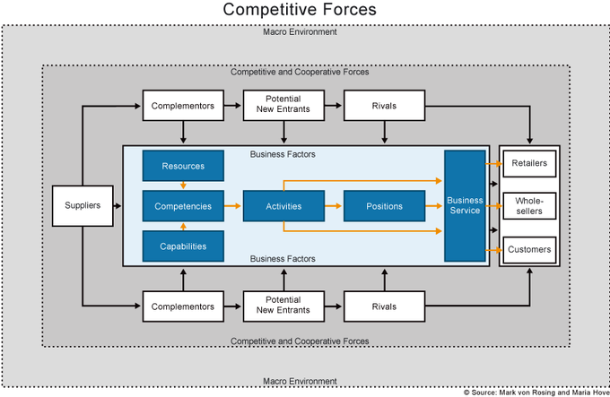
Strategic Environment via Competitive Forces

Slide 4
External Environment Analysis

Slide 5
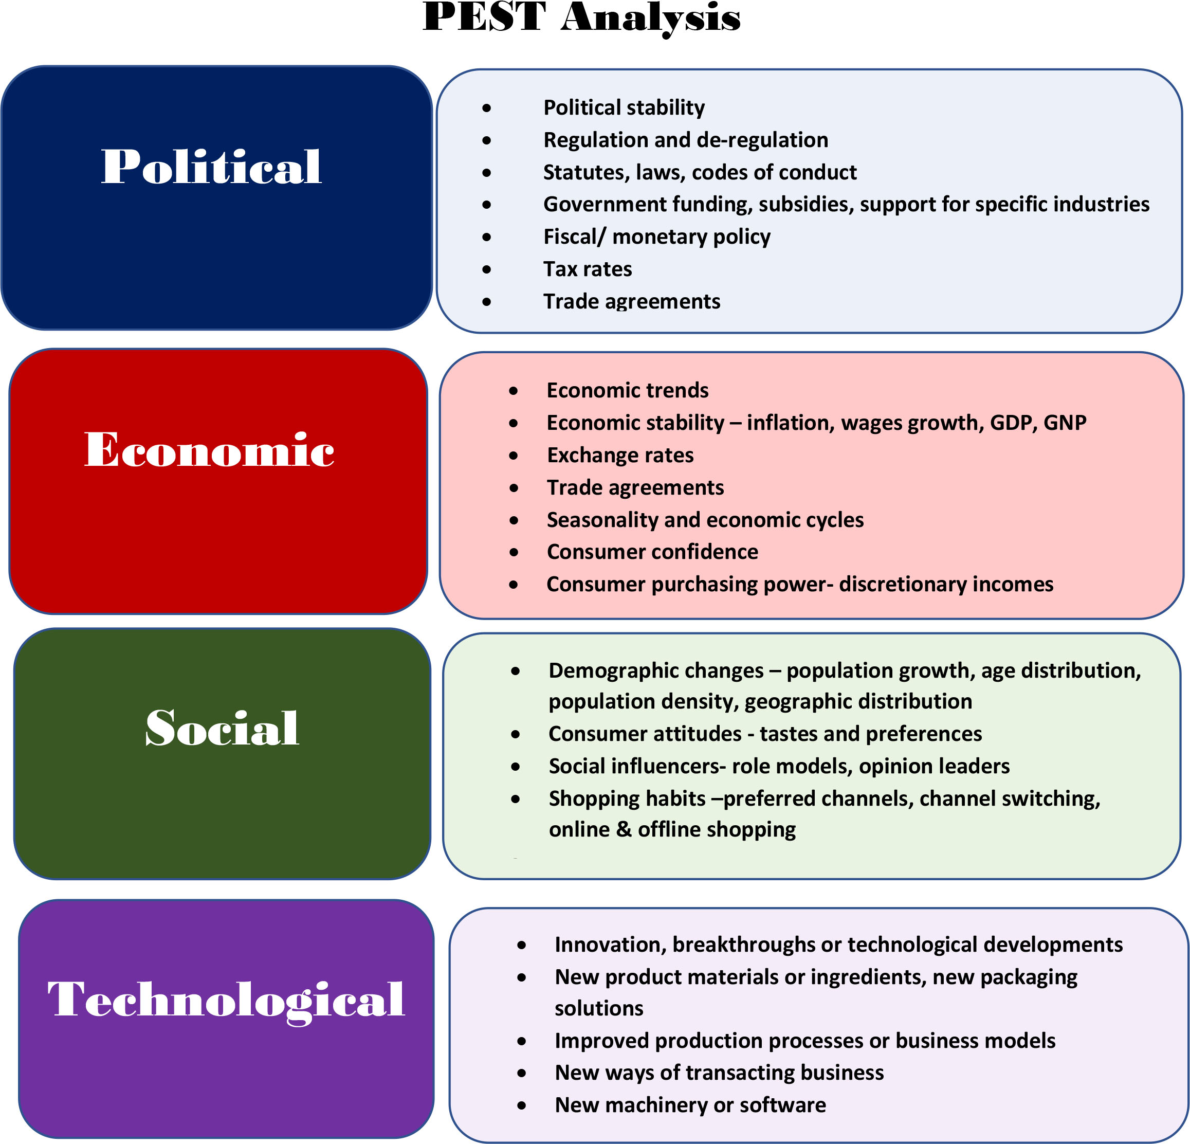
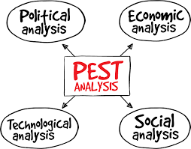
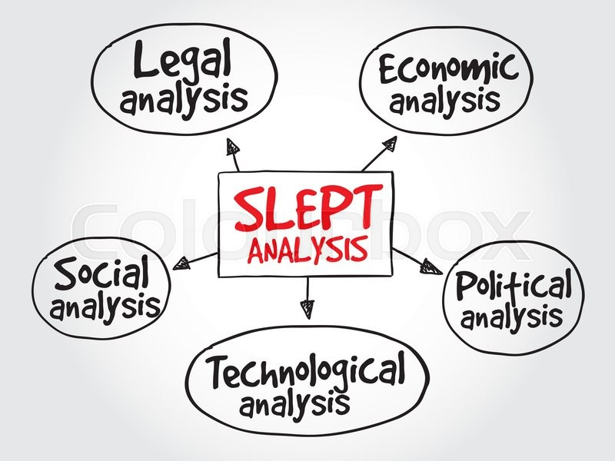
PEST Analysis

Slide 6
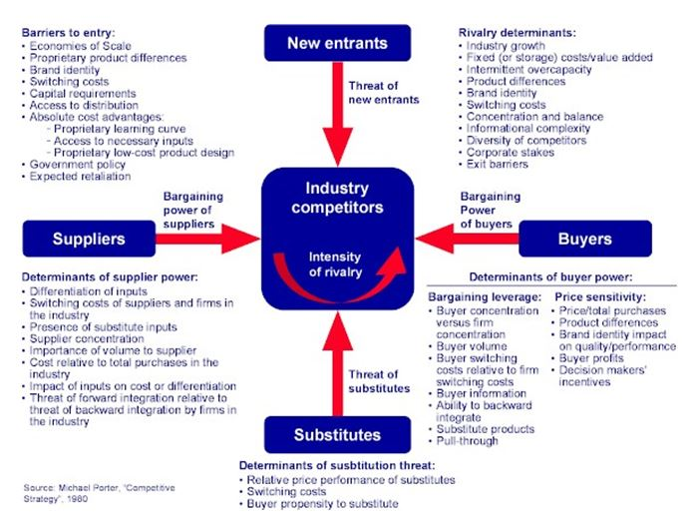
5 Forces Porter

Slide 7
Competitors Analysis
The model can be used to:
develop a profile of the likely strategy changes a competitor might make and how successful they may be
determine each competitor’s probable response to the range of feasible strategic moves other competitors might make
determine each competitor’s probable reaction to the range of industry shifts and environmental changes that may occur.

Slide 8
The External Factor Evaluation (EFE) Matrix
KEY EXTERNAL FACTORS | WEIGHT¹⁾ | RATING²⁾ | WEIGHTED SCORE³⁾
Opportunities
1. 2. 3. ...
Threats
1. 2. 3. ...
TOTAL
Bobot setiap faktor dalam sukses di industri: 0,0 (tidak penting) – 1,0 (sangat penting). Jumlah seluruh faktor adalah 1.
Respon strategi perusahaan terhadap faktor: 1,0 (buruk); 2,0 (rata-rata); 3,0 (di atas rata-rata); 4,0 (superior).
Weight x rating

Slide 9
Competitive Profile Matrix (CPM)
Critical Success Factors | Weigth | Company 1 |  | Company 2 |  | Company 3
 |  | Rating | Score | Rating | Score | Rating | Score
Advertising | .20 | 1 | .20 | 4 | .80 | 3 | .60
Product quality | .10 | 4 | .40 | 3 | .30 | 2 | .20
Price competitiveness | .10 | 3 | .30 | 2 | .20 | 4 | .40
Management | .10 | 4 | .40 | 3 | .20 | 3 | .30
Financial position | .15 | 4 | .60 | 2 | .30 | 3 | .45
Customer loyalty | .10 | 4 | .40 | 3 | .30 | 2 | .20
Global expansion | .20 | 4 | .80 | 1 | .20 | 2 | .40
Market Share | .05 | 1 | .005 | 4 | .20 | 3 | .15
Total | 1.00 |  | 3.15 |  | 2.50 |  | 2.70
Note on Rating Values:
1=major weakness, 2=minor weakness, 3=minor strength, 4= major strength

Slide 10






The I/O Model of Above-Average Returns
The External Environment
Study the external environment, especially the industry environment (The general environment, The industry environment, The competitor environment)
An Attractive Industry
Locate an attractive industry with a high potential for above-average returns
Strategy Formulation
Identify the strategy called for by the attractive industry to earn above-average returns (relates with industry’s KSFs)
Assets and Skills
Develop or acquire assets and skills needed to implement the strategy
Strategy Implementation
Use the firm’s strengths (its developed or acquired assets and skills) to implement the strategy
Superior Returns
Superior returns: earning of above-average returns

Slide 11
Internal Environment Analysis

Slide 12
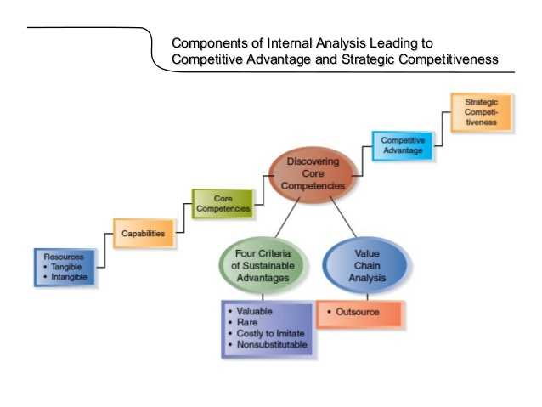
Internal Environment Analysis
Organizational competency is the collective learning in the organization, especially how to co-ordinate diverse production skills and integrate multiple streams of technologies’ (Prahalad &Hamel, 1990: 82)
Four Categories of Resources:
Financial (cash, retained earnings)
Physical (plant & equipment, geographic location)
Human (skills & abilities of individuals)
Organizational (reporting structures, relationships)
Organizational capability is the ability of a firm to perform a coordinated task, utilizing organizational resources, for the purpose of achieving a particular end result
(O`Regan & Ghobadian, 2004)

Slide 13
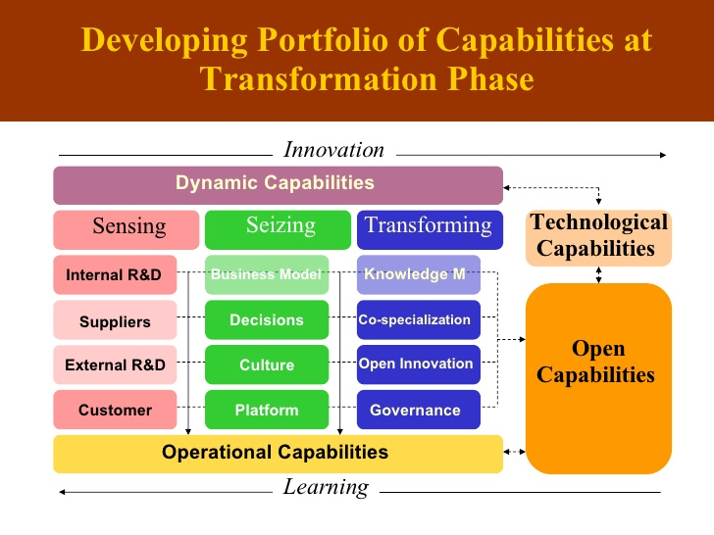

Slide 14
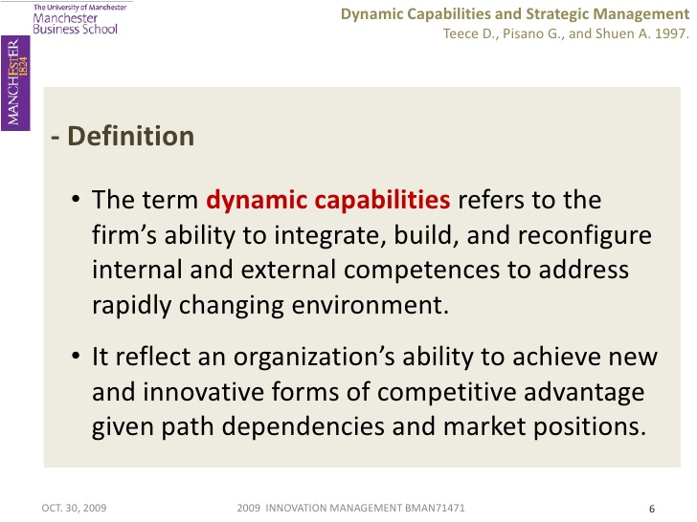

Slide 15
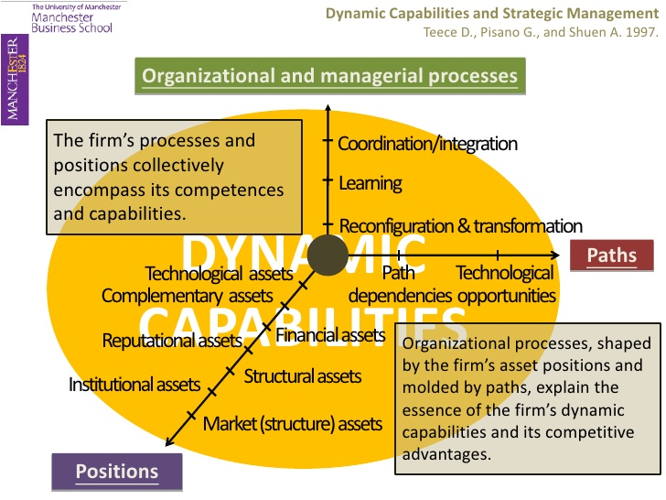

Slide 16
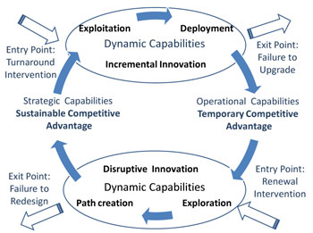
DC: Exploitation and Exploration

Slide 17
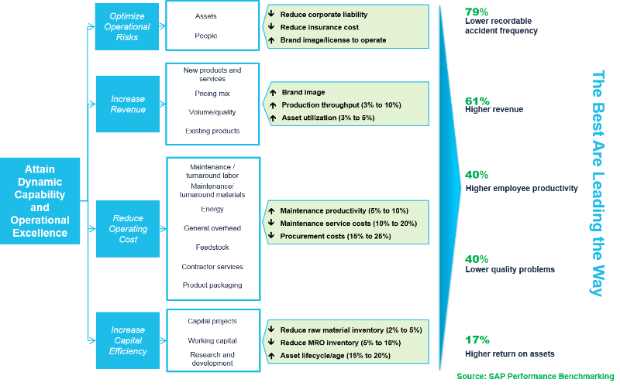

Slide 18
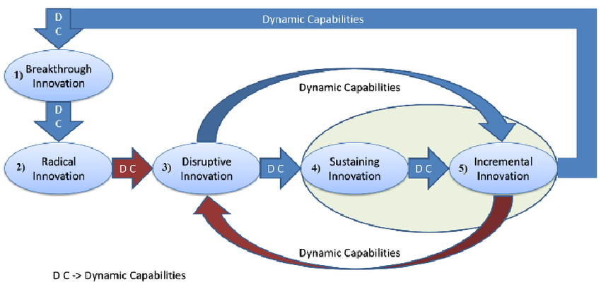
DC and Innovation

Slide 19
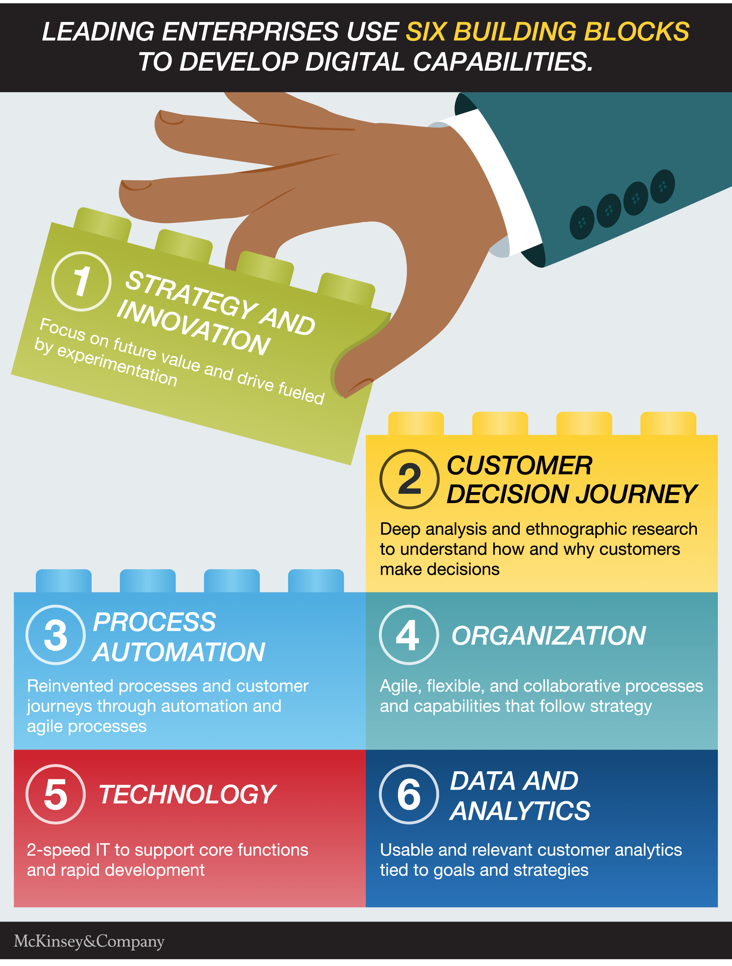
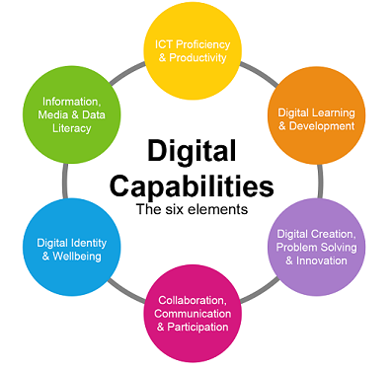

Slide 20
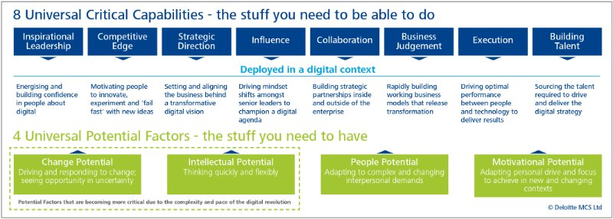
Digital Capabilities

Slide 21
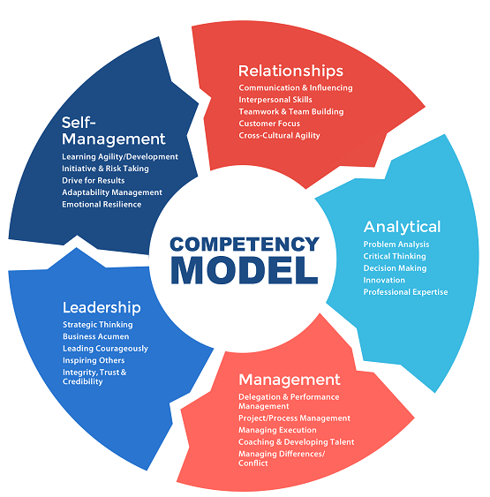
Competency Model
Organizational competencies are the unique factors that make an organization competitive. Organizational competencies (Prahalad & Hamel, 1990, pp. 83–84):
provide potential access to a wide variety of markets,
make a significant contribution to the perceived customer benefits of the end product, and
are difficult for competitors to imitate.
Sony | Miniaturization
Philips | Optical media
Citicorp | Operating system providing 24-hour access to world markets
NEC | Digital technology
Honda | Engines and power trains
Canon | Optics, imaging, and microprocessor controls
Apple | User-friendly interfaces, powerful software architectures, and effective distribution
3M | Pressure-sensitive tapes and coated abrasives

Slide 22
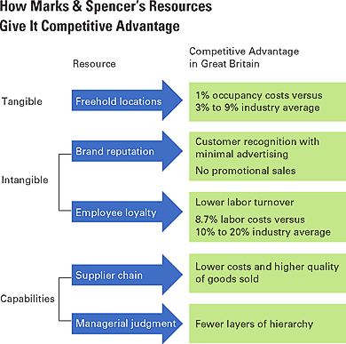
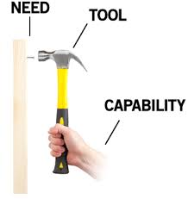

Slide 23
Porter’s Generic Internal Value Chain
Primary Activities
    Inbound Logistics
    Production
    Warehousing & Distribution
    Sales & Marketing
    Dealer Support & Customer Service
Support Activities
    Procurement
    Infrastructure
    Technology: R&D
    Human Resource Management
Primary activities
Support activities
FIRM INFRASTRUCTURE
M
A
HUMAN RESOURCE MANAGEMENT
R
TECHNOLOGY DEVELOPMENT
G
I
PROCUREMENT
N
M
A
INBOUND
OUTBOUND
MARKETING
SERVICE
R
LOGISTICS
OPERATIONS
LOGISTICS
AND SALES
A company’s value chain identifies the primary activities that create customer value and the related support activities—and also reflects the major componnets of its cost structure.
G
I
N
Porter, M. E., (1985), Competitive Advantage, New York: Free Press
Are the company’s prices and costs competitive?

Slide 24
The Value System or Industry Value Chain
A company’s cost competitiveness depends not only on the costs of internally performed activities (its own value chain) but also on costs in the value chain of its suppliers and forward channel allies.
Firm
Value
Chain
Supplier
Value
Chains
Firm
Value
Chain
Channel
Value
Chains
Buyer
Value
Chains
UPSTREAM
Firm
Value
Chain
DOWNSTREAM
Activity-Based Cost Accounting: A tool for determining the costs of value chain activities
Benchmarking: A tool for assessing whether a company’s value chain activities are competitive
Key
Separate VC’s of each SBU in a diversified firm.
The tools for evaluating VC

Slide 25
How Do We Compare?
Historical analysis - are we improving?
Industry averages - valid?
Best practice - against best in class
Benchmarking - what and who against?

Slide 26
The Internal Factor Evaluation (IFE) Matrix
KEY INTERNAL FACTORS | WEIGHT¹⁾ | RATING²⁾ | WEIGHTED SCORE³⁾
Internal Strengths
1. 2. 3. ...
Internal Weaknesses
1. 2. 3. ...
TOTAL
Weighted each factor in industry success: 0,0 (not important) – 1,0 (very important). The sum of all scores should be equal to 1.
Rating of each factor: 1 (major weakness); 2 (minor weakness); 3 (minor strength); 4 (major strength).
Weight x rating

Slide 27
The Resource-Based Model of Above-Average Returns
Identify the firm’s resources. Study its strengths and weaknesses compared with those of competitors
Resources
Capability
Determine the firm’s capabilities. What do the capabilities allow the firm to do better than its competitors.
Determine the potential of the firm’s resources and capabilities in terms of a competitive advantage.
Competitive Advantage
Locate an attractive industry. An industry with opportunities that can be exploited by the firm’s resources and capabilities.
An Attractive Industry
Select a strategy that best allow the firm to utilize its resources and capabilities relative to opportunities in the external environment.
Strategy Implementation
Superior Returns
Superior returns: earning of above-average returns

Slide 28
SWOT Analysis: Matching Process
 | Helpful To achieving the objective | Harmful To achieving the objective
Internal origin Attributes of the organization | Strengths | Weaknesses
External origin Attributes of the environment | Opportunities | Threats
A SWOT analysis is a simple but widely used tool that helps in understanding the strengths, weaknesses, opportunities and threats involved in a project or business activity.
Matching process between the result of external and internal analysis will be required in order to make a basic for long-term objectives decision making and for crafting the strategy itself.

Slide 29
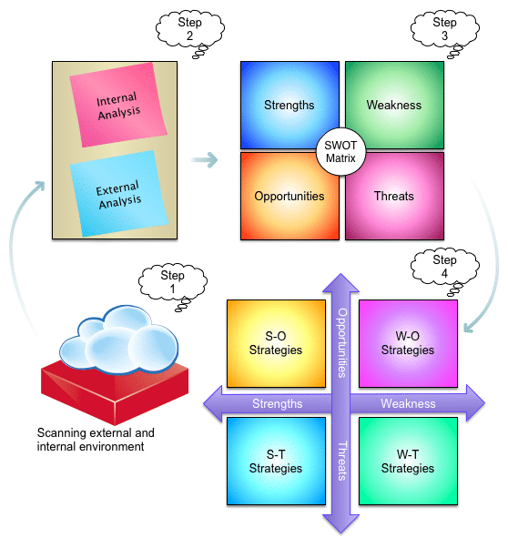
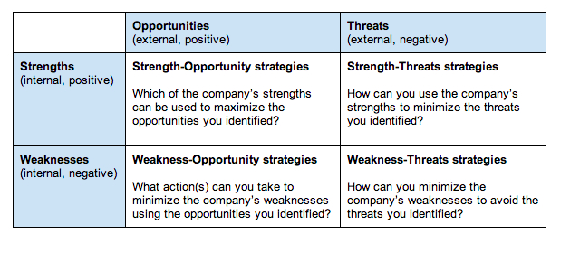
How do we use SWOT Matrix?

Slide 30
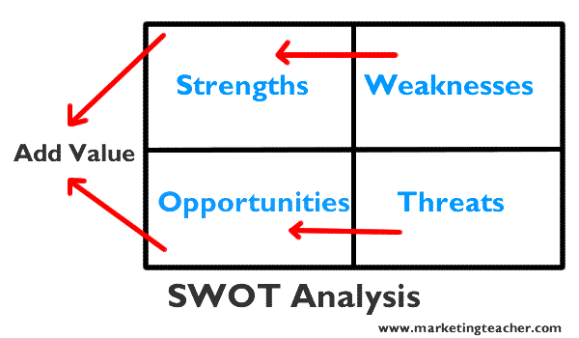
Another SWOT Analysis

Slide 31
The Quantitative Strategic Planning Matrix (QSPM)
KEY FACTORS | WEIGHT | STRATEGIC CHOICES
 |  | STRATEGY 1 |  | STRATEGY 2
 |  | AS | TAS | AS | TAS
Opportunities
...
Threaths
...
 | 1,0
Strengths
...
Weaknesses
...
 | 1,0
SUM TOTAL ATRACTIVENESS SCORE
AS = Atractiveness Score (1=not atractive; 2= somewhat atractive; 3=reasonable atractive; 4=highly atractive).
TAS = Total Atractiveness Score (WEIGHT x AS).

