Slide 1
Cost Of Capital

Slide 2
The financing decision
Assets Liabilities & Equity
Current Assets Current Liabilities
Fixed Assets Long-term Debt
Preferred Stock
Common Equity

Slide 3
The investment decision
Assets Liabilities & Equity
Current Assets Current Liabilities
Fixed Assets Long-term Debt
Preferred Stock
Common Equity

Slide 4
Where we’re going...
Corporate Finance: (The Financing Decision)
Cost of capital
Leverage
Capital Structure

Slide 5
Assets Liabilities & Equity
Current assets Current Liabilities
Long-term Debt
Preferred Stock
Common Equity
}
Capital Structure

Slide 6
Cost of Capital
For Investors, the rate of return on a security is a benefit of investing.
For Financial Managers, that same rate of return is a cost of raising funds that are needed to operate the firm.
In other words, the cost of raising funds is the firm’s cost of capital.

Slide 7
How can the firm raise capital?
Bonds
Preferred Stock
Common Stock
Each of these offers a rate of return to investors.
This return is a cost to the firm.
“Cost of capital” actually refers to the weighted cost of capital - a weighted average cost of financing sources.

Slide 8
Cost of Debt
For the issuing firm, the cost of debt is:
the rate of return required by investors,
adjusted for flotation costs (any costs associated with issuing new bonds), and
adjusted for taxes.

Slide 9
Example: Tax effects of financing with debt
with stock with debt
EBIT 400,000 400,000
- interest expense 0 (50,000)
EBT 400,000 350,000
- taxes (34%) (136,000) (119,000)
EAT 264,000 231,000
Now, suppose the firm pays $50,000 in dividends to the stockholders.

Slide 10
Example: Tax effects of financing with debt
with stock with debt
EBIT 400,000 400,000
- interest expense 0 (50,000)
EBT 400,000 350,000
- taxes (34%) (136,000) (119,000)
EAT 264,000 231,000
- dividends (50,000) 0
Retained earnings 214,000 231,000

Slide 11
Cost of Debt (k_{d}) before Tax
Notation :
NP_{d} = Net proceed of debt = Bond price – Flotation cost
k_{d} = before tax cost of debt
Using Interpolation

Slide 12
Cost of Debt (k_{d}) after Tax

Slide 13
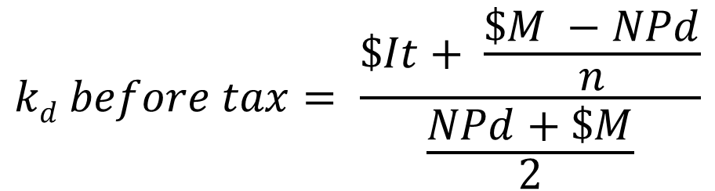
Cost of Debt (k_{d}) before Tax
NP_{d} = Net proceed of debt = Bond price – Flotation cost

Slide 14
Asumsikan bahwa Perusahaan Carter menerbitkan obligasi senilai $ 1.000, coupon rate 8 persen, jatuh tempo 20 tahun, dan harga netonya $ 940. Tarif pajak adalah 40 persen. Maka, biaya hutang sebelum pajak adalah?

Slide 15
PT. Damai menjual obligasi senilai Rp. 10.000.000 dengan jangka waktu 10 tahun, tingkat bunga kupon 9%, dengan nilai nominal per lembar Rp. 10.000. karena obligasi lain yang serupa memberikan bunga lebih besar dari 9% maka perusahaan harus menjual obligasi sebesar Rp. 9.800 sebagai kompensasi atas rendahnya bunga kupon. Biaya penerbitan sekuritas sebesar 2% dari nilai nominal. Dengan asumsi pajak sebesar 30%, berapakah biaya hutang setelah pajak ?

Slide 16
Cost of Preferred Stock
Finding the cost of preferred stock is similar to finding the rate of return (from Chapter 8), except that we have to consider the flotation costs associated with issuing preferred stock.

Slide 17
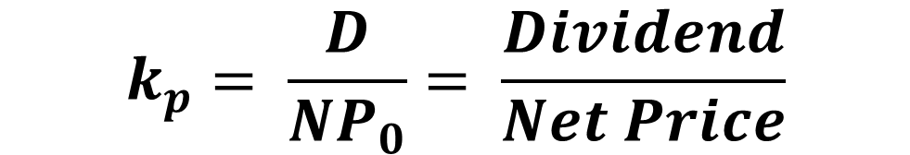
Cost of Preferred Stock
NP₀ = PS price - flotation costs

Slide 18
Misalkan Perusahaan Carter menerbitkan saham preferen yang membayar dividen $ 13 per saham dan terjual seharga $ 100 per saham di pasar modal. Biaya flotasi (atau penjaminan emisi) adalah 3 persen, maka biaya modal saham preferen adalah?

Slide 19
Example: Cost of Preferred
If Prescott Corporation issues preferred stock, it will pay a dividend of $8 per year and should be valued at $75 per share. If flotation costs amount to $1 per share, what is the cost of preferred stock for Prescott?

Slide 21
Cost of Common Equity
There are two sources of Common Equity:
1) Internal common equity (retained earnings).
2) External common equity (new common stock issue).
Do these two sources have the same cost?

Slide 22
Cost of Internal Equity
Since the stockholders own the firm’s retained earnings, the cost is simply the stockholders’ required rate of return.
Why?
If managers are investing stockholders’ funds, stockholders will expect to earn an acceptable rate of return.

Slide 23
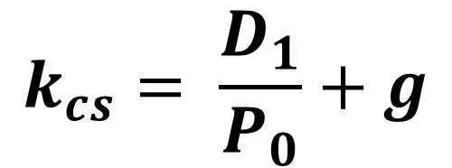
Cost of Internal Equity
Retained Earnings:

Slide 24
Pada bulan Juli 2002, saham biasa PT. XYZ ditutup pada $54.40 per lembar. Pada tahun 2001 PT. XYZ membayar dividen sebesar $0.28. jika dividen diharapkan akan tumbuh sebesar 14,6% per tahun di masa yang akan datang. Berapakah tingkat pengembalian yang dikehendaki investor jika tambahan modal diperoleh dari retained earnings?

Slide 25
Capital Asset Pricing Model (CAPM)
Notation :
kj = cost of internal common equity
k_{rf} = risk free rate
k_{m} = expected market return
β = systematic risk of common stock (beta)

Slide 26

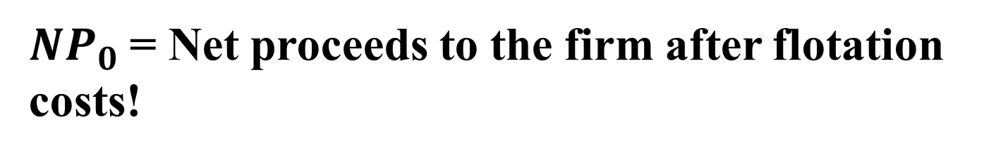
Cost of External Equity
New Common Stock

Slide 27
Contoh soal lanjutan
Jika PT. XYZ memutuskan untuk menerbitkan saham biasa baru, dengan biaya penerbitan sebesar 6% dari harga saham per lembar, berapakah biaya modal dari saham biasa?

Slide 28
Weighted Average Cost of Capital
The weighted cost of capital is just the weighted average cost of all of the financing sources.
Notation :
w = weight / total market value = target capital structure
k_{d} = cost of debt after tax
k_{ps} = cost of preferred stock
k_{cs} = cost of retained earnings
k_{ncs} = cost of new common stock offering

Slide 29
Contoh soal
Target struktur modal QM industries adalah 40% saham biasa, 10% saham preferen dan 50% hutang. Jika biaya modal ekuitas sebesar 18%, biaya modal saham preferen 10%, biaya modal hutang sebelum pajak sebesar 8%, dan tingkat pajak perusahaan sebesar 35%. Berapakah rata-rata tertimbang biaya modal QM Industries?

Slide 30
Weighted Cost of Capital
after tax Capital
Source Cost Structure
debt 6% 20%
preferred 10% 10%
common 16% 70%

Slide 31
Weighted Cost of Capital
(20% debt, 10% preferred, 70% common)
Weighted cost of capital =
.20 (6%) + .10 (10%) + .70 (16%)
= 13.4%

Slide 32
Dengan asumsi struktur modal dari Carter Company adalah sbb:
Mortgage bonds ($1,000 par) $20,000,000
Preferred stock ($100 par) 5,000,000
Common stock ($40 par) 20,000,000
Retained earnings $5,000,000
Dengan biaya modal setelah pajak adalah:
Biaya modal hutang 5,14%
Biaya modal saham preferen 13,40%
Biaya modal saham biasa 17,11%
Dan biaya modal retained earnings adalah 16,00%
Berapakah WACC dari Carter Company?

Slide 33
Contoh Soal
Ford Motor Company menerbitkan saham preferen dengan harga penutupan sebesar $23.45 dengan dividen tahunan sebesar $2.25 per lembar. Jika flotation cost sebesar 2%, berapakah biaya modal saham preferen?

Slide 34
Sebuah perusahaan melakukan investasi pada saham AMCO dengan mengharapkan tingkat keuntungan sebesar 15% dan tingkat keuntungan bebas risiko sebesar 10%. Dari data selama 10 tahun diketahui bahwa nilai beta adalah 1,25. Hitunglah return saham AMCO yang juga merupakan biaya modal ekuitas (modal sendiri) perusahaan tersebut !

