Slide 1
Analysis & Impact of Leverage

Slide 2
Leverage
Pengungkit
Penggunaan biaya keuangan dan biaya tetap dalam usaha untuk meningkatkan (lever up) profitabilitas.

Slide 3
Leverage
1. Operating Leverage
Penggunaan biaya operasional tetap oleh perusahaan.
2. Financial Leverage
Penggunaan biaya keuangan tetap oleh perusahaan.
3. Total/ Combined Leverage

Slide 4
Two concepts that enhance our understanding of risk... Risk: Likely variability associated with expected revenue or income streams.
1) Business risk: variability in the firm’s expected EBIT.
2) Financial risk: a direct result of the firm’s financing decision

Slide 5
1) Operating Leverage - affects a firm’s business risk.
2) Financial Leverage - affects a firm’s financial risk.

Slide 6
Break Even Analysis Element
Total cost
Fixed cost
Variable cost
Direct labor
Insurance
Depreciation
Administrative salaries
Direct materials
Sales commission

Slide 7
Definisi
Fixed cost (indirect cost)
Costs that do not vary in total dollar amount as sales volume or quantity of output changes
Variable cost (direct costs)
Costs that are fixed per unit of output but vary in total as output changes

Slide 8
Break Even Analysis
Sales
TC = Sales
EBIT = 0
Total Cost
Sales and cost ($)
Variable Cost
Fixed Cost
Negative EBIT
Positive EBIT
Unit produced and sold

Slide 9

Break Even Point
Unit produced or sold
Q_{B} = Quantity of output at BEP
F = Fixed cost
P = Price / unit
V = Variable cost / unit

Slide 10

Break Even Point
Sales dollar
S* = Sales at BEP
F = Fixed cost
VC = Total variable cost
VC / S = the ratio of total VC to sales

Slide 11
Contoh :
Basket Wonders (BW) wants to determine both the quantity and sales break-even points when:
Fixed costs are $100,000
Baskets are sold for $43.75 each
Variable costs are $18.75 per basket

Slide 12
Contoh :
Break-even occurs when:
Q_{BE} = FC / (P - V)
Q_{BE} = $100,000 / ($43.75 - $18.75)
Q_{BE} = 4,000 Units
S_{BE} = $175,000

Slide 13
Break-Even Chart
Total Revenues
Profits
250
Total Costs
175
REVENUES AND COSTS
($ thousands)
Fixed Costs
100
Losses
Variable Costs
50
0 1,000 2,000 3,000 4,000 5,000 6,000 7,000
QUANTITY PRODUCED AND SOLD

Slide 14
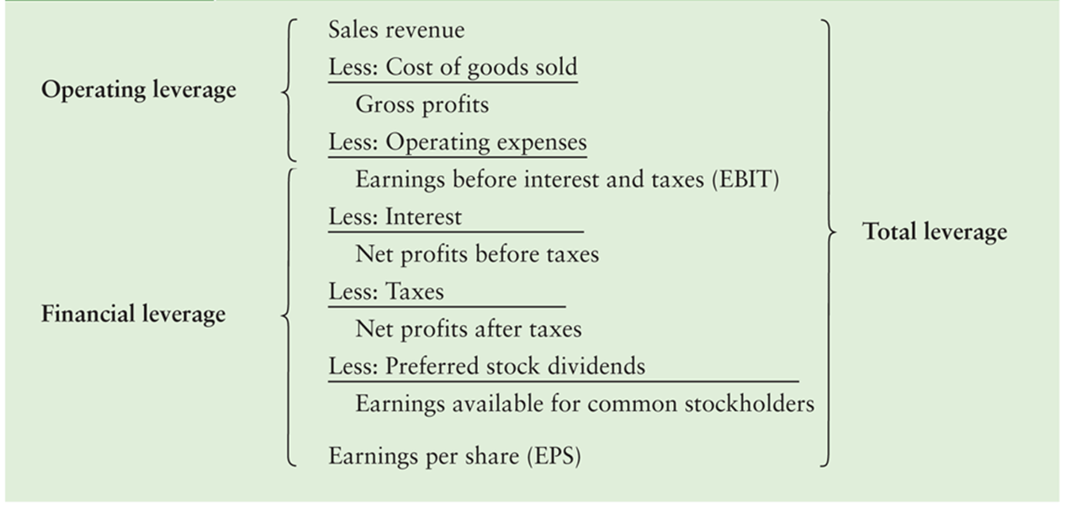
Analyctical Income Statement

Slide 15
Operating Leverage: Measuring the Degree of Operating Leverage
Operational leverage results from the presence of fixed operational costs in the firm’s income stream.
The degree of operating leverage (DOL) measures the sensitivity of changes in Sales to changes in EBIT.

Slide 16
Degree of Operating Leverage
By it’s definition DOL can be formulated as :
By it’s aplication DOL can be formulated as :

Slide 17
DOL and BEP
Sales
DOL = tak terhingga
Total Cost
Sales and cost ($)
Variable Cost
Fixed Cost
DOL menurun mendekati -1
DOL menurun mendekati 1
Unit produced and sold (Q)

Slide 18
Contoh :
Lisa Miller wants to determine the degree of operating leverage at sales levels of 6,000 unit. As we did earlier, we will assume that:
Fixed costs are $100,000
Baskets are sold for $43.75 each
Variable costs are $18.75 per basket

Slide 19
Interpretasi
If DOL = 3x, then a 1% increase in sales will result in a 3% increase in operating income (EBIT).

Slide 20
Degree of Financial Leverage
Financial leverage results from the presence of fixed financial costs in the firm’s income stream.
The degree of financial leverage (DFL) measures the sensitivity of changes in EBIT to changes in EPS.

Slide 21
Degree of Financial Leverage
By it’s definition DFL can be formulated as :
By it’s aplication DFL can be formulated as :

Slide 22
Degree of Financial Leverage
If we have the data, we can use this formula:
EBIT
EBIT - I
DFL =

Slide 23
Contoh :
Chen Foods, a small Oriental food company, expects EBIT of $10,000 in the current year. It has a $20,000 bond with a 10% annual coupon rate and an issue of 600 shares of $4 annual dividend preferred stock. It also has 1,000 share of common stock outstanding and company tax rate 40%.
The annual interest on the bond issue is $2,000 (10% x $20,000). The annual dividends on the preferred stock are $2,400 ($4/share x 600 shares).

Slide 24
Interpretasi
If DFL = 2.5x, then a 1% increase in operating income (EBIT) will result in a 2.5% increase in earnings per share (EPS).

Slide 25
Degree of Combined Leverage (DCL)
Combined leverage: by using operating leverage and financial leverage, a small change in sales is magnified into a larger change in earnings per share.

Slide 26
Degree of Combined Leverage
Q = Unit produced and sold
P = Price / unit
V = Variable cost / unit
F = Fixed cost

Slide 27
Degree of Combined Leverage
DCL = DOL x DFL
% change in EPS
% change in Sales
=

Slide 28
Contoh :
Club Corp. memiliki sales sebesar $300,000 dengan harga per unit $10. fixed cost untuk seluruh operasional $100,000 dan variable cost $6 per unit. Interest yang harus dibayar adalah $4000. berapakah DCL?
Sales = Unit yang dijual x harga jual produk

Slide 29
Interpretasi
If DCL = 7.5x, then a 1% increase in sales will result in a 7.5% increase in earnings per share.

Slide 30
Levered Company
Penjualan (100,000 units) $1,400,000
Biaya Variabel (VC) $800,000
Biaya Tetap (F) $250,000
Bunga (I) $125,000
Pajak (Tax) 34%
Saham yang dikeluarkan perusahaan (lembar) 100,000
Berdasarkan data levered company, Jawablah pertanyaan di bawah ini:
1) Jika Penjualan naik sebesar 10%, Berapakah pendapatan operasional? DOL
2) Jika Pendapatan Operasional naik sebesar 10%, Berapa EPS yang akan didapatkan? DFL
3) Jika Penjualan naik sebesar 10%, Bagaimana EPS yang akan didapatkan? DCL

Slide 31
In-class Project:
Berdasarkan data levered company, Jawablah pertanyaan di bawah ini:
1) Jika Penjualan naik sebesar 10%, Berapakah pendapatan operasional?
2) Jika Pendapatan Operasional naik sebesar 10%, Berapa EPS yang akan didapatkan?
3) Jika Penjualan naik sebesar 10%, Bagaimana EPS yang akan didapatkan?

Slide 32
At XYZ Restaurant, which sells only pepperoni pizza, the variable expenses per pizza might be $5.56 and Its fixed expenses per month might be $5,650. if the price of pizza is $10, how many pizzas does XYZ Restaurant need to sell at $10 each to cover all those fixed monthly expenses?

Slide 33
Terima kasih

