Slide 1

Pengetahuan Bahan Teknik ILI2K2
Imperfection, Dislocations, Strengthening
Minggu-4

Slide 2
Issues to Address
Imperfection
No such thing as a perfect crystal
What are these imperfections?
Why are they important?
Dislocations
Strengthening

Slide 3
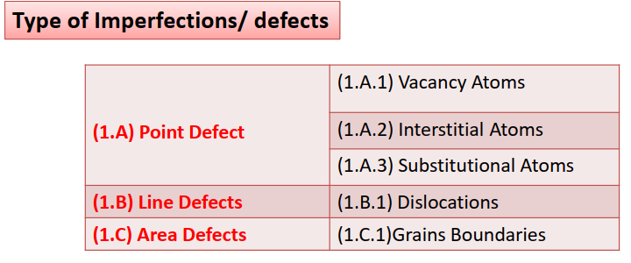
Imperfections

Slide 4
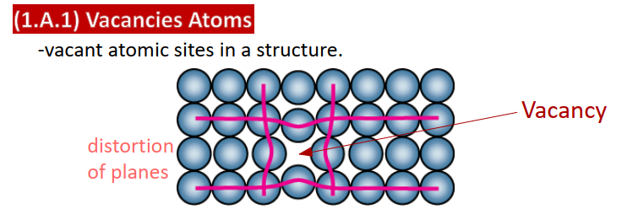
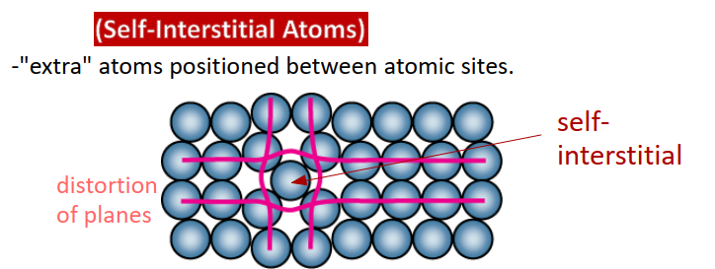
Point Defects

Slide 5

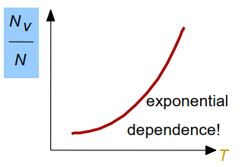

Vacancy Atoms

Slide 6

Vacancy Atoms (Case)

Slide 7
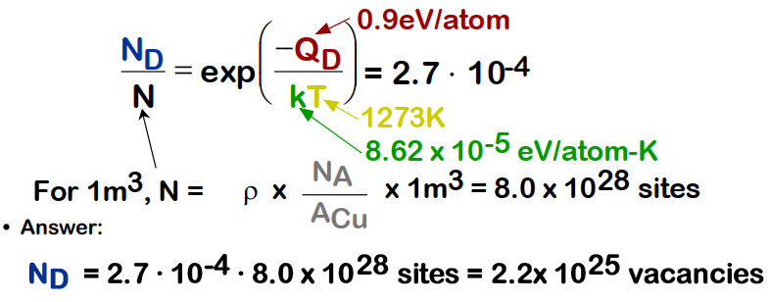
Vacancy Atoms (Case)

Slide 8
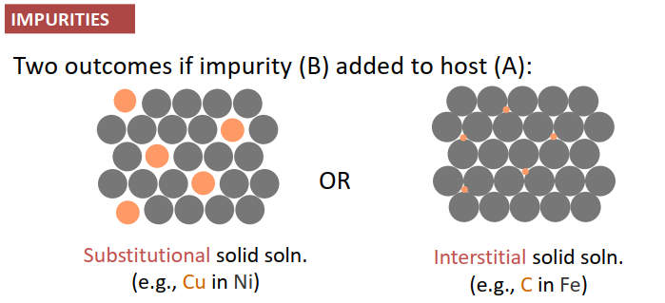
Interstitial & Substitutional Atoms

Slide 9

Interstitial & Substitutional Atoms

Slide 10
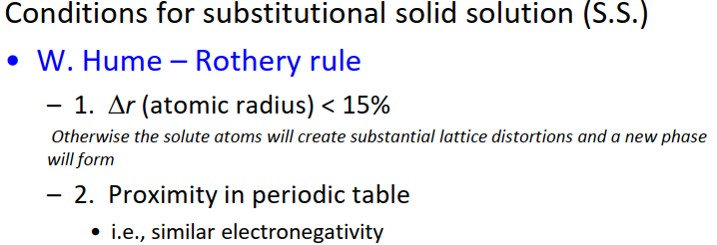

Impurities

Slide 11
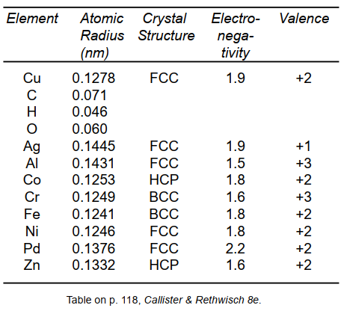
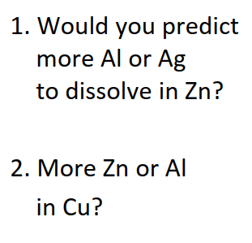
Impurities

Slide 12
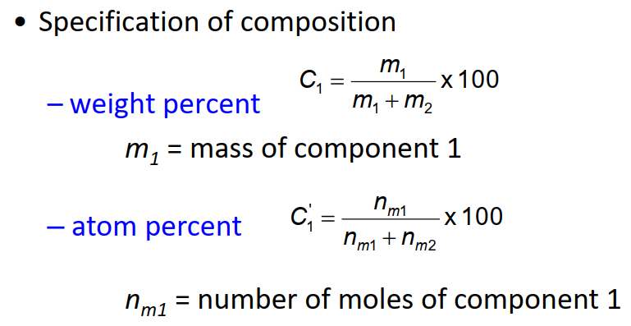
Impurities

Slide 13



Linear Defect

Slide 14
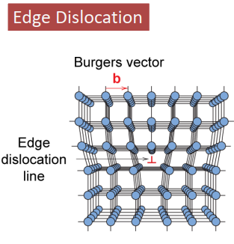
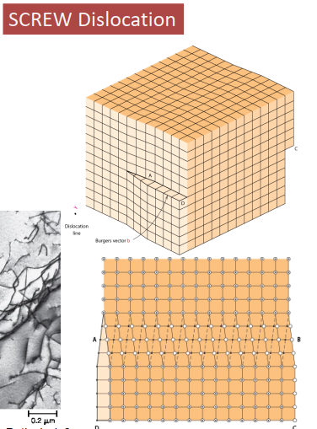
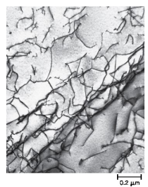
Linear Defect

Slide 15



Area Defect

Slide 16

Area Defect

Slide 17
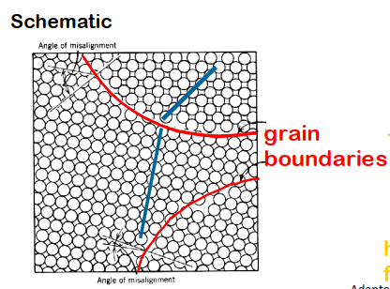
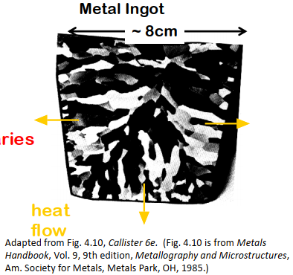
Area Defect

Slide 18
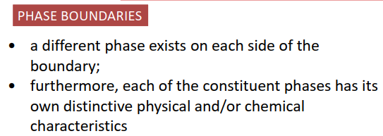
Area Defect

Slide 19
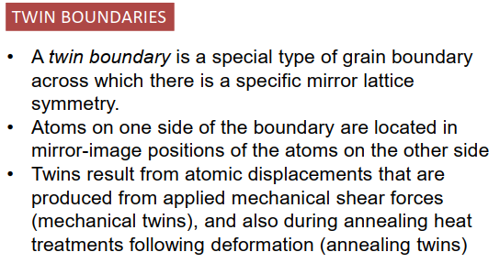
Area Defect

Slide 20
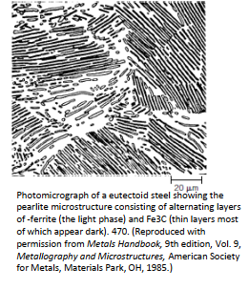
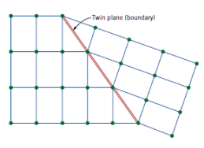
Area Defect

Slide 21

Microscopic Examination

Slide 22

Microscopic Examination

Slide 23
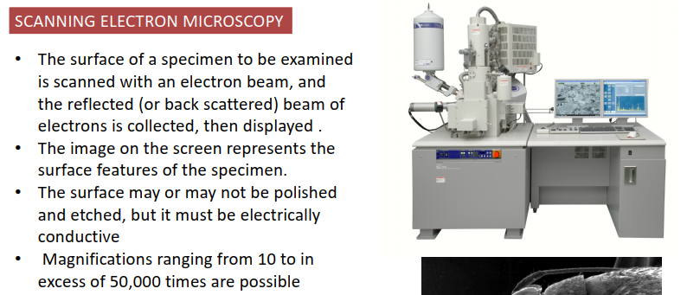
Microscopic Examination

Slide 24
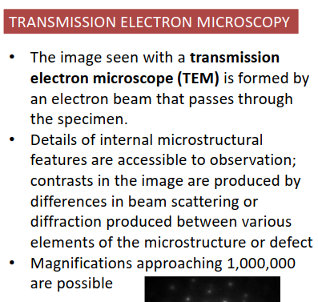
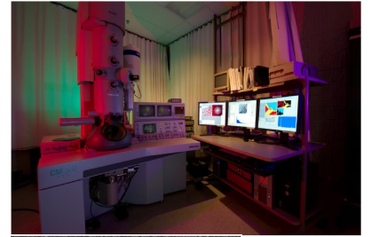
Microscopic Examination

Slide 25
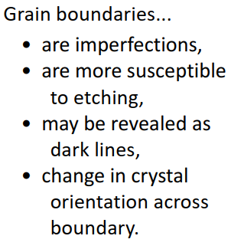
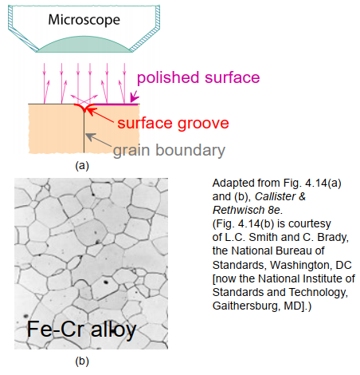
Microscopic Examination

Slide 26
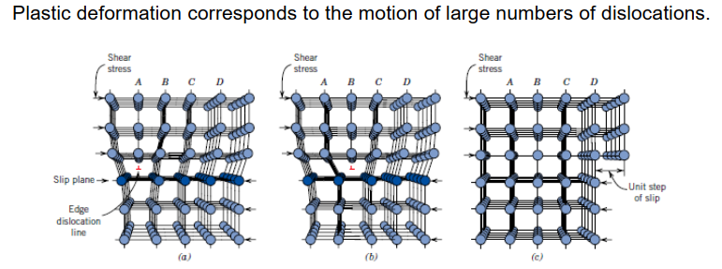
Dislocation Motion

Slide 27

Dislocation Motion

Slide 28
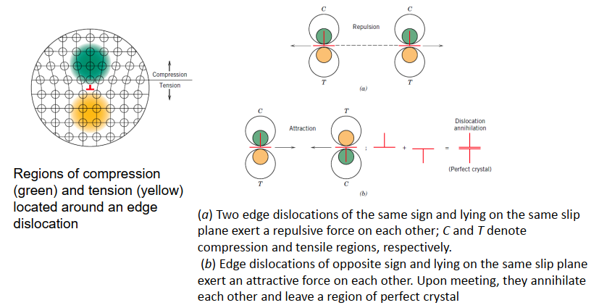
Dislocation Motion

Slide 29
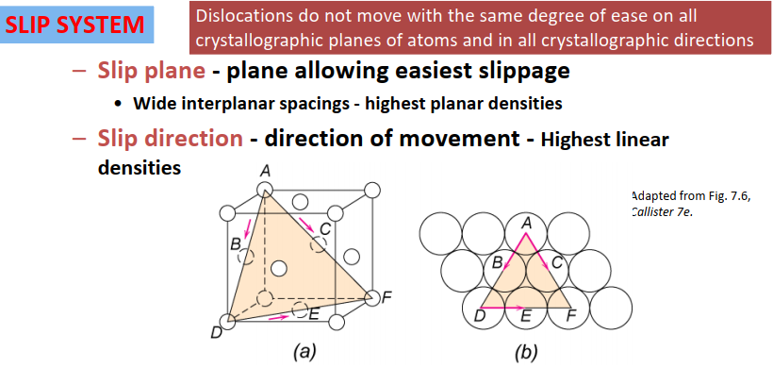

Dislocation Motion

Slide 30
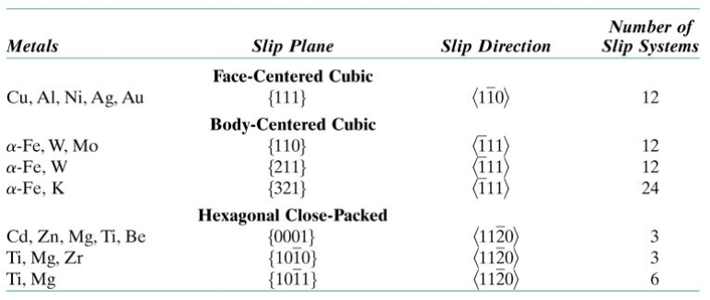
Dislocation Motion

Slide 31



Dislocation Motion

Slide 32
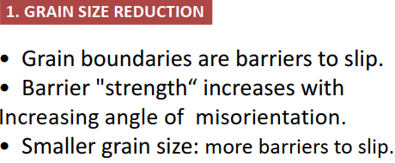
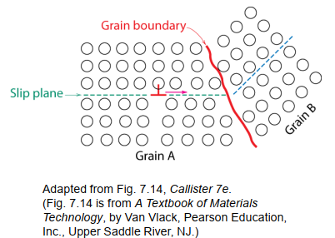

Mechanism of Strengthening

Slide 33

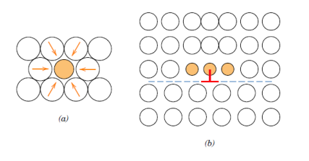
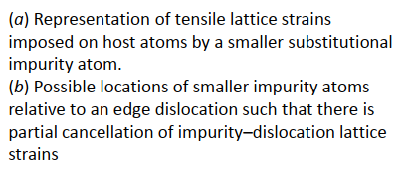
Mechanism of Strengthening

Slide 34
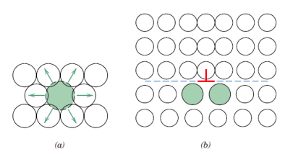
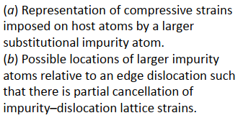
Mechanism of Strengthening

Slide 35
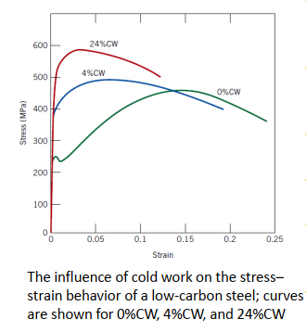

Mechanism of Strengthening

Slide 36
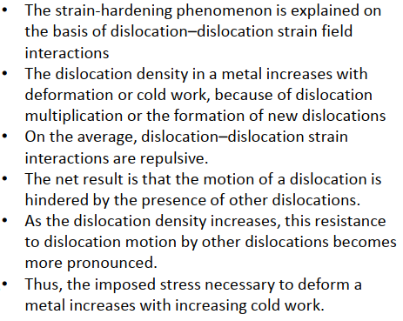
Mechanism of Strengthening

Slide 37


Recovery, Recrystallization & Grain Growth

Slide 38

Recovery, Recrystallization & Grain Growth

Slide 39

Recovery, Recrystallization & Grain Growth

Slide 40
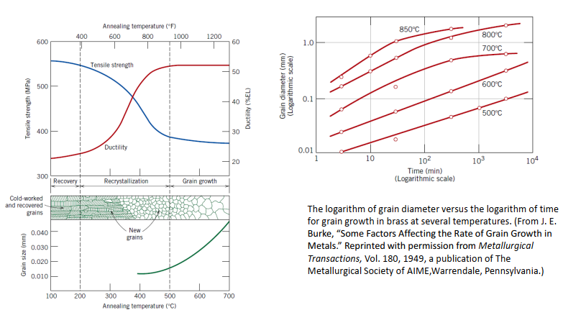
Recovery, Recrystallization & Grain Growth

Slide 41
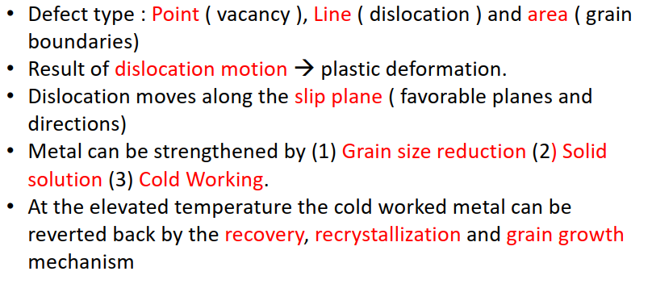
Summary

Slide 42
Thank you

