Slide 1
IEI6A2 - Pengantar Teknik Industri
Perancangan Fasilitas
Tim Dosen FRI
Prodi S2 Teknik Industri – Fakultas Rekayasa Industri

Slide 2
Course Learning Outcome (CLO)
mampu menjelaskan peranan perancangan fasilitas pada disiplin keilmuan teknik industri
Mahasiswa mampu mengidentifikasi siklus perancangan fasilitas
Mahasiswa mampu mengidentifikasi ciri-ciri perencanaan fasilitas yang baik

Slide 3
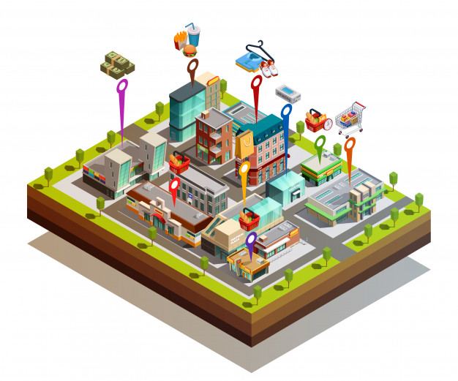
Definition and Objectives

Slide 4
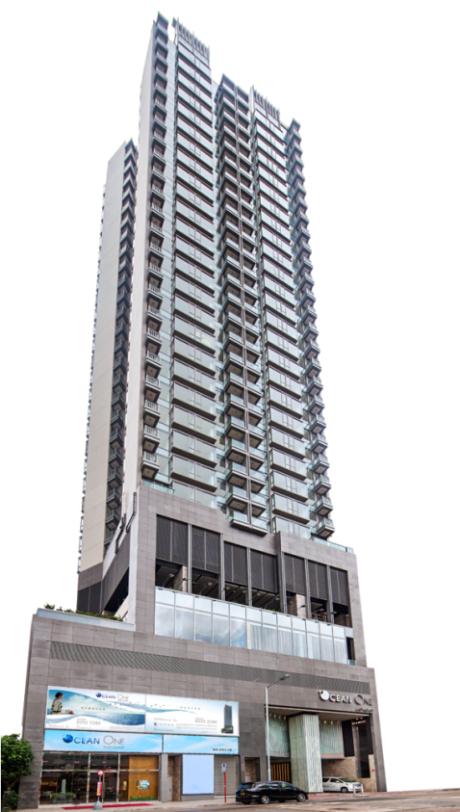

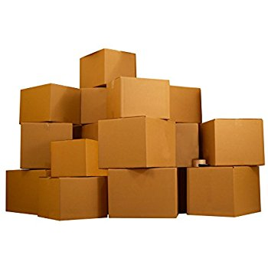
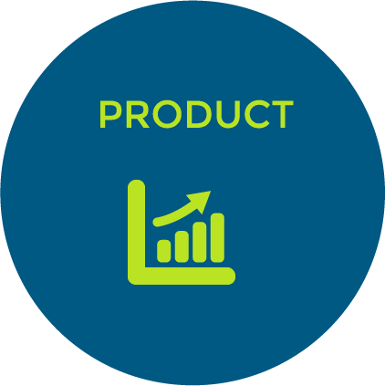

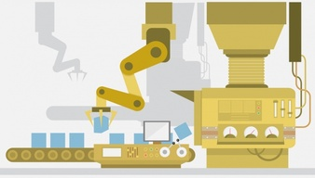
Facilities Definition
Buildings where people, material, and machines come together for a state of purpose (typically to make a tangible product or provide a service)
=

Slide 5
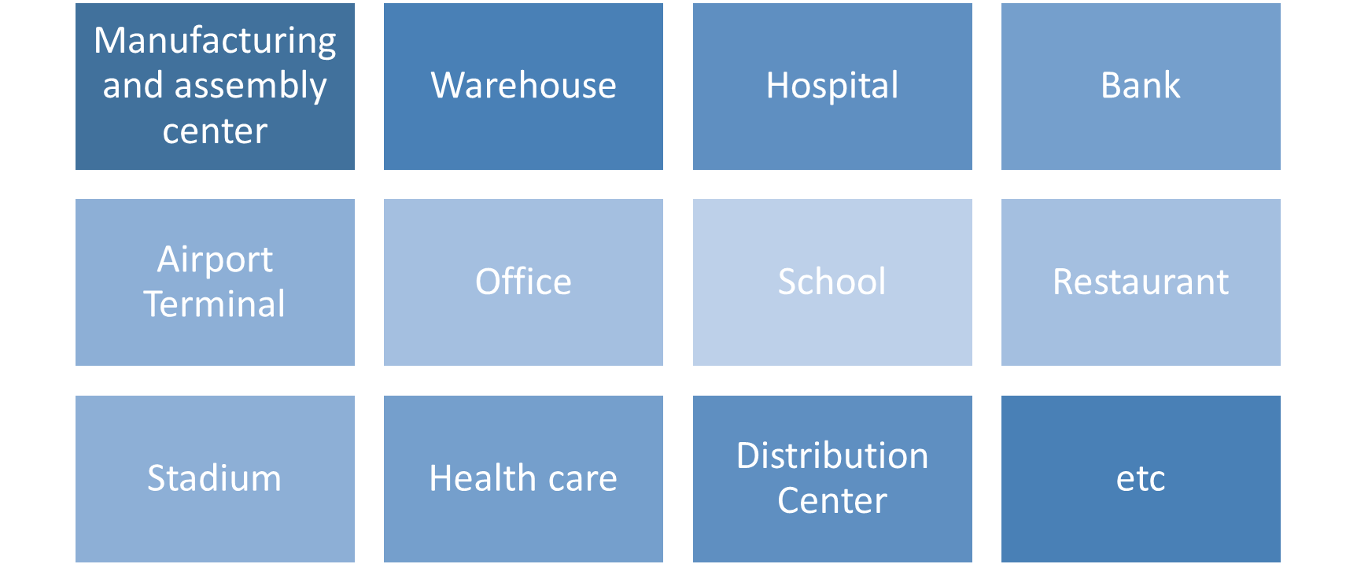
Jenis Sarana

Slide 6

Facilities Planning Objective
determine the location which, in consideration of all factors affecting deliver-to-customers cost of the products to be manufactured, will be minimized

Slide 7
The Facilities Planning Objectives
(Tompkims,et al,2010)
Improve customer satisfaction.
Increase return on assets (ROA) by maximizing inventory turns, minimizing obsolete inventory, maximizing employee participation, and maximizing continuous improvement.
Maximize speed for quick customer response.
Reduce cost and grow the supply chain profitability.
Integrate the supply chain through improved material handling, material control, and good housekeeping.

Slide 8
The Facilities Planning Objectives (Tompkims,et al,2010)
Minimize return on investment (ROI) on all capital expenditures.
Be adaptable and promote ease of maintenance.
Assure sustainability and resilience.
Provide of employee safety, job satisfaction, energy efficiency, and environmental responsibility.
Effectively utilize people, equipment, space, and energy.

Slide 9
Facilities Planning Hierarchy
Facilities Planning
Facilities Location
Facilities Design
Facilities Layout Design
Facilities System Design
Handling System Design

Slide 10
Facilities Planning

Slide 11
Facilities Planning Cycle (Tompkins et al, 2010)
Specify/Update Primary and related activities to accomplish objectives
Determine Space requirements for all activities
Determine Facility Location
The feasibility of incorporating the new operation or facility on existing site?
Maintain and Continuously improve
Not Feasible
Feasible
Develop alternative plans and evaluate
Select facilities plan
Implement plan

Slide 12
Facilities Location

Slide 13
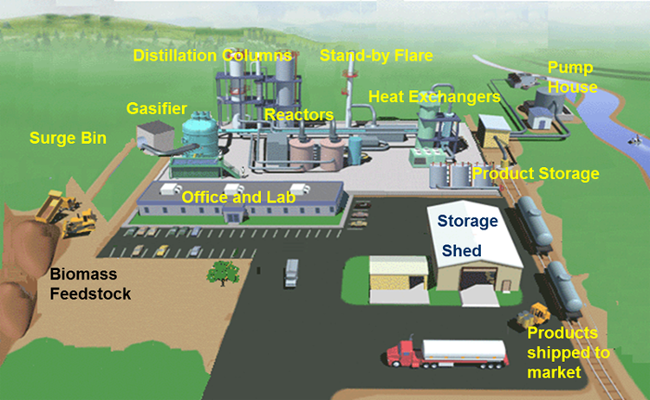
Facilities Location
refers to its placement with respect to customers, suppliers, and other facilities with which it interfaces

Slide 14
Facilities Location
The determination of Facilities location will consider
Market
Raw materials
Labor
Transportation
Utilities
Climate
Federal activities in area
Representation in progress
Financing
State government and taxes
Local government and taxes
Community facilities
Community appearance
The size of the community
Population trend
Community planning and zoning
Individual Sites
Others
Source : Apple M. James

Slide 15
Analytical Techniques
Transportation Method of linear programming
Multiple Objectives
Mathematical Programming
Public-Sector Location Problems

Slide 16
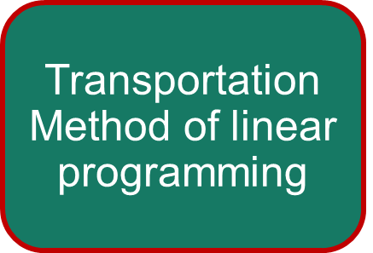
Analytical Techniques (Turner, 1993)
It is relatively simple to formulate a manufacturing plant location problem as a transportation linear programming problem involving minimization of total cost to distribute the product.

Slide 17
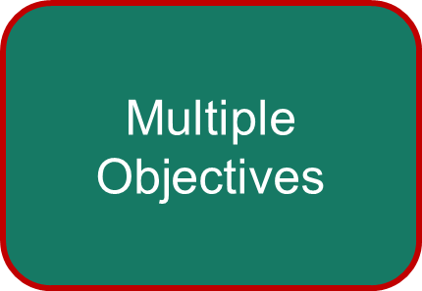
Analytical Techniques (Turner, 1993)
The proceeding section demonstrated that there are many factors to be considered in the final location decision. One technique for analytically considering many factors in the use of a method for decision making with multiple objectives.

Slide 18
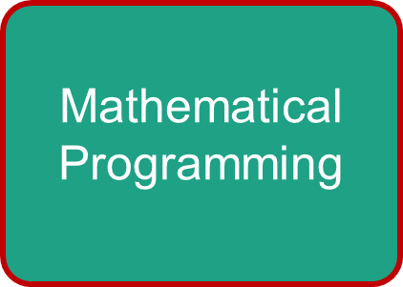
Analytical Techniques (Turner, 1993)
Much work has recently been done toward optimally determining the number, location, and size of plants (warehouses) through what is known as mathematical programming.

Slide 19
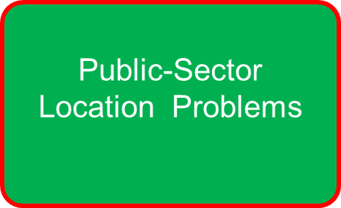
Analytical Techniques (Turner, 1993)
There has been much interest recently in the use of industrial engineering in the location of public-sector service agencies. In the public sector the objective is frequently to minimize some maximum respon time, for example, in the to get to a fire or emergency.

Slide 20
Facilities System Design

Slide 21
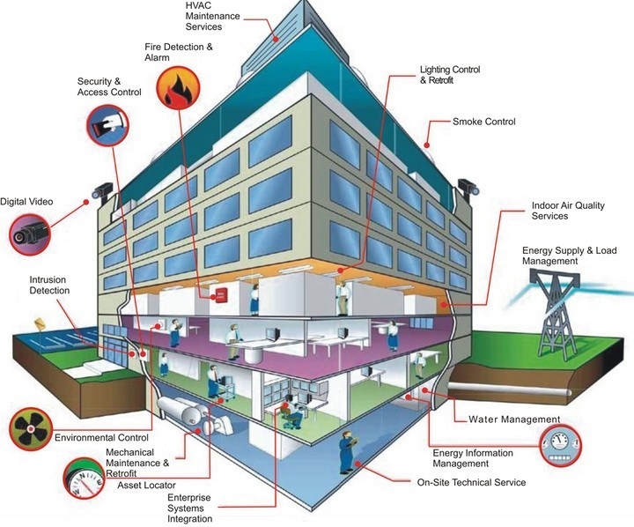
Facilities System Design
  the determination of how the design component of a facility support achieving the facility's objective is referred to as facility design

Slide 22
Facilities System
Structural System
Atmospheric System
Enclosure System
Lighting and Electrical System
Life Safety System
Sanitation System
Building Automation System
Computerized Maintenance Management System

Slide 23
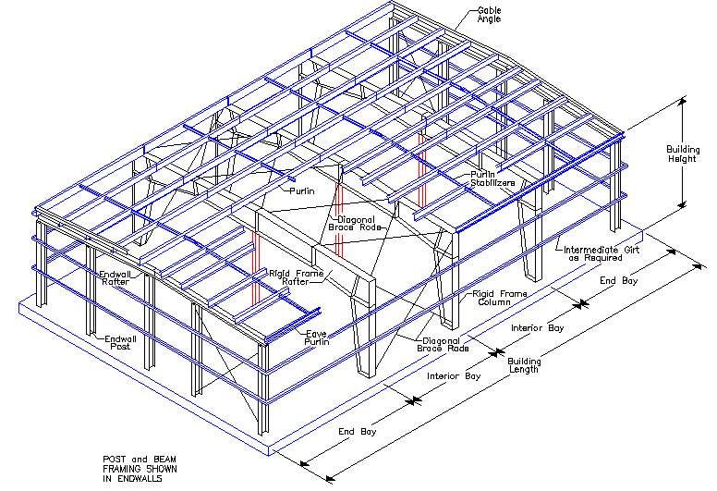
Structural System
  The objective of the structural system is to ensure that the building will be stable. The degree of stability required and designed into the building is dictated by the load conditions.
  The most common structural types for industrial facilities are the steel skeleton frame or reinforced concrete skeleton frame.
Sources: http://www.spbuildingsystems.com/multi-span-structures.html

Slide 24
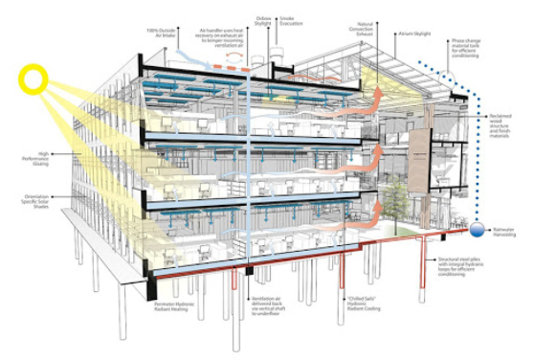
Atmospheric System
  Atmospheric systems provide for the health and comfort of occupants and for needs of building equipment and machinery.
  It is done by heating and cooling building air and by controlling humidity.
Sources: http://greencastleinnovation.com/air-conditioning/

Slide 25
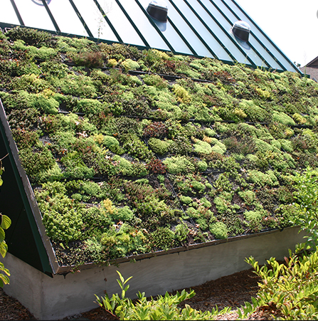
Enclosure System
  The enclosure system provides a barrier against the effects of extreme cold or heat, lateral forces (wind), water, and undesirable (human, insects).
  The enclosure elements are floor, walls, and roof. All three elements are intended provide the facility with a specified comfort level, which is often impacted by the thermal performance of the building enclosure.
Sources: https://www.barbourproductsearch.info/why-choose-a-green-roof-system-blog000321.html

Slide 26
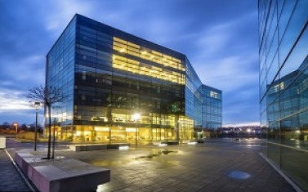
Lighting and Electrical System
  Every electrical system should have sufficient capacity to serve the loads for which it is designed, plus spare capacity to meet anticipated growth.
  both present and future load requirements are included in the design data so that the design engineer can adequately size mains, switchgear, transformers, feeders, panel boards, and circuits to handle the future electrical needs of the facility.
Sources: https://betterbuildingssolutioncenter.energy.gov/alliance/
technology-solution/lighting-electrical

Slide 27
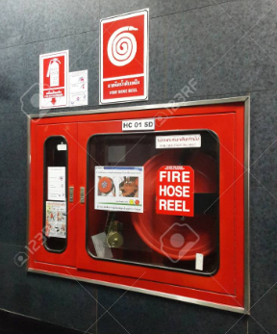
Life Safety System
  Life safety systems are designed to control emergency situations that will disrupt normal operation. These emergencies are created primarily by fire, seismic events and power failure.
  Fire is the most pervasive of the three and accounts for the majority of costs associated with disaster.
Sources: https://www.123rf.com/photo_103049661_water-equipment-for-fire-
protection-system-and-fire-hose-reel-in-building-fire-fighting-equipment.html

Slide 28
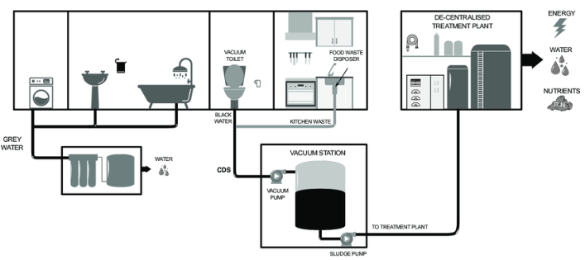
Sanitation System
  Sanitation systems consist of a hot and cold water supply, a distribution network to supply portable and cleansing water, and a collection network for refuse.
  The plumbing system, which typically handles the supply of hot and cold water, and the sewage system form the bulk of the sanitation system.
Sources: https://www.researchgate.net/figure/Schematic-representtion-of-a-
sanitation-system-according-to-decentralised-sanitation-and_fig1_324926162

Slide 29
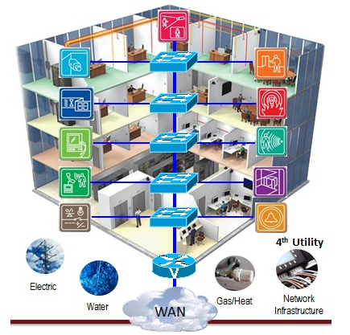
Building Automation System
  Building automation systems link most of the previously discussed systems together via systems integration into a central control point of process control devices, temperature and humidity measurements, alarm and security systems, lighting controls, and heating, ventilation, and air conditioning monitoring and control.
Sources: https://testindo.com/kategori/246/building-automation-system

Slide 30
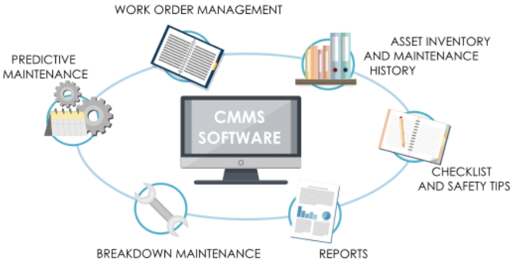
Computerized Maintenance Management System
  The computerized maintenance management systems support long-term physical asset management and day-to-day maintenance.
Sources: https://www.researchgate.net/figure/2-Examples-of-functions-of-CMMS-7_fig4_308379654

Slide 31
Facilities Layout

Slide 32
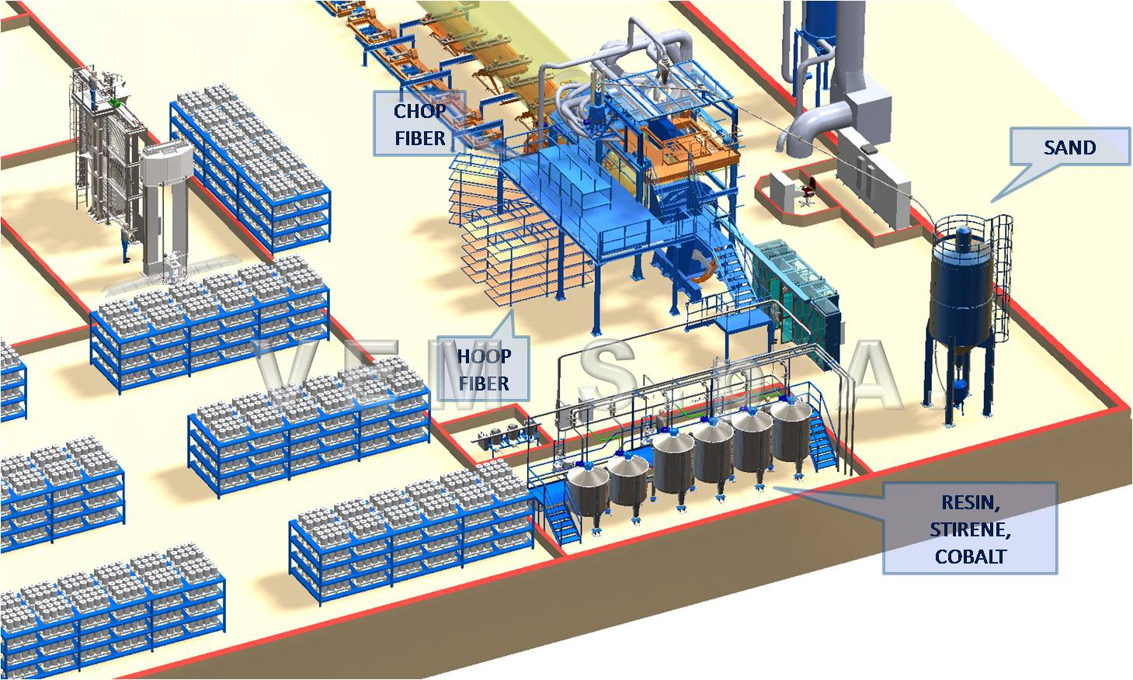
Facilities Layout
Facilities Layout
  Consists of all equipment, machinery and furnishings within the building/facilities.

Slide 33
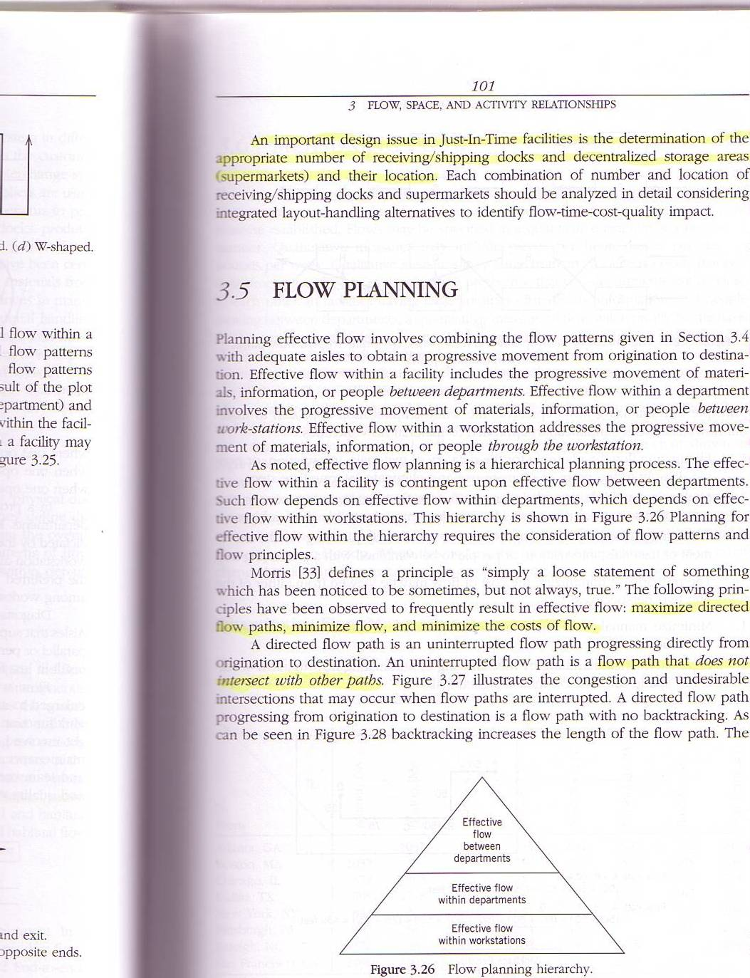
Material Flow

Slide 34
Layout Type
Product layout
Process Layout
Product Family Layout
Fixed layout

Slide 35
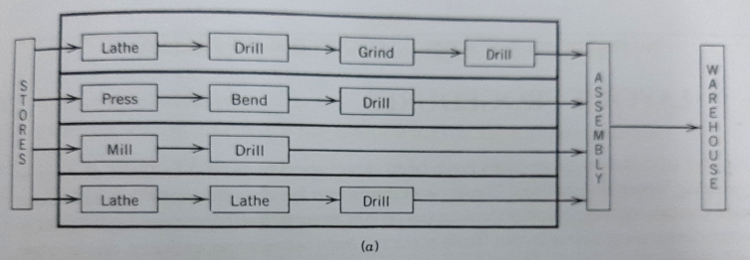
Product Layout

Slide 36
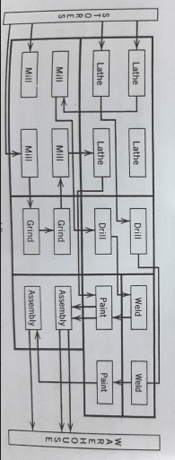
Process Layout

Slide 37
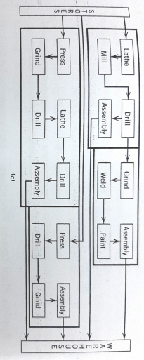
Product Family Layout

Slide 38
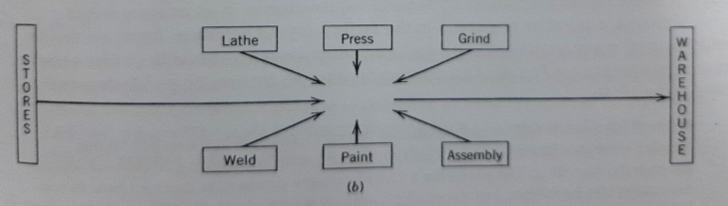
Fixed Location Layout

Slide 39

Handling System Design

Slide 40
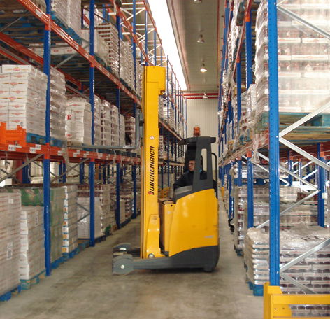
Handling System Design
Handling System
Consists of the mechanism need to satisfy the required facility interactions.

Slide 41
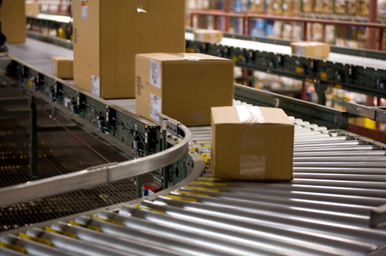
Material Handling Definition
The art and science of moving, storing, protecting and controlling material
Providing the right amount of the right material, in the right condition at the right place in the right position in the right sequence and for the right cost
-Tompkins-

Slide 42
Material Handling Definition
Involves moving, storing, protecting, and controlling material
Right amount
Right material
Right condition
Right sequence
Right orientation
Right place
Right time
Right cost
Right method

Slide 43
The Material Handling System Equation
To help guide the development of alternative material handling system designs
WHY ?
WHAT ?
WHERE ?
WHEN ?
HOW ?
WHO ?
WHICH ?
MATERIALS
+
MOVES (Place & Time)
+
METHODS
PREFERRED SYSTEM
Material Handling Systems Alternatives

Slide 44
Material Handling Equipment
Containers and Unitizing Equipment
Material Transport Equipment
Storage and Retrieval Equipment
Automatic Data Collection and Communication Equipment

Slide 45
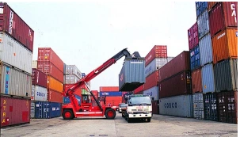
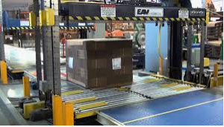
Containers and Unitizing Equipment
Containers
Unitizers

Slide 46
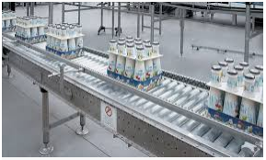
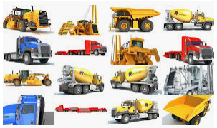
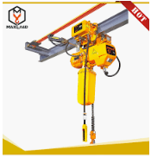
Material Transport Equipment
Conveyors
Industrial Vehicles
Monorails, hosts, cranes

Slide 47
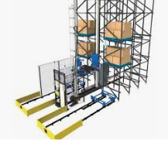
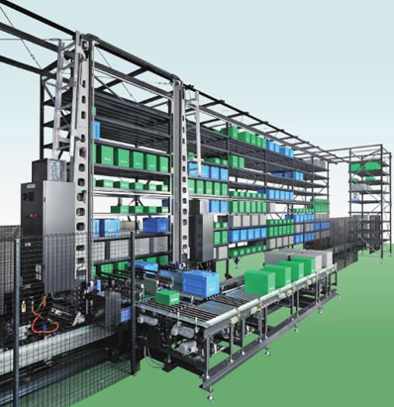
Storage and Retrieval Equipment
Unit load storage and retrieval
Small load storage and retrieval

Slide 48
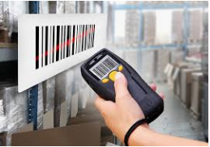
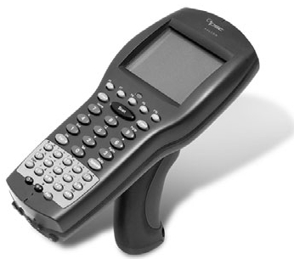
Automatic data collection and communication equipment
Automatic identification and recognition
Automatic paperless communication

Slide 49
Good Facilities

Slide 50

Characteristics of Good Facilities (Tompkins, et al 2016)
Flexibility
Modularity
Upgradability
Adaptability
Selective Operability
Environmental & Energy Friendliness

Slide 51
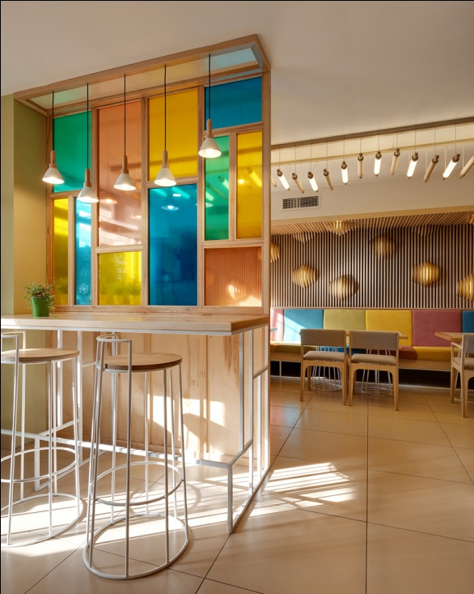
Flexibility
Fasilitas yang fleksibel akan dapat menangani berbagai kebutuhan tanpa diperlukan banyak perubahan
Fasilitas yang fleksibel memiliki kemampuan untuk diubah atau disesuaikan secara cepat untuk mengikuti perubahan kondisi

Slide 52
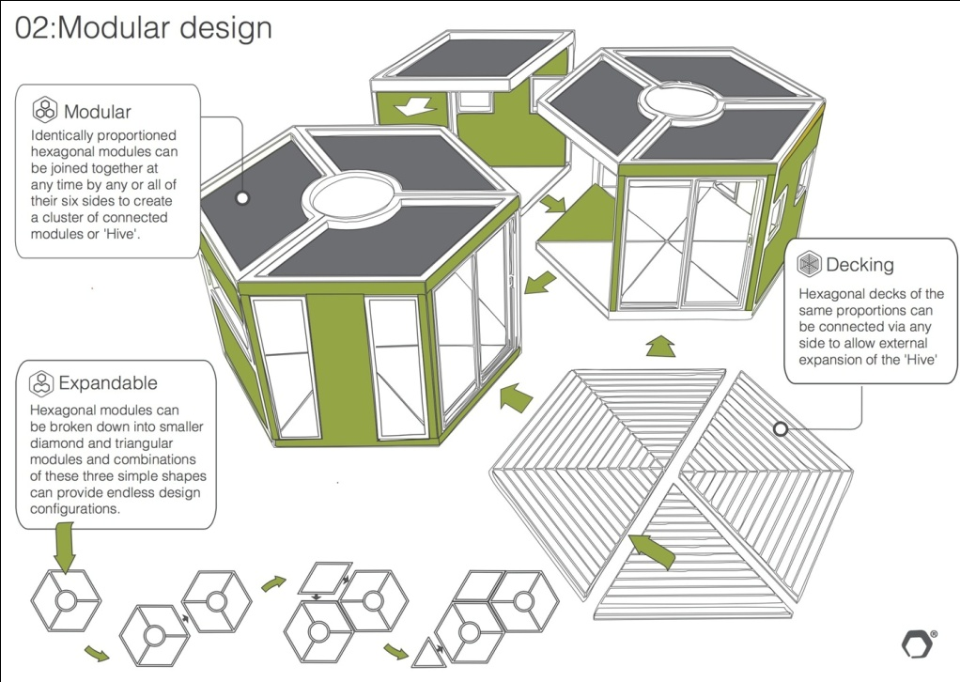
Modularity
membagi sistem menjadi bagian-bagian kecil (modul) yang dapat mandiri dibuat dan kemudian digunakan dalam sistem yang berbeda untuk mengarahkan beberapa fungsi.
Modular facilities are those with systems that cooperate efficiently over a wide range of operating rates.

Slide 53


Upgradability
Mampu mengintegrasikan kemajuan dalam sistem peralatan dan teknologi

Slide 54
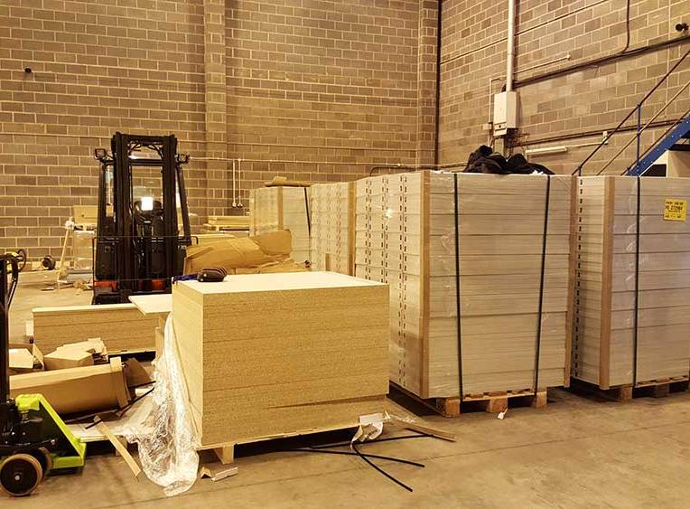
Adaptability
Mempertimbangkan implikasi dari kalender, siklus, dan puncak dalam penggunaan fasilitas

Slide 55
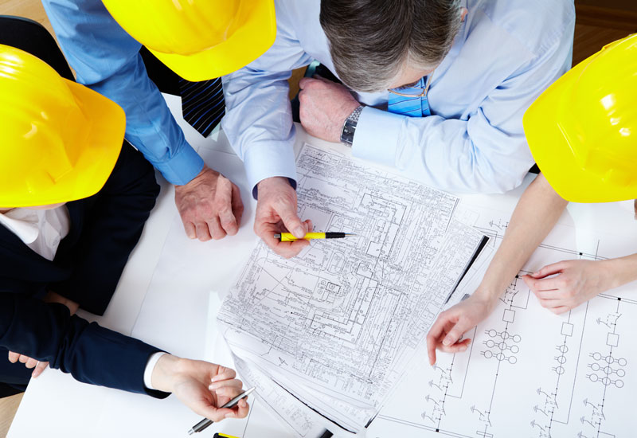
Selective Operability
memahami cara setiap segmen fasilitas beroperasi dan memungkinkan rencana cadangan diterapkan.
rencana yang disusun untuk menghadapi situasi kritis yang diperkirakan akan terjadi

Slide 56
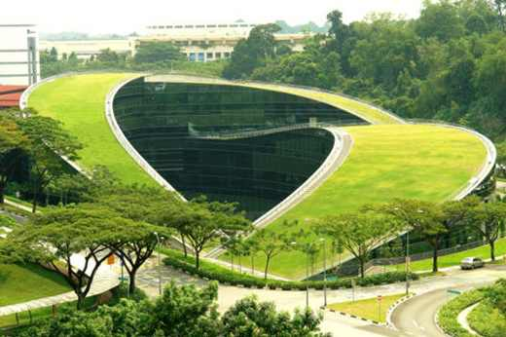
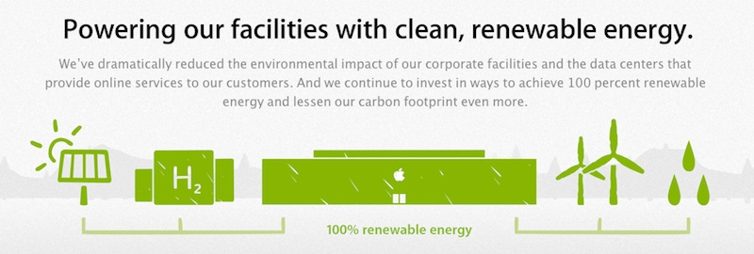
Environmental & Energy Friendliness
Menjalankan 5 kunci penting dalam menjaga kesehatan manusia dan lingkungan: perkembangan lahan yang berkelanjutan, penghematan air, efisiensi energi, pemilihan material, dan indoor environmental quality

Slide 57


