Slide 1
Data Mining

Slide 2
Definisi Data Mining
The term data mining was originally used to describe the process through which previously unknown patterns in data were discovered.
Many other names that are associated with data mining include knowledge extraction, pattern analysis, data archaeology, information harvesting, pattern searching, and data dredging.
Sumber Referensi: http://www.contohURL.com

Slide 3
Karakteristik Utama dan Tujuan Data Mining
Data are often buried deep within very large databases, which sometimes contain data from several years.
The data mining environment is usually a client/server architecture or a Web-based IS architecture.
Sophisticated new tools, including advanced visualization tools, help to remove the information or buried in corporate files or archival public records.

Slide 4
Karakteristik Utama dan Tujuan Data Mining (2)
The miner is often an end user, empowered by data drills and other powerful query tools to ask ad hoc questions and obtain answers quickly, with little or no programming skill.
Striking it rich often involves finding an unexpected result and requires end users to think creatively throughout the process, including the interpretation of the findings.

Slide 5
Karakteristik Utama dan Tujuan Data Mining (3)
Data mining tools are readily combined with spreadsheets and other software development tools.
Because of the large amounts of data and massive search efforts, it is sometimes necessary to use parallel processing for data mining.

Slide 6
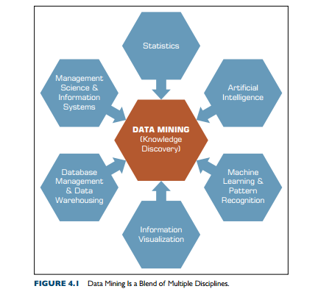
Data Mining Position

Slide 7
Jenis Data Mining
Associations
Predictions
Clusters
Sequential relationships
find the commonly co-occurring groupings of things, such as beer and
diapers going together in market-basket analysis.
tell the nature of future occurrences of certain events based on what has happened in the past, such as forecasting the absolute temperature of a particular day
identify natural groupings of things based on their known characteristics, such as assigning customers in different segments based on their demographics and past purchase behaviors
discover time-ordered events, such as predicting that an existing banking customer who already has a checking account will open a savings account followed by an investment account within a year

Slide 8
Data Mining
Data mining tasks can be classified into three main categories:
  prediction,
  association, and
  clustering.

Slide 9
Prediction
Prediction is commonly referred to as the act of telling about the future.
A term that is commonly associated with prediction is forecasting.
Whereas prediction is largely experience and opinion based, forecasting is data and model based.
In data mining terminology, prediction and forecasting are used synonymously, and the term prediction is used as the common representation of the act.

Slide 10
Prediction
Depending on the nature of what is being predicted, prediction can be named more specifically as
  classification (where the predicted thing, such as tomorrow’s forecast, is a class label such as “rainy” or “sunny”) or
  regression (where the predicted thing, such as tomorrow’s temperature, is a real number, such as “65°F”).

Slide 11
Classification
Classification, or supervised induction, is perhaps the most common of all data mining tasks.
The objective of classification is to analyze the historical data stored in a database and automatically generate a model that can predict future behavior

Slide 12
Classification
Common classification tools include:
  neural networks and decision trees (from machine learning),
  logistic regression and discriminant analysis (from traditional statistics), and
  emerging tools such as rough sets,
  support vector machines (SVMs), and
  genetic algorithms.

Slide 13
Clustering
Clustering partitions a collection of things (e.g., objects, events, presented in a structured data set) into segments (or natural groupings) whose members share similar characteristics.
Unlike in classification, in clustering the class labels are unknown.
The most commonly used clustering techniques include:
  k-means (from statistics) and
  self-organizing maps (from machine learning), which is a unique neural network architecture developed by Kohonen (1982).

Slide 14
Association
Associations, or association rule learning in data mining, is a popular and well-researched technique for discovering interesting relationships among variables in large databases.
In the context of the retail industry, association rule mining is often called market-basket analysis.
Two commonly used derivatives of association rule mining are link analysis and sequence mining.

Slide 15
Association (2)
Algorithms used in association rule mining include:
  Apriori (where frequent itemsets are identified) and
  FP-Growth, OneR, ZeroR, and Eclat.

Slide 16
Visualization and
time-series forecasting
Visualization can be used in conjunction with other data mining techniques to gain a clearer understanding of underlying relationships.
In time-series forecasting, the data consists of values of the same variable that is captured and stored over time in regular intervals.
These data are then used to develop forecasting models to extrapolate the future values of the same variable.

Slide 17
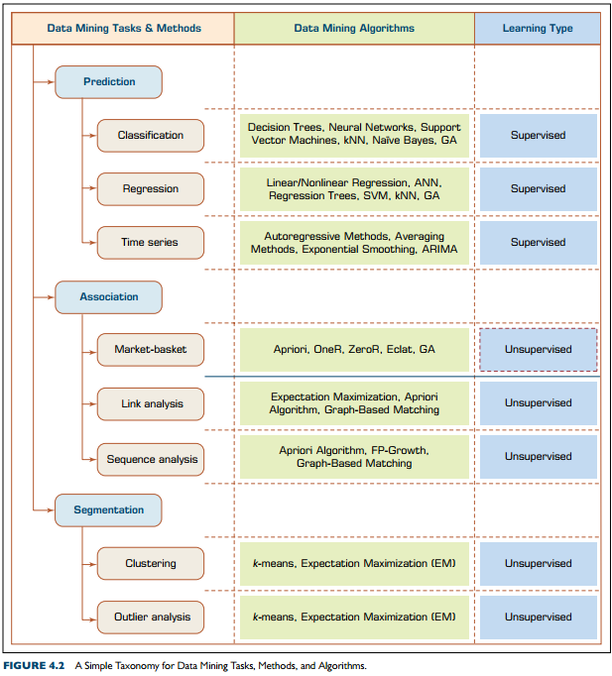
Data Mining Taxonomy

Slide 18
Data Mining Taxonomy (2)

Slide 19
Data Mining Taxonomy (3)

