Slide 1
Chapter 20
Managing Mass Communications

Slide 2
Advertising
Any paid form of nonpersonal presentation
and promotion of ideas, goods, or
services by an identified sponsor.

Slide 3
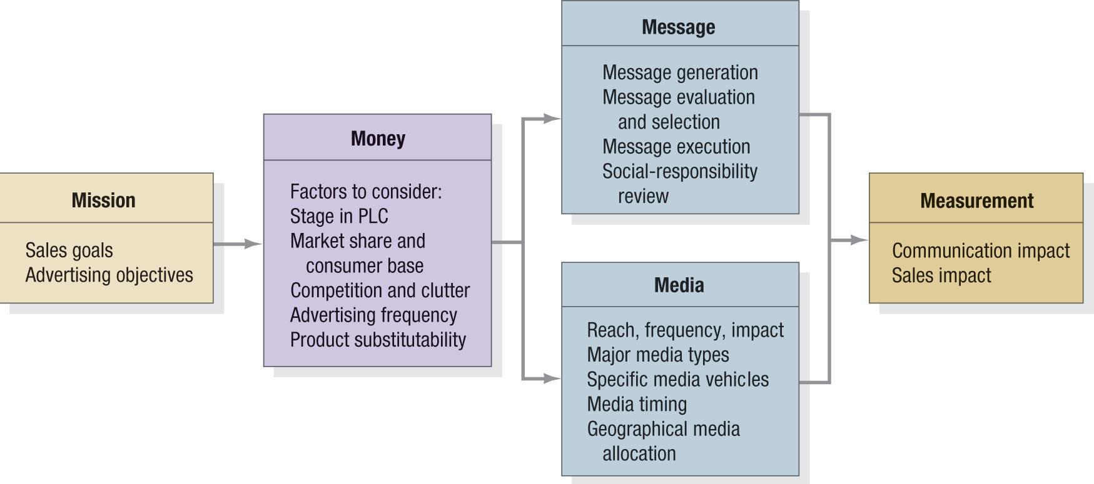
Figure 18.1 The Five M’s of Advertising

Slide 4
Advertising Objectives
Informative
advertising
Persuasive
advertising
Reminder
advertising
Reinforcement
advertising

Slide 5

Factors to Consider in Setting an Advertising Budget
Stage in the product life cycle
Market share and consumer base
Competition and clutter
Advertising frequency
Product substitutability

Slide 6

Developing the Advertising Campaign
Message generation and evaluation
Creative development and execution
Social responsibility review

Slide 7

Creative Brief
Positioning statement
Key message
Target market
Objectives
Key brand benefits
Brand promise
Evidence of promise
Media
Background
Creative considerations

Slide 8
Television
Advantages
Reaches broad spectrum of consumers
Low cost per exposure
Ability to demonstrate product use
Ability to portray image and brand personality
Disadvantages
Brief
Clutter
High cost of production
High cost of placement
Lack of attention by viewers

Slide 9
Print Ads
Advantages
Detailed product information
Ability to communicate user imagery
Flexibility
Ability to segment
Disadvantages
Passive medium
Clutter
Unable to demonstrate product use

Slide 10
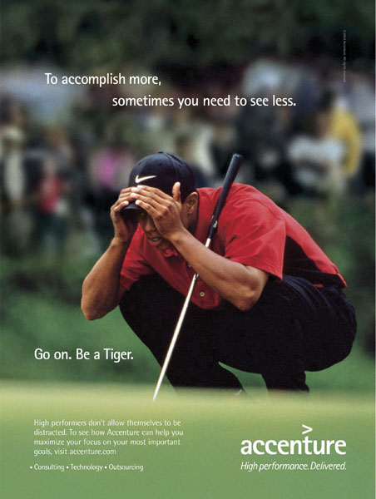
Print Ad Components
Headline
Picture
Signature

Slide 11
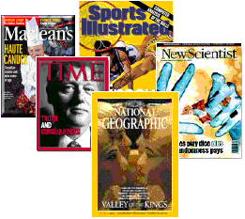
Choosing Among Major Media Types
Target audience and media habits
Product characteristics
Message characteristics
Cost

Slide 12
Major Media Types
Newspapers
Television
Direct mail
Radio
Magazines
Outdoor
Yellow pages
Newsletters
Brochures
Telephone
Internet

Slide 13
Sales Promotion
Collection of incentive tools, mostly
short term, designed to stimulate
quicker or greater purchase
of particular products or services
by consumers or the trade.

Slide 14
Sales Promotion Tactics
Consumer-directed
Samples
Coupons
Cash refund offers
Price offs
Prizes
Patronage rewards
Free trials
Promotions
Trade-directed
Price offs
Allowances
Free goods
Sales contests
Trade shows
Specialty advertising

Slide 15
Public Relations Functions
Press relations
Product publicity
Corporate communications
Lobbying
Counseling

Slide 16

Marketing Public Relations Functions
Assist in product launches
Assist in repositioning mature products
Build interest in a product category
Influence specific target groups
Defend products
Build corporate image

Slide 17

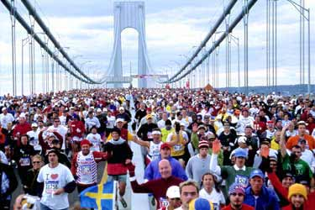
Major Tools in Marketing PR
Publications
Events
Sponsorships
News
Speeches
Public Service Activities
Identity Media

