Slide 1
Data Quality Consideration and Preprocessing

Slide 2
Data Quality
The quality of the models, charts and studies in data analytics depends on the quality of the data being used.
The nature of the application domain, human error, the integration of different data sets (say, from different devices), and the methodology used to collect data can generate data sets that are noisy, inconsistent, or contain duplicate records.
Main problems: missing values, inconsistency, redundancy, noise and outliers in a data set

Slide 3
Missing Values
Attributes values only recorded some time after the start of data collection, so that early records do not have a value
the value of an attribute being unknown at time of collection
distraction, misunderstanding or refusal at time of collection
attribute not required for particular objects
non-existence of a value
fault in the data collection device
cost or difficulty of assigning a class label to an object in classification problems.

Slide 4
Handle Missing Values
Ignore missing values:
  Use for each object only the attributes with values, without paying attention to missing values. This does not require any change in the modeling algorithm used, but the distance function should ignore the values of attributes with at least one missing value;
  Modify a learning algorithm to allow it to accept and work with missing values.
Remove objects: Use only those objects with values for all attributes.
Make estimates: Fill the missing values with estimates based on values for this attribute in the other objects.

Slide 5
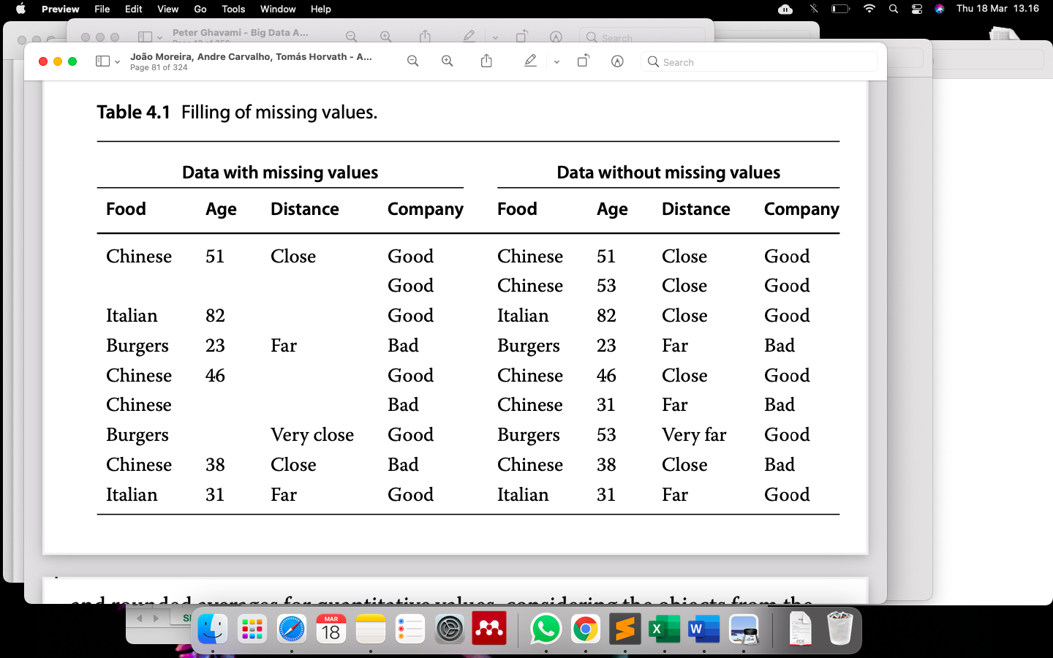
Example Filling of Missing Values
Using the mode for qualitative values
Rounded averages for quantitative values,
Considering the objects from the same class: those with the same label for the target attribute “Company”.

Slide 6
Redundant Data
Redundant data can be duplicate data.
Deduplication is a preprocessing technique whose goal is to identify and remove copies of objects in a data set.

Slide 7
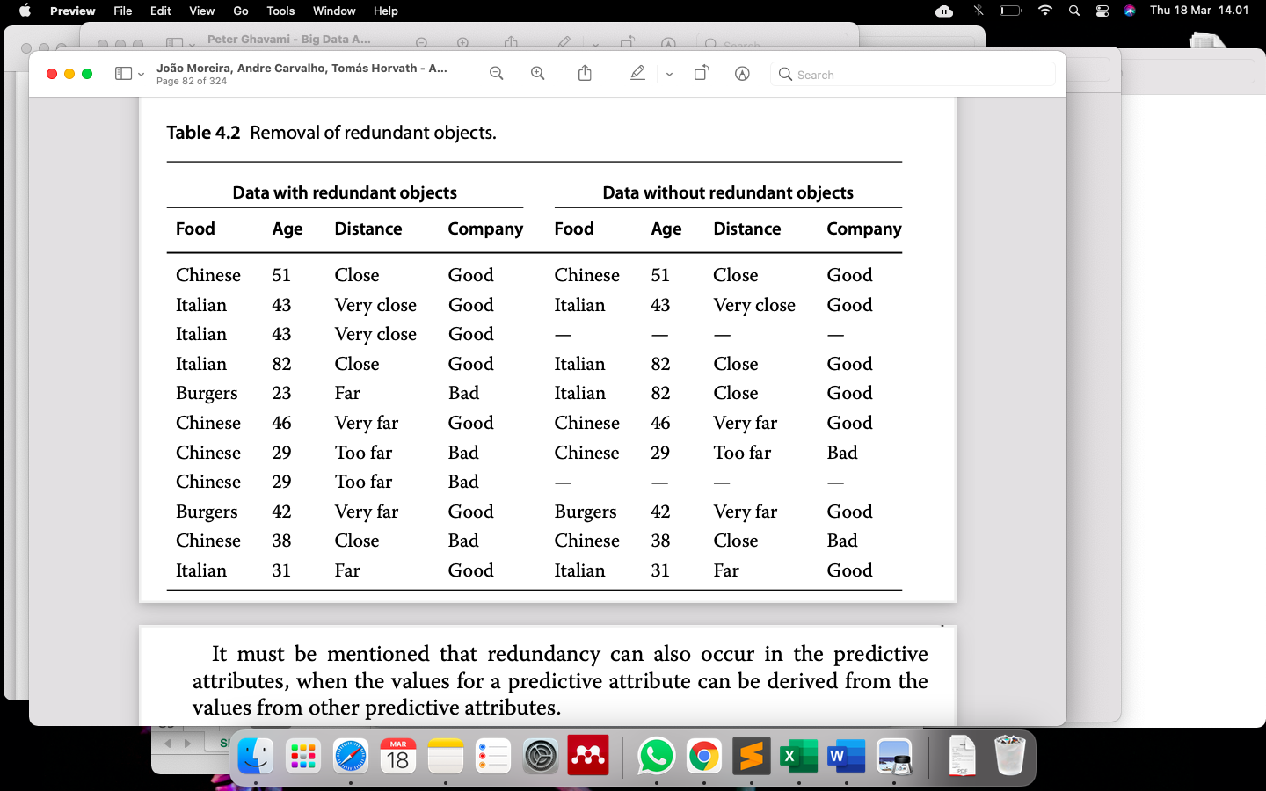
Handle Redundant Data: Remove

Slide 8
Inconsistent Data
A data set can also have inconsistent values.
A good policy to deal with inconsistent values in the predictive attribute is to treat them as missing values.

Slide 9
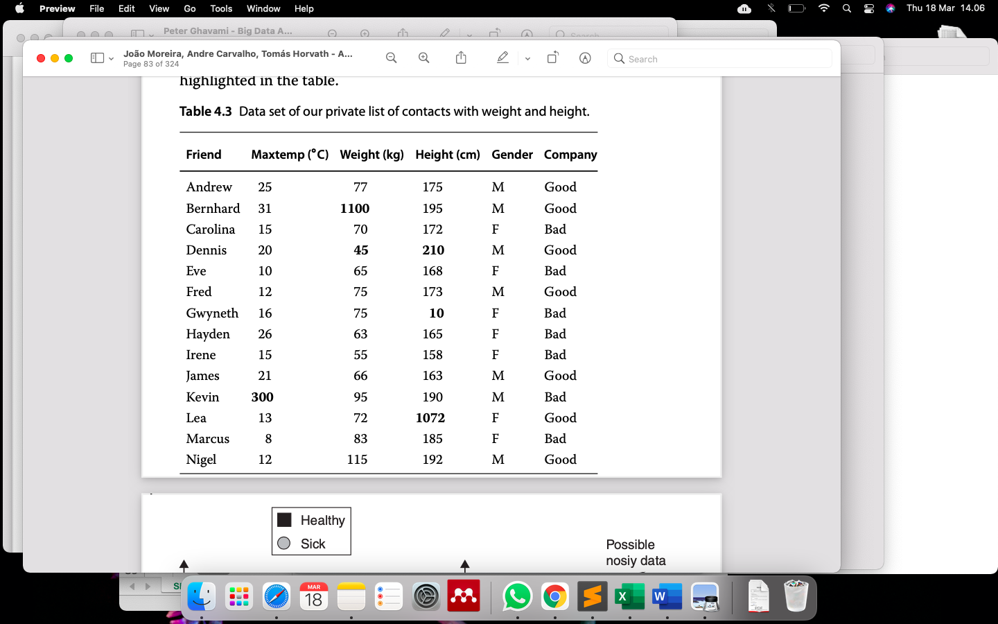
Example of Inconsistent Data

Slide 10
Noisy Data
Data that do not meet the set of standards expected for them.
Noise can be caused by incorrect or distorted measurements, human error or even contamination of the samples.
Noise detection can be performed by adaptation of classification algorithms or by the use of noise filters for data preprocessing

Slide 11
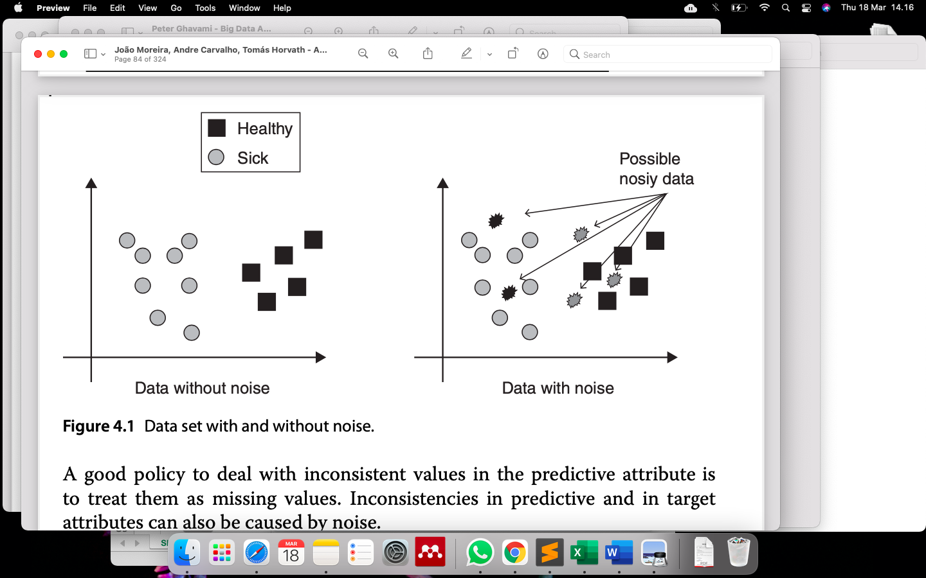
Illustration Noisy Data

Slide 12
Outliers
Outliers are anomalous values or objects.
As objects whose values for one or more predictive attributes are very different from the values found in the same predictive attributes of other objects.
A simple yet effective method to detect outliers in quantitative attributes is based in the interquartile range.

Slide 13
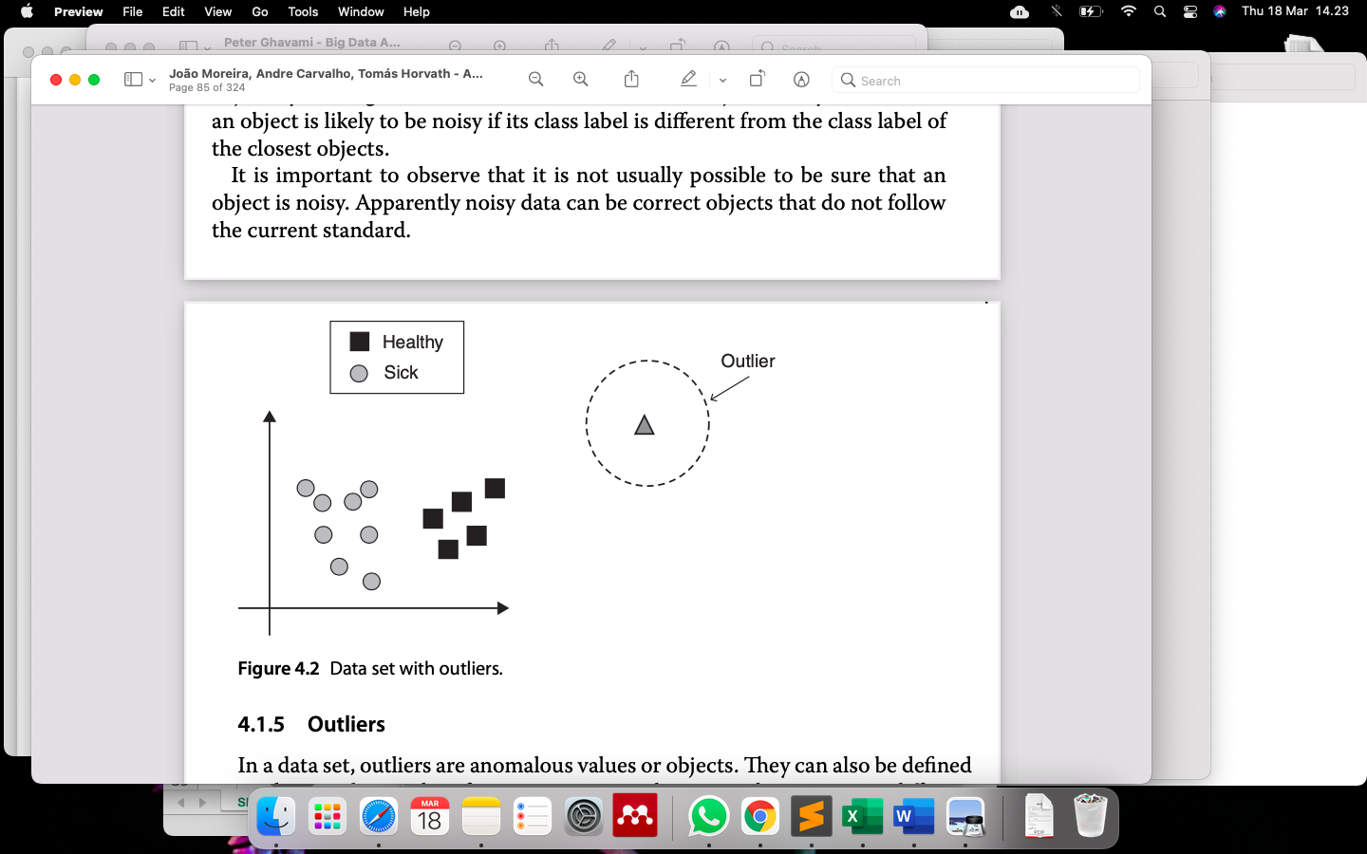
Illustration of Outlier Data

Slide 14
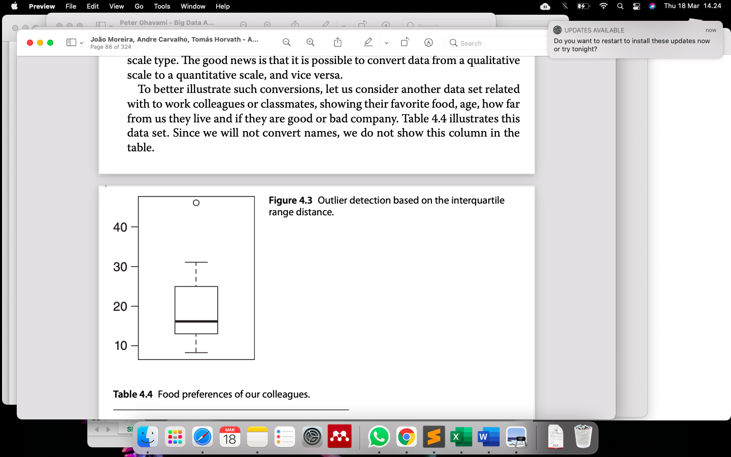
Outlier detection based on the interquartile range distance

