Slide 1
Time Value of Money (TVM)

Slide 2
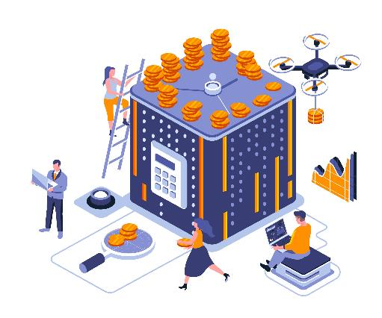
Topic Content
01
The TVM: Introduction to Valuation
07
Future Value of Annuity
02
Future Value and Compounding
08
Present Value of Annuity
03
Present Value and Discounting
09
Comparison of Different Types of Interest Rates
04
Present versus Future Value
10
Fractional Time Period
05
Determining the Discount Rate
11
Sub Topic #11
06
Determining the Time Period
12
Sub Topic #12

Slide 3


Which would you prefer?
Introduction
OR
$1,000 today
$1,000 in 2 years

Slide 4
Which would you prefer?
Introduction
OR
$1,000 today
$1,000 in 2 years

Slide 5
Which would you prefer?
Introduction
OR
$1,000 today
$1,000 in 2 years
You already recognize that there is TIME VALUE TO MONEY !!

Slide 6

Introduction
Why is TIME such an important element in your decision?
TIME allows you the opportunity to postpone consumption and earn INCOME or INTEREST.

Slide 7



Introduction
The time value of money (TVM) refers to the fact that a dollar in hand today is worth more than a dollar promised at some time in the future.
On a practical level, one reason for this is that you could earn interest while you waited; so a dollar today would grow to more than a dollar later.
The trade-off between money now and money later thus depends on, among other things, the rate you can earn by investing.

Slide 8



Introduction
TVM is useful in decision making.
Ranging from simple personal decisions — buying a house, saving for a child’s education, and estimating income in retirement — to more complex corporate financial decisions —picking projects in which to invest and the right financing mix for these projects.
Thus, TVM can solve the basic problems faced by the financial manager: how to determine the value today of cash flows expected in the future.

Slide 9
Introduction
One of the most important tools in time value analysis is the time line, which is used by analysts to help visualize what is happening in a particular problem and then to help set up the problem for solution.
Time 0 is today; Time 1 is one period from today, or the end of Period 1; Time 2 is two periods from today, or the end of Period 2; and so on.
Thus, the numbers bellow the tick marks represent end-of-period values.
Often the periods are years, but other time intervals such as semiannual periods, quarters, months, or even days can be used.
Time:
0
1
2
3
4
5
6
n-1
n

Slide 10
Introduction
If each period on the time line represents a year, the interval from the tick mark corresponding to 0 to the tick mark corresponding to 1 would be Year 1, the interval from 1 to 2 would be Year 2, and so on.
Note that each tick mark corresponds to the end of one period as well as the beginning of the next period.
In other words, the tick mark at Time 1 represents the end of Year 1, and it also represents the beginning of Year 2 because Year 1 has just passed.
The end of Year 1
Year:
0
1
2
3
4
5
6
n-1
n
The beginning of Year 2

Slide 11
Introduction
Dealing with cash flows that are at different points in time is made easier using a time line that shows both the timing and the amount of each cash flow in a stream.
A Time Line for Cash Flows of $100 in Cash Flows Received at the End of Each of Next 4 Years:
A Time Line for Cash Flows of $100 in Cash Received at the Beginning of Each Year for Next 4 Years:

Slide 12
Notation
CF₁
CF₂
CF₃
CF₄
CF₅
CF₆
CF_{n-1}
FV
0
1
2
3
4
5
6
n-1
n
PV
Notations | Stand For
PV | Present value
FV | Future value
CF_{t} | Cash flow at the end of period t
A | Annuity
r | Interest rate or discount rate
g | Expected growth rate in cash flows
n | Number of periods/ years over which cash flows are received or paid

Slide 13
Notation
CF₁
CF₂
CF₃
CF₄
CF₅
CF₆
CF_{n-1}
FV
0
1
2
3
4
5
6
n-1
n
Present Value is the current value of a future amount of money, or a series of payments, evaluated at a given discount rate.
PV
Notations | Stand For
PV | Present value
FV | Future value
CF_{t} | Cash flow at the end of period t
A | Annuity
r | Interest rate or discount rate
g | Expected growth rate in cash flows
n | Number of periods/ years over which cash flows are received or paid

Slide 14
Notation
CF₁
CF₂
CF₃
CF₄
CF₅
CF₆
CF_{n-1}
FV
0
1
2
3
4
5
6
n-1
n
Future Value is the value at some future time of a present amount of money, or a series of payments, evaluated at a given interest rate.
PV
Notations | Stand For
PV | Present value
FV | Future value
CF_{t} | Cash flow at the end of period t
A | Annuity
r | Interest rate or discount rate
g | Expected growth rate in cash flows
n | Number of periods/ years over which cash flows are received or paid

Slide 15
Notation
CF₁
CF₂
CF₃
CF₄
CF₅
CF₆
CF_{n-1}
FV
0
1
2
3
4
5
6
n-1
n
Cash Flow is the net amount of cash and cash equivalents being transfered into (cash inflow) and out (cash outflow) of a business.
PV
Notations | Stand For
PV | Present value
FV | Future value
CF_{t} | Cash flow at the end of period t
A | Annuity
r | Interest rate or discount rate
g | Expected growth rate in cash flows
n | Number of periods/ years over which cash flows are received or paid

Slide 16
Notation
CF₁
CF₂
CF₃
CF₄
CF₅
CF₆
CF_{n-1}
FV
0
1
2
3
4
5
6
n-1
n
Annuity is a series of equal payments or receipts that occur at the end (ordinary annuity) or at the beginning (annuity due) of each period at evenly spaced intervals.
PV
Notations | Stand For
PV | Present value
FV | Future value
CF_{t} | Cash flow at the end of period t
A | Annuity
r | Interest rate or discount rate
g | Expected growth rate in cash flows
n | Number of periods/ years over which cash flows are received or paid

Slide 17
Notation
CF₁
CF₂
CF₃
CF₄
CF₅
CF₆
CF_{n-1}
FV
0
1
2
3
4
5
6
n-1
n
Interest rates and discount rates both relate to the cost of money, although in different ways. An interest rate is the rate of return you expect from an investment, while discount rate refers to the rate used to determine the present value of cashflows.
PV
Notations | Stand For
PV | Present value
FV | Future value
CF_{t} | Cash flow at the end of period t
A | Annuity: constant cash flows over several periods
r | Interest rate or discount rate
g | Expected growth rate in cash flows
n | Number of periods/ years over which cash flows are received or paid

