Slide 1
Introduction to Data Analytic Thinking

Slide 2
The Ubiquity of Data Opportunities
The primary goals of this book are to help you view business problems from a data perspective and understand principles of extracting useful knowledge from data. There is a fundamental structure to data-analytic thinking, and basic principles that should be understood.
There are also particular areas where intuition, creativity, common sense, and domain knowledge must be brought to bear. A data perspective will provide you with structure and principles, and this will give you a framework to systematically analyze such problems. As you get better at data-analytic thinking you will develop intuition as to how and where to apply creativity and domain knowledge

Slide 3
The Ubiquity of Data Opportunities(1)
It is important to understand data science even if you never intend to apply it yourself. Data-analytic thinking enables you to evaluate proposals for data mining projects.
For example, if an employee, a consultant, or a potential investment target proposes to improve a particular business application by extracting knowledge from data, you should be able to assess the proposal systematically and decide whether it is sound or flawed. This does not mean that you will be able to tell whether it will actually succeed for data mining projects, that often requires trying but you should be able to spot obvious flaws, unrealistic assumptions, and missing pieces

Slide 4
Data Science, Engineering, and Data-Driven Decision Making
Data science involves principles, processes, and techniques for understanding phenomenavvia the (automated) analysis of data.

Slide 5
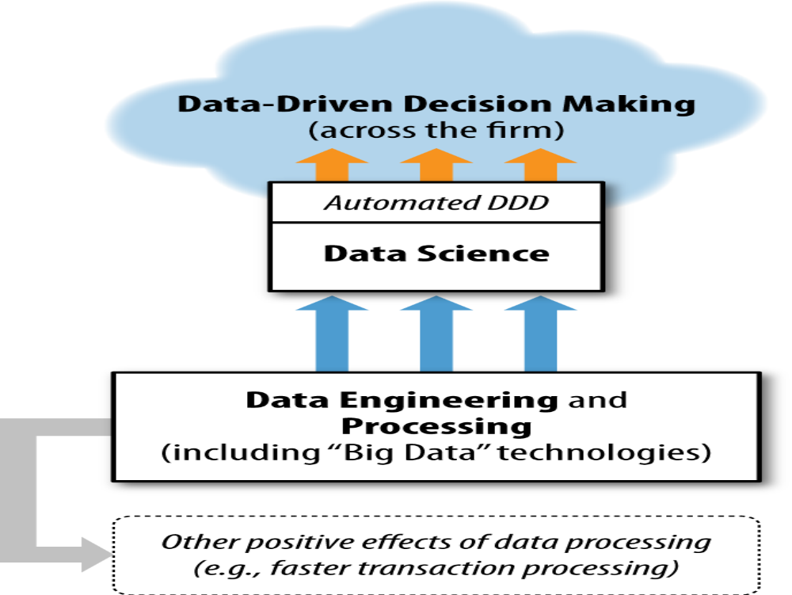
Data Science, Engineering, and Data-Driven Decision Making(1)
From the picture places data science in the context of various other closely related and datarelatedvprocesses in the organization. Itdistinguishes data science from other aspects of data processing that are gaining increasing attention in business.
And shows data science supporting data-driven decision-making, but also overlapping with data-driven decision-making. This highlights the often overlooked fact that, increasingly, business decisions are being made automatically by computer systems. Different industries have adopted automatic decision-making at different rates.

Slide 6
Data Science, Engineering, and Data-Driven Decision Making(2)
Data-driven decision-making (DDD) refers to the practice of basing decisions on the analysis of data, rather than purely on intuition.
For example, a marketer could select advertisements based purely on her long experience in the field and her eye for what will work. Or, she could base her selection on the analysis of data regarding how consumers react to different ads. She could also use a combination of these approaches. DDD is not an all-or-nothing practice, and different firms engage in DDD to greater or lesser degrees.

Slide 7
Data Processing and “Big Data”
Data processing technologies are very important for many data-oriented business tasks that do not involve extracting knowledge or data-driven decision-making, such as efficient transaction processing, modern web system processing, and online advertising campaign management. “Big data” technologies (such as Hadoop, HBase, and MongoDB) have received considerable media attention recently.
Big data essentially means datasets that are too large for traditional data processing systems, and therefore require new processing technologies. As with the traditional technologies, big data technologies are used for many tasks, including data engineering.

Slide 8
From Big Data 1.0 to Big Data 2.0
We should expect a Big Data 2.0 phase to follow Big Data 1.0. Once firms have become capable of processing massive data in a flexible fashion, they should begin asking: “What can I now do that I couldn’t do before, or do better than I could do before?” This is likely to be the golden era of data science.

Slide 9
From Big Data 1.0 to Big Data 2.0 (1)
It is important to note that in the Web 1.0 era some precocious companies began applying Web 2.0 ideas far ahead of the mainstream. Amazon is a prime example, incorporating the consumer’s “voice” early on, in the rating of products, in product reviews (and deeper, in the rating of product reviews). Similarly, we see some companies already applying Big Data 2.0. Amazon again is a company at the forefront, providing data-driven recommendations from massive data.

Slide 10
Data and Data Science Capability as a Strategic Asset
Data, and the capability to extract useful knowledge from data, should be regarded as key strategic assets. Too many businesses regard data analytics as pertaining mainly to realizing value from some existing data, and often without careful regard to whether the business has the appropriate analytical talent.
Viewing these as assets allows us to think explicitly about the extent to which one should invest in them. Often, we don’t have exactly the right data to best make decisions and/or the right talent to best support making decisions from the data.

Slide 11
Data and Data Science Capability as a Strategic Asset(1)
Further, thinking of these as assets should lead us to the realization that they are complementary. The best data science team can yield little value without the appropriate data; the right data often cannot substantially improve decisions without suitable data science talent.
As with all assets, it is often necessary to make investments. Building a top-notch data science team is a nontrivial undertaking, but can make a huge difference for decision-making. We will discuss strategic considerations involving data

Slide 12
Data-Analytic Thinking
it is important to understand data science even if you never intend to do it yourself, because data analysis is now so critical to business strategy. Businesses increasingly are driven by data analytics, so there is great professional advantage in being able to interact competently with and within such businesses.
Understanding the fundamental concepts, and having frameworks for organizing data-analytic thinking not only will allow one to interact competently, but will help to envision opportunities for improving data-driven decision-making, or to see data-oriented competitive threats

Slide 13
Data-Analytic Thinking(1)
Firms in many traditional industries are exploiting new and existing data resources for competitive advantage. They employ data science teams to bring advanced technologies to bear to increase revenue and to decrease costs. In addition, many new companies are being developed with data mining as a key strategic component

Slide 14
Data-Analytic Thinking(2)
Facebook and Twitter, along with many other “Digital 100” companies (Business Insider, 2012), have high valuations due primarily to data assets they are committed to capturing or creating.4 Increasingly, managers need to oversee analytics teams and analysis projects, marketers have to organize and understand data-driven campaigns, venture capitalists must be able to invest wisely in businesses with substantial data assets, and business strategists must be able to devise plans that exploit data.

Slide 15
the fundamental concepts of data science
Extracting useful knowledge from data to solve business problems can be treated systematically by following a process with reasonably well-defined stages.
If you look too hard at a set of data, you will find something but it might not generalize beyond the data you’re looking at. This is referred to as overfitting a dataset. overfitting is one of the most important concepts to grasp when applying data mining to real problems. The concept of overfitting and its avoidance permeates data science processes, algorithms, and evaluation methods.

Slide 16
the fundamental concepts of data science
From a large mass of data, information technology can be used to find informative descriptive attributes of entities of interest.
Fundamental concept: Formulating data mining solutions and evaluating the results involves thinking carefully about the context in which they will be used. If our goal is the extraction of potentially useful knowledge, how can we formulate what is useful? It depends critically on the application in question

