Slide 1

ANDROID DEVELOPMENT WITH JAVA II
Course: Mobile Application
Instructor:
Suryo Adhi Wibowo, S.T., M.T., Ph.D.
Rissa Rahmania, S.T., M.T.
Gelar Budiman, S.T., M.T.
Research Center for Advanced Wireless Technologies (AdWiTech),
School of Electrical Engineering, Telkom University
Telkom University
1
Bandung, 12 Desember 2018
Notes:
Bismillahirrahmanirrahiim
Assalamualaykum wr.wb
Good morning everyone.
My name is Siti Hartinah
Today I would like to present my joined work with Hario Prakoso and Dr. Eng. Khoirul Anwar
With the title is -------This research was (sebutin projek atas)

Slide 2
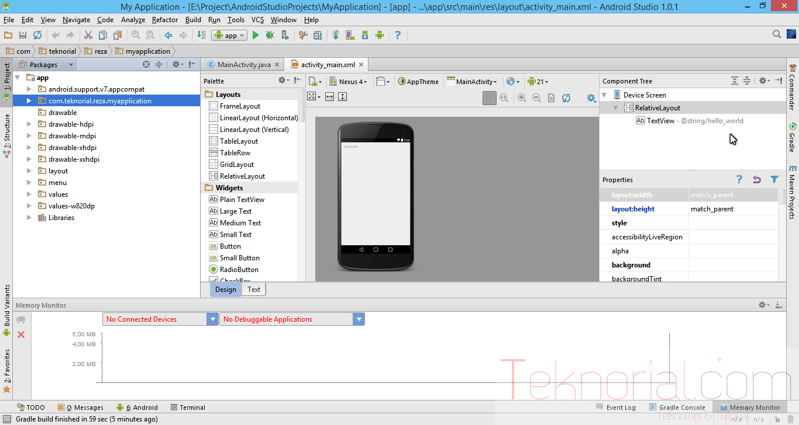
Android Activities
(2/24)
Tampilan Android Studio
blog.teknorial.com
2
2
Telkom University
2
Bandung, 12 Desember 2018
2
2
Notes:
This is my presentation outline

Slide 3
Android Activities
(3/24)
Single, focused thing that the user can do
Presented to the user as full-screen windows
Consider each Activity both a screen and a feature
Apps can activate Activities in other Apps
3
2
Telkom University
3
Bandung, 12 Desember 2018
3
3
Notes:
This is my presentation outline

Slide 4
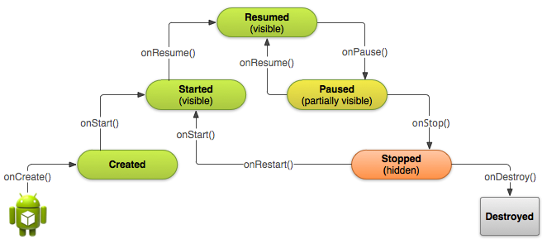
The App Lifecycle
(4/24)
4
2
Telkom University
4
Bandung, 12 Desember 2018
4
4
Notes:
This is my presentation outline

Slide 5
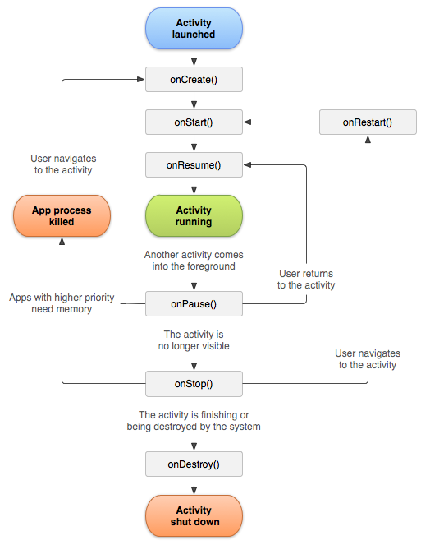
The Activity Lifecycle
(5/24)
If there is an activity is in the foreground of the screen (at the top of the stack), it is currently active
If there is an activity has lost its focus but still visible (transparent activity or non full-sized activity), it will be paused.
If there is an activity is completely obscured by another activity, it will be stopped.
If there is an paused activity or stopped activity, those activities will be terminating by system by asking it to finish, or killing its own process.
5
2
Telkom University
5
Bandung, 12 Desember 2018
5
5
Notes:
This is my presentation outline

Slide 6
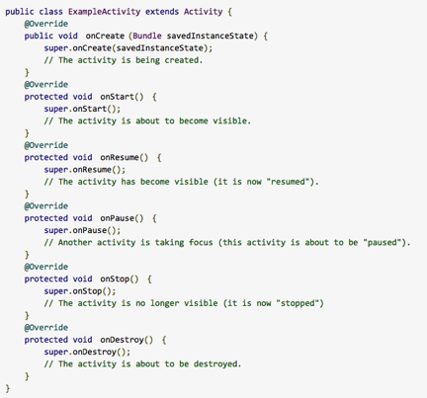
Lifecycle Callbacks
(6/24)
Make sure to make the correct calls in the correct methods!
If you do everything in onCreate(), then problems could occur when you switch
On a device rotation, onDestroy() / onCreate() is called
Consider saving state using onSaveInstanceState() to retain App state between switching
6
2
Telkom University
6
Bandung, 12 Desember 2018
6
6
Notes:
This is my presentation outline

Slide 7
Starting Activities
(7/24)
All activities must be stated in the androidmanifest.xml file.
You may start an activity that lets the user pick a person in a list of contacts; when it ends, it returns the person that was selected. To do this, you call the startActivityForResult(Intent, int) version with a second integer parameter identifying the call. The result will come back through your onActivityResult(int, int, Intent) method.
When an activity exits, it can call setResult(int) to return data back to its parent. It must always supply a result code, which can be the standard results RESULT_CANCELED, RESULT_OK, or any custom values starting at RESULT_FIRST_USER.
public class MyActivity extends Activity {
...
static final int PICK_CONTACT_REQUEST = 0;
public boolean onKeyDown(int keyCode, KeyEvent event) {
if (keyCode == KeyEvent.KEYCODE_DPAD_CENTER) {
// When the user center presses, let them pick a contact.
startActivityForResult(
new Intent(Intent.ACTION_PICK,
new Uri("content://contacts")),
PICK_CONTACT_REQUEST);
return true;
}
return false;
}
protected void onActivityResult(int requestCode, int resultCode,
Intent data) {
if (requestCode == PICK_CONTACT_REQUEST) {
if (resultCode == RESULT_OK) {
// A contact was picked. Here we will just display it
// to the user.
startActivity(new Intent(Intent.ACTION_VIEW, data));
}
}
}
}
7
2
Telkom University
7
Bandung, 12 Desember 2018
7
7
Notes:
This is my presentation outline

Slide 8

Launching a New Activity
(8/24)
The launch a new activity, you have create an Intent for that Activity.
8
2
Telkom University
8
Bandung, 12 Desember 2018
8
8
Notes:
This is my presentation outline

Slide 9
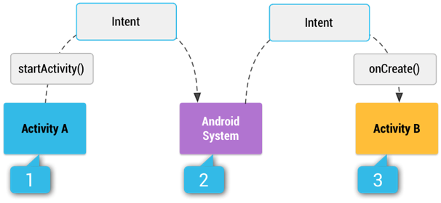
The Intent Lifecycle
(9/24)
https://cs4720.cs.virginia.edu
9
2
Telkom University
9
Bandung, 12 Desember 2018
9
9
Notes:
This is my presentation outline

Slide 10
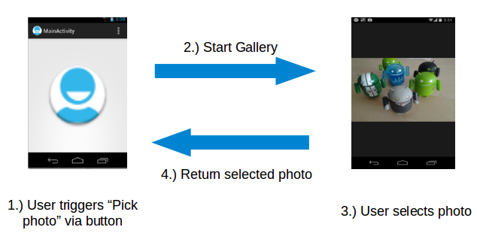
What is Intents?
(10/24)
It can be used with startActivity to launch an Activity.
An Intent is a message package that is used to request services / information from other components in the Android system.
In Android the reuse of other application components is a concept known as task. An application can access other Android components to achieve a task. For example, from a component of your application you can trigger another component in the Android system, which manages photos, even if this component is not part of your application
http://www.vogella.com
10
2
Telkom University
10
Bandung, 12 Desember 2018
10
10
Notes:
This is my presentation outline

Slide 11
Explicit Intents
(11/24)
Explicit intents explicitly define the component which should be called by the Android system, by using the Java class as identifier. Explicit intents are typically used within an application as the classes in an application are controlled by the application developer. The following shows how to create an explicit intent and send it to the Android system to start an activity.
The following shows how to create an explicit intent and send it to the Android system to start an activity.
Intent i = new Intent(this, ActivityTwo.class);
i.putExtra("Value1", "This value one for ActivityTwo ");
i.putExtra("Value2", "This value two ActivityTwo");
11
2
Telkom University
11
Bandung, 12 Desember 2018
11
11
Notes:
This is my presentation outline

Slide 12
Implicit Intents
(12/24)
Implicit intents specify the action which should be performed and optionally data which provides content for the action. If an implicit intent is sent to the Android system, it searches for all components which are registered for the specific action and the fitting data type. If only one component is found, Android starts this component directly.
For example, the following tells the Android system to view a webpage. All installed web browsers should be registered to the corresponding intent data via an intent filter.
Intent i = new Intent(Intent.ACTION_VIEW, Uri.parse("http://www.vogella.com"));
startActivity(i);
12
2
Telkom University
12
Bandung, 12 Desember 2018
12
12
Notes:
This is my presentation outline

Slide 13
Fragments
(13/24)
The FragmentActivity subclass can make use of the Fragment class to better modularize their code, build more sophisticated user interfaces for larger screens, and help scale their application between small and large screens.
A fragment its own views, layout, and lifecycle.
If you take a look at a fragment, it is almost the same as an activity
You have to state a fragment in the layout of activity if you want to add a fragment.
13
2
Telkom University
13
Bandung, 12 Desember 2018
13
13
Notes:
This is my presentation outline

Slide 14
Android Service
(14/24)
Application component that can perform long-running operations in the background, and it doesn't provide a user interface.
A background service performs an operation that isn't directly noticed by the user. For example, if an app used a service to compact its storage, that would usually be a background service.
A foreground service performs some operation that is noticeable to the user. For example, an audio app would use a foreground service to play an audio track.
14
2
Telkom University
14
Bandung, 12 Desember 2018
14
14
Notes:
This is my presentation outline

Slide 15
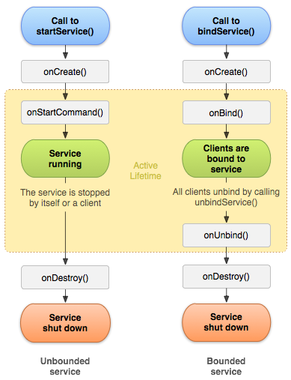
Android Service Lifecycle
(15/24)
https://developer.android.com
15
2
Telkom University
15
Bandung, 12 Desember 2018
15
15
Notes:
This is my presentation outline

Slide 16
Callback Method
(16/24)
To create a service, you must create a subclass of Service or use one of its existing subclasses. These are the most important callback methods that you should override:
onStartCommand() -- The system invokes this method by calling startService() when another component (such as an activity) requests that the service be started.
onBind() -- The system invokes this method by calling bindService() when another component wants to bind with the service (such as to perform RPC).
onCreate() -- The system invokes this method to perform one-time setup procedures when the service is initially created (before it calls either onStartCommand() or onBind()).
onDestroy() -- The system invokes this method when the service is no longer used and is being destroyed. Your service should implement this to clean up any resources such as threads, registered listeners, or receivers. This is the last call that the service receives.
16
2
Telkom University
16
Bandung, 12 Desember 2018
16
16
Notes:
This is my presentation outline

Slide 17
Differences Between Intents and Service (1)
(17/24)
When to use?
The Service can be used in tasks with no UI, but shouldn't be too long. If you need to perform long tasks, you must use threads within Service.
The IntentService can be used in long tasks usually with no communication to Main Thread. If communication is required, can use Main Thread handler or broadcast intents. Another case of use is when callbacks are needed (Intent triggered tasks).
How to trigger?
The Service is triggered by calling method startService().
The IntentService is triggered using an Intent, it spawns a new worker thread and the method onHandleIntent()is called on this thread.
17
2
Telkom University
17
Bandung, 12 Desember 2018
17
17
Notes:
This is my presentation outline

Slide 18
Differences Between Intents and Service (2)
(18/24)
Runs On
The Service runs in background but it runs on the Main Thread of the application.
The IntentService runs on a separate worker thread.
Limitations / Drawbacks
The Service may block the Main Thread of the application.
The IntentService cannot run tasks in parallel. Hence all the consecutive intents will go into the message queue for the worker thread and will execute sequentially.
18
2
Telkom University
18
Bandung, 12 Desember 2018
18
18
Notes:
This is my presentation outline

Slide 19
Differences Between Intents and Service (3)
(19/24)
When to stop?
If you implement a Service, it is your responsibility to stop the service when its work is done, by calling stopSelf() or stopService(). (If you only want to provide binding, you don't need to implement this method).
The IntentService stops the service after all start requests have been handled, so you never have to call stopSelf().
19
2
Telkom University
19
Bandung, 12 Desember 2018
19
19
Notes:
This is my presentation outline

Slide 20
Android Data Management
(20/24)
What apps you usually use almost everyday?
  Browser (Chrome, Firefox, Opera)
  Office Suite
  Games
  Spesific software (Netbeans, Matlab, etc.)
20
2
Telkom University
20
Bandung, 12 Desember 2018
20
20
Notes:
This is my presentation outline

Slide 21
The Sandbox
(21/24)
iOS and Android are built in UNIX
Each app runs on its own sandbox
Sandbox contains the files and also folders that the app allowed
All resource files have to stored in these folders.
21
2
Telkom University
21
Bandung, 12 Desember 2018
21
21
Notes:
This is my presentation outline

Slide 22
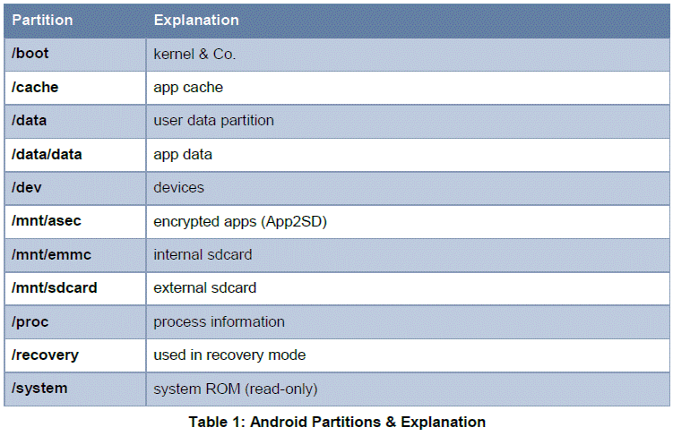
Android File System
(22/24)
dataforensics.org/android-phone-forensics-analysis/
22
2
Telkom University
22
Bandung, 12 Desember 2018
22
22
Notes:
This is my presentation outline

Slide 23
Android Storage
(23/24)
Core Data: SQLite DB built into every app
Language Specific: FileInputStream and FileOutputStream
Network: Web services, network DBs, etc.
Key-Value: SharedPreferences
23
2
Telkom University
23
Bandung, 12 Desember 2018
23
23
Notes:
This is my presentation outline

Slide 24
THANK YOU
24
2
Telkom University
24
Bandung, 12 Desember 2018
24
24
Notes:
This is my presentation outline

