Slide 1

ANDROID DEVELOPMENT WITH JAVA I
Course: Mobile Application
Instructor:
Suryo Adhi Wibowo, S.T., M.T., Ph.D.
Rissa Rahmania, S.T., M.T.
Gelar Budiman, S.T., M.T.
Research Center for Advanced Wireless Technologies (AdWiTech),
School of Electrical Engineering, Telkom University
Telkom University
1
Bandung, 12 Desember 2018
1
Notes:
Bismillahirrahmanirrahiim
Assalamualaykum wr.wb
Good morning everyone.
My name is Siti Hartinah
Today I would like to present my joined work with Hario Prakoso and Dr. Eng. Khoirul Anwar
With the title is -------This research was (sebutin projek atas)

Slide 2
The Android Architecture
(2/17)
Application
Home
Contacts
Phone
Browser
…
Application Framework
Activity Manager
Window
Manager
Content Provider
View System
Package Manager
Telephony
Manager
Resource
Manager
Location Manager
Notification Manager
Libraries
Android Runtime
Surface Manager
Media Framework
SQL Lite
Core Libraries
OpenGL | ES
Freetype
Webkit
Dalvik Virtual Machine
SGL
SSL
libc
Linux Kernel
Display Driver
Camera Driver
Flash Memory Driver
Binder (PC) Driver
Keypad Driver
WiFi Driver
Audio Drivers
Power Management
2
2
Telkom University
2
Bandung, 12 Desember 2018
2
2
Notes:
This is my presentation outline

Slide 3
Main Components
(3/17)
Activities – represent a single screen with a UI
Services – represents a process running in the background
Content Provider – a link back to the data
Broadcast Receiver – listens for system-wide messages to respond to
Application – a set of Activities that make up a cohesive unit
Intent – a message to be passed
3
2
Telkom University
3
Bandung, 12 Desember 2018
3
3
Notes:
This is my presentation outline

Slide 4
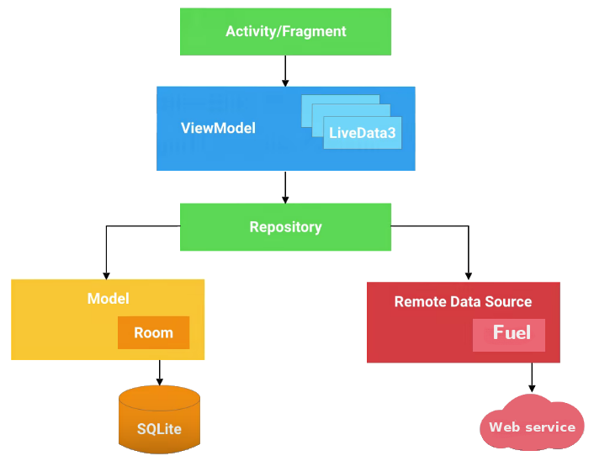
MVVM Components
(4/17)
Model-View-ViewModel with Android Architecture Components
Display data and
forward on UI events
UI is notified of changes using observation
Holds all of the data
needed for the UI
Single source of truth for all app data, clean API for UI to communicate with
Manage local data SQLite data source, using objects
Manage cloudservice
4
2
Telkom University
4
Bandung, 12 Desember 2018
4
4
Notes:
This is my presentation outline

Slide 5
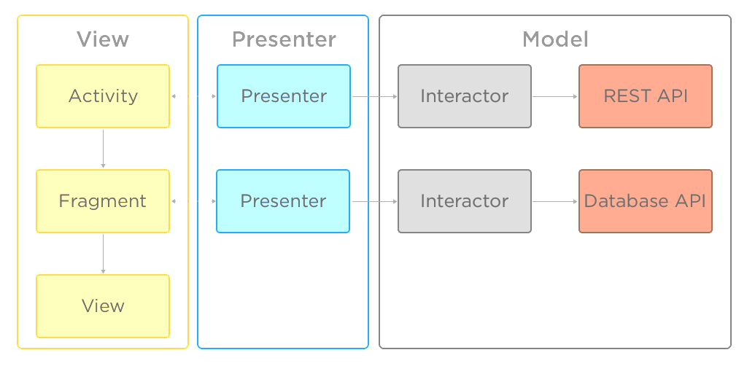
MVP Components
(5/17)
Model-View-Presenter with Android Architecture Components
View — basically a passive interface cum UI which is responsible for routing user’s action to the presenter.
Presenter — Presenter is the middleman or mediator between View and Model which hold responsibilities of everything which has to deal with presentation logic in your application.
Model — is where your business logic and application data is stored.
https://android.jlelse.eu
5
2
Telkom University
5
Bandung, 12 Desember 2018
5
5
Notes:
This is my presentation outline

Slide 6
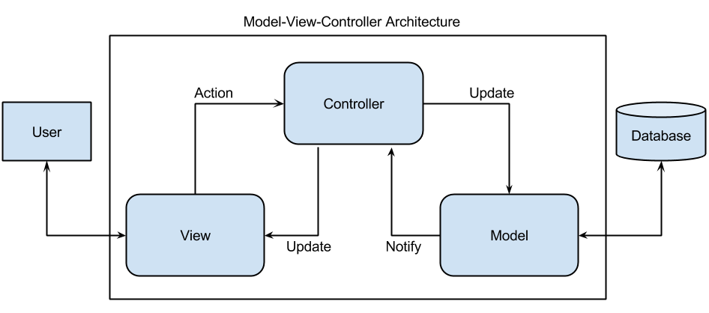
MVC Components
(6/17)
View – provides the interaction that the user sees (typically, a web page). The view components provide data to the user and send actions to the Controller for manipulating data.
Model – defines the data for the application (typically, the data is stored in a database).
Controller – basically, provides the interface between the View and the Model.
patricksoftwareblog.com
6
2
Telkom University
6
Bandung, 12 Desember 2018
6
6
Notes:
This is my presentation outline

Slide 7
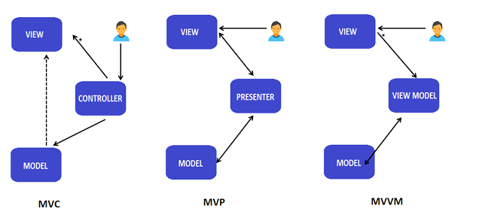
MVVM Compared to MVC and MVP
(7/17)
medium.com/@ankit.sinhal
MVC: Three components – View (your UI), Model (your business entities / data – that view is displaying) & Controller (contains the logic that alters the model depending on the action triggered by UI, typically implementing a Use Case).
MVP: Again three components. But dependencies change (look at arrows in the diagram). Over here we replace Controller with Presenter (one which presents the changes done in model back to view).
MVVM: Model–View-ViewModel talks of creating a new model (in addition to your domain model). This model normally adds additional properties from the prespective of View (as we understand that View has controls in addition to data which it’s displaying).
7
2
Telkom University
7
Bandung, 12 Desember 2018
7
7
Notes:
This is my presentation outline

Slide 8
Tying it all Together
(8/17)
If an App is made up of all these disparate parts, what holds them all together?
The AndroidManifest.xml file!
  Sets up all permissions the user has to agree to (i.e. Internet, GPS, contacts, etc.)
  Declares the API level of the App
  Requests hardware features needed
  Needed libraries
  Which Activities are part of this App
8
2
Telkom University
8
Bandung, 12 Desember 2018
8
8
Notes:
This is my presentation outline

Slide 9
What about the other stuff?
(9/17)
Typically referred to as “assets,” anything that isn’t code is placed in the res/ folder
Music
Images
Some static data files
Where’s the UI?
The User Interface for an Android App is defined in the layout xml files
Each layout xml file should correspond to an Activity
9
2
Telkom University
9
Bandung, 12 Desember 2018
9
9
Notes:
This is my presentation outline

Slide 10


What is Android Studio
(10/17)
Android focused IDE (designed spesifically for Android development)
Similar to Eclipse with ADT Plug-in
Contains All the Android SDK Tools to design, test, debug, and profile your app
Some static data files
New Android development environment based on IntelliJ IDEA
is based on
10
2
Telkom University
10
Bandung, 12 Desember 2018
10
10
Notes:
This is my presentation outline

Slide 11
Features of Android Studio
(11/17)
Powerful code editing (smart editing, code refactoring)
Rich layout editor
Gradle-based build support
Maven support
Template based wizards
Lint tool analysis
Easy access to Google service (e.g GCM)
11
2
Telkom University
11
Bandung, 12 Desember 2018
11
11
Notes:
This is my presentation outline

Slide 12

Gradle Build System
(12/17)
Gradle is an advanced build management system based on Groovy
It is an open source build system
Combines the power of Ant and Maven
12
2
Telkom University
12
Bandung, 12 Desember 2018
12
12
Notes:
This is my presentation outline

Slide 13
Features & Benefits of Gradle
(13/17)
Dependency Management – Flexible approach to dependency management that can reuse existing maven repositories or reference local JARs)
A single build system – Gradle is the authoritative build across the IDE and the command-line)
Product Flavors – Free & paid version
Build variants – Playstore or Amazon or any other stores
Build type – Debug, QA, release
Binary Bundles for Libraries (.aar) – Gradle supports the new .aar binary bundle format for the library project
13
2
Telkom University
13
Bandung, 12 Desember 2018
13
13
Notes:
This is my presentation outline

Slide 14




Dependency Management
(14/17)
Ant
Source code files and lib are stored together
turns into
compiled with
14
2
Telkom University
14
Bandung, 12 Desember 2018
14
14
Notes:
This is my presentation outline

Slide 15


Dependancy Management
(15/17)
Maven Builds
Source code files and lib are stored together
Maven Central Repository
compiled
with
read pom.xml
Get dependencies
turns into
All sources and JARs turn into APK
15
2
Telkom University
15
Bandung, 12 Desember 2018
15
15
Notes:
This is my presentation outline

Slide 16


Dependancy Management
(16/17)
Gradle Builds
Source code files and lib are stored together
Maven Central Repository
Local files
Project itself
ANDROID APK
All sources and Jars are combined into APK
Debug
QA
Release
2
Telkom University
16
Bandung, 12 Desember 2018
16
16
Notes:
This is my presentation outline

Slide 17
THANK YOU
17
2
Telkom University
17
Bandung, 12 Desember 2018
17
17
Notes:
This is my presentation outline

