Slide 1
Capital Budgeting

Slide 2

Definition of Capital Budgeting
Capital budgeting is the process of determining and selecting the most profitable long-term projects.
Long-term asset purchase planning process.
Example:
The company wants to determine whether to undertake a project to purchase a new machine for.
How to decide?
Will the machine be profitable?
Will the company get a high return on investment?

Slide 3

Project Types
1
Mutually Exclusive
Only one project will be accepted, others rejected
2
Independent Project
Projects are not interconnected so they can be selected or rejected

Slide 4
Project Classifications
Replacement Decision
Expansion
Security and/or environmental projects
To maintain business, there is no need to do detailed analysis
For cost reduction, more detailed analysis is needed
Into existing products or markets, detailed analysis is needed
New products or markets. Complex, requires detailed analysis
That usually accompany new investments or projects

Slide 5



Capital Budgeting Stages
01
Cash Flow Evaluation
02
Deciding to Accept/Reject The Project

Slide 6
Capital Budgeting Stages
Initial Cashflow
What is the cash flow at “time 0?”
Represents the cash flow that occurs when the investment is made, such as the cost of building a new installation unit until it is ready to operate, consisting of:
Pre-construction costs
Purchase of materials and equipment
Construction
Start-up
Working capital
01
Cash Flow Evaluation

Slide 7
Capital Budgeting Stages
b) Operational Cash Flows
Represents cash flow generated from project operations.
In operating cash flow is taken into account:
Cash inflow from product sales
Cash outflow for cash operating expenses and depreciation.
01
Cash Flow Evaluation
If the funds for investment come from their own capital
Operating Cash Flow = EAT + Depreciation
If the funds for investment come partly from loans:
Operating Cash Flow = EAT + Depreciation + Interest (1 – T)

Slide 8
Capital Budgeting Stages
c) Terminal Cash Flow
How much cash flow at the end of the project?
Is the cash flow that occurs at the end of the project, which consists of:
01
Salvage Value , the estimated selling price of fixed assets at the end of the project life.
Working Capital Recovery (Capital Recovery), the return of working capital needed at the beginning of the project or during the life of the project because when the project ends the working capital is no longer needed.
Cash Flow Evaluation
Formula :
Salvage value
+/- Tax impact on capital gain/loss
+ Return of net working capital
Cash Flow Terminals

Slide 9
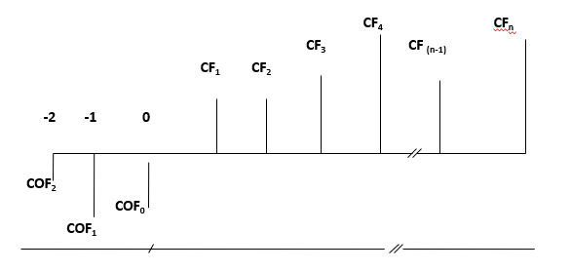
Capital Budgeting Diagram
Initial Outlay
Annual Cash Flow
Terminal Cash Flow
CO = Cash Out Flow CF = Cash Flow

Slide 10

Capital Budgeting Stages
Initial Cash Flow
Operational Cash Flow
Terminal Cash Flow
Purchase of new assets
Capitalized expenses (transportation, insurance, etc.)
Working capital
Income
Operating Expenses
Depreciation
EBIT ( e –f –g )
Interest
EBT ( h – i )
Tax
EAT ( j – k )
Depreciation
Interest (1-T)
Salvage value
Tax on Salvage Value
Working Capital Recovery
Total Initial Cash Flow (a + b + c)
Total Operational Cash Flow (l + m + n)
Total Terminal Cash Flow
(p – q + r)
Net Cash Flow ( d + o + s )

Slide 11
Capital Budgeting Stages
Example :
Expenditures for working capital are made when the investment will start and the source of capital comes from own capital.
Expenditures for working capital are carried out during the life of the project and the source of capital comes from own capital and loans from banks
1
2

Slide 12
Description | 0 | 1 | 2 | 3 | 4 | 5 | 6
Initial Cash Flow : Machine Purchase Price B. Transportation & Installation Working capital Total Initial Cash Flow Operating Cash Flow: Income Operating Expenses : - Cash - Depreciation Expense Total Operating Cost Operating Profit (EBIT) Interest EBT Tax (25%) Net Profit (EAT) Depreciation Expense Total Operating Cash Flow Terminal Cash Flow : Salvage value Tax (25%) Salvage Value After Tax Working Capital Recovery Terminal Cash Flow Total NET CASH FLOW | 860 40 60 960 (960) | 480 250 150 400 80 0 80 20 60 150 210 210 | 500 260 150 410 90 0 90 22,5 67,5 150 217,5 217,5 | 530 270 150 420 110 0 110 27,5 82,5 150 232,5 232,5 | 550 280 150 430 120 0 120 30 90 150 240 240 | 580 300 150 450 130 0 130 32,5 97,5 150 247,5 247,5 | 610 310 150 460 150 0 150 37,5 112,5 150 262,5 72 18 54 60 114 376,5
1
Expenditures for working capital are made when the investment will start and the source of capital comes from own capital.

Slide 13
Description | 0 | 1 | 2 | 3 | 4 | 5
Initial Cash Flow : Machine Purchase Price Operating Cash Flow: Income Operating Expenses : - Cash Depreciation Expense Total Operating Cost Operating Profit (EBIT) Interest EBT Tax (25%) Net Profit (EAT) Depreciation Expense Interest (1- 25%) Working capital Total Operating Cash Flow Terminal Cash Flow : Salvage value Tax (25%) Salvage Value After Tax Working Capital Recovery Terminal Cash Flow Total NET CASH FLOW | 350.000 (350.000) | 500.000 325.000 70.000 395.000 105.000 10.000 95.000 23.750 71.250 70.000 7.500 - 20.000 128.750 128.750 | 550.000 350.000 70.000 420.000 130.000 8.362 121.638 30.410 91.228 70.000 6.272 -5.000 162.500 162.500 | 605.000 377.500 70.000 447.500 157.500 6.559 150.941 37.735 113.206 70.000 4.919 -8.000 180.125 180.125 | 665.500 407.750 70.000 477.750 187.750 4.557 183.193 45.798 137.395 70.000 3.412 -10.000 200.807 200.807 | 732.050 441.025 70.000 511.025 221.025 2.396 218.629 54.657 163.972 70.000 1.797 -15.000 220.769 150.000 37.500 112.500 58.000 170.500 391.269
2
Expenditures for working capital are carried out during the life of the project and the source of capital comes from own capital and loans from banks

Slide 14

Capital Budgeting Decision Method
Analysis
PBP
DCF
Discounted
NPV
IRR
Reguler
PI
MIRR

Slide 15
Capital Budgeting Decision Method
Example:
A manufacturer considers a proposed investment of $10,000 with no salvage value that can generate annual cash flows of $2000, $3000, $4000 and $5000 over 4 years, respectively. Assuming the required rate of return (cost of capital) is 10%.
By using capital budgeting methods, is the project accepted or rejected?
After-tax FCF
Year | After-tax FCF
0 | (10.000)
1 | 2.000
2 | 3.000
3 | 4.000
4 | 5.000
Year

Slide 16
Capital Budgeting Decision Method
To determine which project to choose, the company must have a benchmark.
Reguler PayBack Period
DEFINITION
DECISION RULE
The number of years required to recover the initial investment cost
The shorter the payback period, the better
If
Payback ≤ Payback Benchmark
The project is accepted
If
Payback > Payback Benchmark
The project is rejected

Slide 17

Capital Budgeting Decision Method
Reguler PayBack Period
Year | After-tax FCF | Cumulative Inflow
0 | (10.000) (b) | 0
1 | 2.000 | 2.000
2 | 3.000 | 5.000
3 (a) | 4.000 | 9.000 (c)
4 | 5.000 (d) | 14.000
$$PBP=3+\frac{\left(10.000−9000\right)}{5000}$$
= 3,4 𝑦𝑒𝑎𝑟
If the Benchmark, which the company expects to be 4 years, is the project accepted or rejected? YES
Because Payback Payback ≤ benchmark, the project is accepted

Slide 18


Capital Budgeting Decision Method
Discounted PayBack Period
Improvement of the payback period method
Discount the estimated cash flow using the company's cost of capital

Slide 19

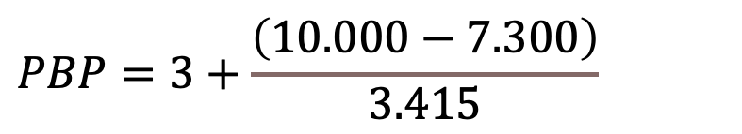
Capital Budgeting Decision Method
Discounted PayBack Period
Year | After-tax FCF | PVIF_{10%,n} | Discounted FCF | Cumulative Disc. FCF
0 | (10.000) (b)
1 | 2.000 | 0.909 | 1.818 | 1.818
2 | 3.000 | 0.826 | 2.478 | 4.296
3 (a) | 4.000 | 0.751 | 3.004 | 7.300 (c)
4 | 5.000 | 0.683 | 3.415 (d) | 10.715
$$PBP=3+\frac{\left(10.000−7.300\right)}{3.415}$$
$$=3,79 year$$
If the Benchmark, which the company expects to be 4 years, is the project accepted or rejected? YES
Payback ≤ benchmark → Accept the project

Slide 20

Capital Budgeting Decision Method
Net Present Value NPV
Criterion
If
NPV ≥ 0
If
NPV ˂ 0
FCF = the annual cash flow in time period t
k = the appropriate discount rate or cost of capital
IO = initial cash outlay (initial cashflow)
n = the project’s expected life
Accept
the project
Reject
the project

Slide 21
Capital Budgeting Decision Method
Net Present Value - NPV
Year | After-tax FCF | PVIF_{10%,n} | Discounted FCF | Cumulative Disc. FCF
0 | (10.000)
1 | 2.000 | 0.909 | 1.818 | 1.818
2 | 3.000 | 0.826 | 2.478 | 4.296
3 | 4.000 | 0.751 | 3.004 | 7.300
4 | 5.000 | 0.683 | 3.415 | 10.715
NPV = 10.715 – 10.000
= 715
NPV ≥ 0 → Accept the project

Slide 22
Capital Budgeting Decision Method
Profitability Index - PI
Criterion
If
PI ≥ 1,0
If
PI ˂ 1,0
PI = profitability index
FCF = free cash flow
k = discount rate
IO = initial cash outlay (initial cashflow)
Accept
the project
Reject
the project

Slide 23
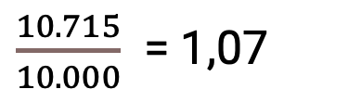
Capital Budgeting Decision Method
Profitability Index - PI
Year | After-tax FCF | PVIF_{10%,n} | Discounted FCF | Cumulative Disc. FCF
0 | (10.000)
1 | 2.000 | 0.909 | 1.818 | 1.818
2 | 3.000 | 0.826 | 2.478 | 4.296
3 | 4.000 | 0.751 | 3.004 | 7.300
4 | 5.000 | 0.683 | 3.415 | 10.715
$\frac{10.715}{10.000}$ = 1,07
PI =
PI ≥ 1,0→ Accept the project

Slide 24
Capital Budgeting Decision Method
Internal Rate of Return - IRR
Criterion
If
IRR ≥ k
If
IRR ˂ k
FCF = Free cash flow
IO = Initial outlay (Initial cashflow)
IRR = Internal rate of return
Accept
the project
Reject
the project

Slide 25
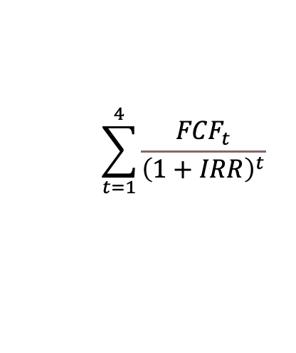
Capital Budgeting Decision Method
Internal Rate of Return - IRR
Year | After-tax FCF
0 | (10.000)
1 | 2.000
2 | 3.000
3 | 4.000
4 | 5.000
$$\sum_{t=1}^{4}{\frac{{FCF}_{t}}{{\left(1+IRR\right)}^{t}}}$$
10.000 =
IRR ? By Interpolation

Slide 26
Capital Budgeting Decision Method
Internal Rate of Return – 3 simple step
At 10% discount rate, PV of cash inflow = $10.715. So, 10% will be our lower limit.
To make PV < Initial Outlay, the discount rate must be higher than 10%, say 15%. Then, calculate the PV of cash inflow at 15% discount rate.
Then estimate the IRR by interpolating the data
Discount rate | PV of cash inflow
10% | 10.715
IRR = ? | 10.000
15% | 9.500

Slide 27


Capital Budgeting Decision Method
Internal Rate of Return – 3 simple step
Discount rate | PV of cash inflow
10% | 10.715
IRR = ? | 10.000
15% | 9.500
X
715
5%
1.215
IRR (12,94%) ˃ k (10%) → Accept the project

Slide 28
Capital Budgeting Decision Method
Modified Internal Rate of Return- MIRR
Criterion
If
MIRR ≥ required rate of return
If
MIRR ˂ required rate of return
ACOF = annual cash outflow in period t
ACIF = annual cash inflow in period t
TV = terminal value of ACIF
n = project’s expected life
k = required rate of return or discount rate
Accept
the project
Reject
the project

Slide 29
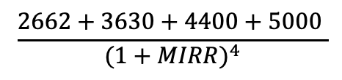

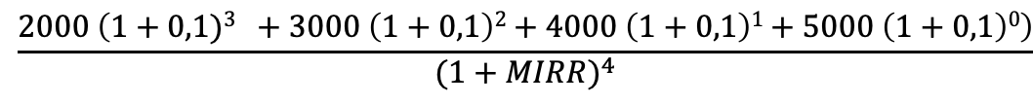



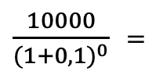


Capital Budgeting Decision Method
Modified Internal Rate of Return- MIRR
Year | After-tax FCF
0 | (10.000)
1 | 2.000
2 | 3.000
3 | 4.000
4 | 5.000
$\frac{10000}{{(1+0,1)}^{0}}$ =
$$\frac{2000 \left(1+0,1)3 +3000 \left(1+0,1\right)2+4000 \left(1+0,1\right)1+5000 \left(1+0,1\right)0\right)}{{(1+MIRR)}^{4}}$$
10.000 =
$$\frac{2662+3630+4400+5000 }{{(1+MIRR)}^{4}}$$
= $\frac{15692 }{{(1+MIRR)}^{4}}$
$${(1+MIRR)}^{4}$$
= $\frac{15692 }{10.000}$
MIRR = 1,12 -1 = 0,12 = 12 %
$$\text{=} \sqrt[4]{\frac{15692}{10.000}}$$
MIRR (12%) ≥ required rate of return (10%) → Accept the project
$$\left(1+MIRR\right)$$
$$\left(1+MIRR\right)$$
= 1,12

