Slide 1

Introduction to Android
Course: Mobile Application
Instructor:
Suryo Adhi Wibowo, S.T., M.T., Ph.D.
Rissa Rahmania, S.T., M.T.
Gelar Budiman, S.T., M.T.
Research Center for Advanced Wireless Technologies (AdWiTech),
School of Electrical Engineering, Telkom University
Telkom University
1
Bandung, 12 Desember 2018
1
Notes:
Bismillahirrahmanirrahiim
Assalamualaykum wr.wb
Good morning everyone.
My name is Siti Hartinah
Today I would like to present my joined work with Hario Prakoso and Dr. Eng. Khoirul Anwar
With the title is -------This research was (sebutin projek atas)

Slide 2
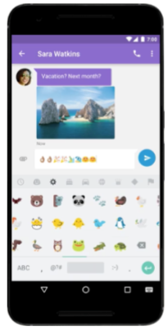
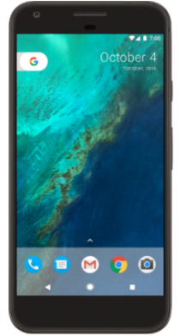
What is Android?
(2/10)
Android is an operating system and programming platform developed by Google for smartphones and other mobile devices (such as tablets). It can run on many different devices from many different manufacturers.
Android includes a software development kit for writing original code and assembling software modules to create apps for Android users. It also provides a marketplace to distribute apps. All together, Android represents an ecosystem for mobile apps.
Why Develop apps for Android?
Addressing business requirements
Building new services
Creating new business
Providing games and other types of content for users
Source: https://google-developer-training.gitbooks.io/android-developer-fundamentals-course-concepts/content/en/Unit%201/10_c_intro_to_android.html
2
2
Telkom University
2
Bandung, 12 Desember 2018
2
2
Notes:
This is my presentation outline

Slide 3
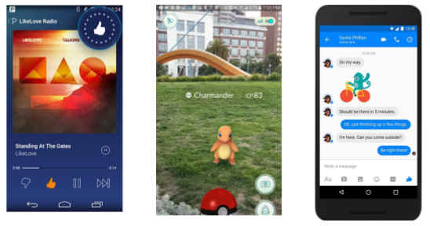
Android: Most popular platform for mobile apps
(3/10)
Android powers hundreds of millions of mobile devices in more than 190 countries around the world. It has the largest installed base of any mobile platform and is still growing fast. Every day another million users power up their Android devices for the first time and start looking for apps, games, and other digital content.
Source: https://google-developer-training.gitbooks.io/android-developer-fundamentals-course-concepts/content/en/Unit%201/10_c_intro_to_android.html
3
2
Telkom University
3
Bandung, 12 Desember 2018
3
3
Notes:
This is my presentation outline

Slide 4
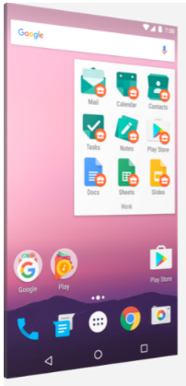
Android: Best experience for app users
(4/10)
Android provides a touch-screen user interface (UI) for interacting with apps.
  based on direct manipulation, using touch gestures such as swiping, tapping and pinching to manipulate on-screen objects.
  Keyboard: customizable virtual keyboard for text input, game controllers and full-size physical keyboards connected by Bluetooth or USB.
Home screen: contain several pages of app icons, which launch the associated apps, and widgets, which display live, auto-updating content such as the weather, the user's email inbox or a news ticker. Android can also play multimedia content such as music, animation, and video.
  made up of several pages, between which the user can swipe back and forth.
Source: https://google-developer-training.gitbooks.io/android-developer-fundamentals-course-concepts/content/en/Unit%201/10_c_intro_to_android.html
4
2
Telkom University
4
Bandung, 12 Desember 2018
4
4
Notes:
This is my presentation outline

Slide 5
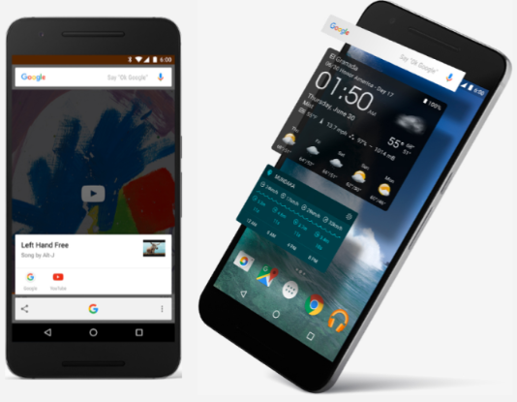
Android: Best experience for app users
(5/10)
Provide immediate response to user input.
  The vibration capabilities of an Android device can provide haptic feedback. Internal hardware such as accelerometers, gyroscopes and proximity sensors, are used by many apps to respond to additional user actions.
  Sensors can detect rotation of the screen from portrait to landscape for a wider view or it can allow the user to steer a virtual vehicle in a racing game by rotating the device as if it were a steering wheel.
The Android platform, based on the Linux kernel, is designed primarily for touchscreen mobile devices such as smartphones and tablets.
Since Android devices are usually battery-powered, Android is designed to manage processes to keep power consumption at a minimum, providing longer battery use.
Source: https://google-developer-training.gitbooks.io/android-developer-fundamentals-course-concepts/content/en/Unit%201/10_c_intro_to_android.html
5
2
Telkom University
5
Bandung, 12 Desember 2018
5
5
Notes:
This is my presentation outline

Slide 6
Android: Easy to develop apps
(6/10)
Use the Android software development kit (SDK) to develop apps that take advantage of the Android operating system and UI. The SDK includes a comprehensive set of development tools including a debugger, software libraries of prewritten code, a device emulator, documentation, sample code, and tutorials.
To develop apps using the SDK, use the Java programming language for developing the app and Extensible Markup Language (XML) files for describing data resources.
To help you develop your apps efficiently, Google offers a full Java Integrated Development Environment (IDE) called Android Studio, with advanced features for developing, debugging, and packaging Android apps. Using Android Studio, you can develop on any available Android device, or create virtual devices that emulate any hardware configuration.
Source: https://google-developer-training.gitbooks.io/android-developer-fundamentals-course-concepts/content/en/Unit%201/10_c_intro_to_android.html
6
2
Telkom University
6
Bandung, 12 Desember 2018
6
6
Notes:
This is my presentation outline

Slide 7
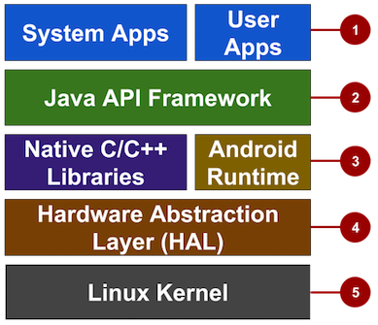
Android: Easy to develop apps
(7/10)
The following diagram shows the major components of the Android stack — the operating system and development architecture.
Apps: Your apps live at this level, along with core system apps for email, SMS messaging, calendars, Internet browsing, or contacts.
Java API Framework: All features of Android are available to developers through application programming interfaces (APIs) written in the Java language.
Libraries and Android Runtime: Each app runs in its own process and with its own instance of the Android Runtime, which enables multiple virtual machines on low-memory devices.
Hardware Abstraction Layer (HAL): This layer provides standard interfaces that expose device hardware capabilities to the higher-level Java API framework.
Linux Kernel: Using a Linux kernel enables Android to take advantage of key security features and allows device manufacturers to develop hardware drivers for a well-known kernel.
Source: https://google-developer-training.gitbooks.io/android-developer-fundamentals-course-concepts/content/en/Unit%201/10_c_intro_to_android.html
7
2
Telkom University
7
Bandung, 12 Desember 2018
7
7
Notes:
This is my presentation outline

Slide 8
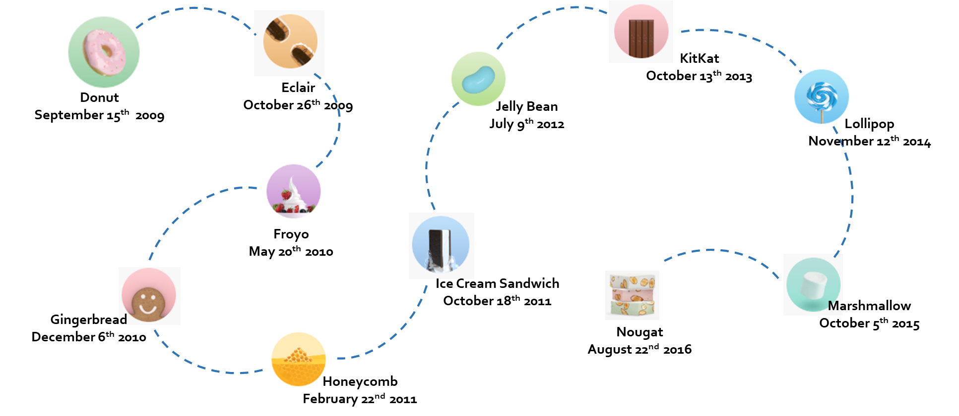
Android Versions
(8/10)
Source: https://google-developer-training.gitbooks.io/android-developer-fundamentals-course-concepts/content/en/Unit%201/10_c_intro_to_android.html
8
2
Telkom University
8
Bandung, 12 Desember 2018
8
8
Notes:
This is my presentation outline

Slide 9
The Challenges of Android app development
(9/10)
Building for a multi-screen world
  The challenge for many developers is to design UI elements that can work on all devices It is also the developer’s responsibility to provide an app’s resources such as icons, logos, other graphics, and text styles to maintain uniformity of appearance across different devices.
Getting performance right
  An app's performance—how fast it runs, how easily it connects to the network, and how well it manages battery and memory usage—is affected by factors such as battery life, multimedia content, and Internet access.
Keeping your code and your users secure
  Use tools such as ProGuard (provided in Android Studio), which detects and removes unused classes, fields, methods, and attributes, and encrypt all of your app's code and resources while packaging the app.
Remaining compatible with older platform versions
  Consider how to add new Android platform version features to an app, while ensuring that the app can still run on devices with older platform versions.
Understanding the market and the user.
Source: https://google-developer-training.gitbooks.io/android-developer-fundamentals-course-concepts/content/en/Unit%201/10_c_intro_to_android.html
9
2
Telkom University
9
Bandung, 12 Desember 2018
9
9
Notes:
This is my presentation outline

Slide 10
THANK YOU
10
2
Telkom University
17
Bandung, 12 Desember 2018
10
10
Notes:
This is my presentation outline

