Slide 1
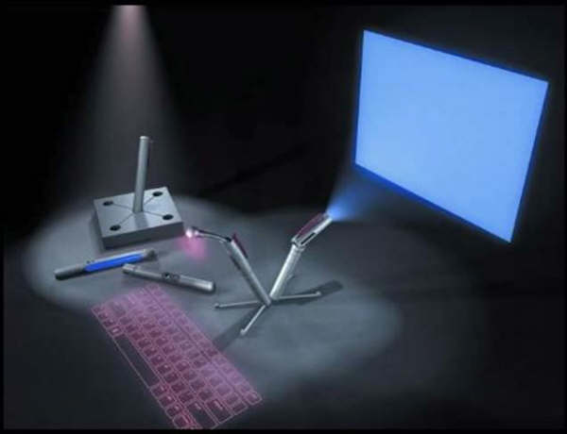

Step 6 : Select the proper interaction device
D1H1C3 Perancangan antarmuka aplikasi
D3 Teknik informatika
Fakultas ilmu terapan
Telkom university

Slide 2
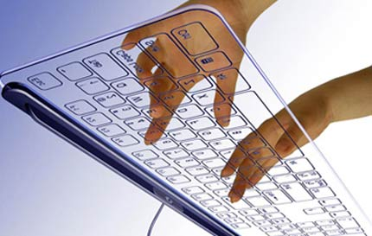
Interaction Device
Adalah suatu mekanisme input atau device yang digunakan user untuk mengkomunikasikan keinginan dan kebutuhannya kepada komputer, dan/atau mekanisme Output atau device yang digunakan komputer untuk memberikan respond kepada user
Notes:
Adalah suatu mekanisme input atau device yang digunakan user untuk mengkomunikasikan keinginan dan kebutuhannya kepada komputer, dan/atau mekanisme Output atau device yang digunakan komputer untuk memberikan respond kepada user.

Slide 3
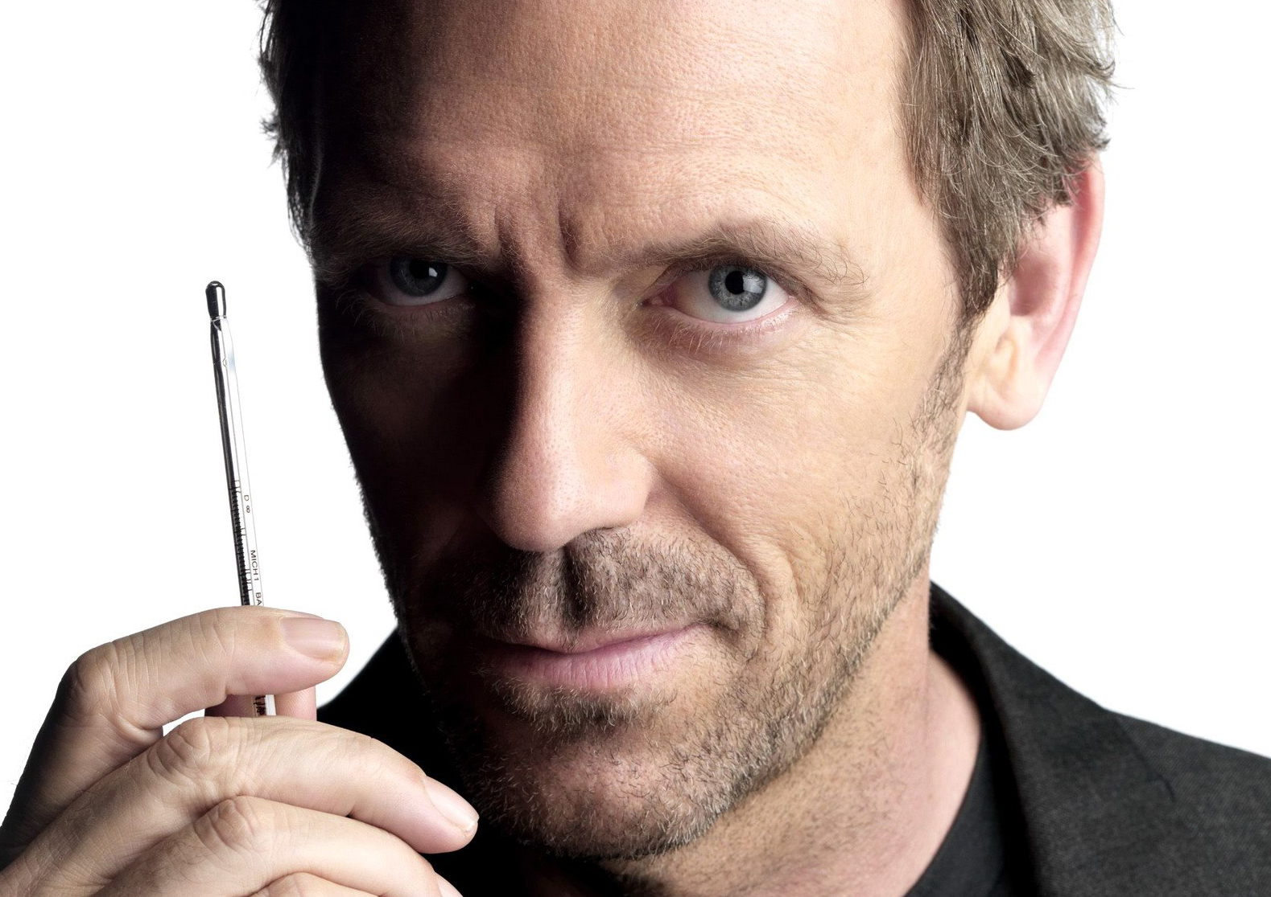
Pemilihan Device yang tepat adalah hal PENTING!
Notes:
Pemilihan device yang tepat untuk mengakomodir pekerjaan user adalah sesuatu yang sangat penting bagi kesuksesan sistem

Slide 4
Jika Tepat maka Performansi Cepat dan akurat, Jika Tidak tepat produktifitas turun, error naik, STRESS
Notes:
Pemilihan device yang tepat yang sesuai dengan kebutuhan user akan menyebabkan performansi yang cepat dan akurat. Pemilihan device yang tidak tepat akan mengarah kepada produktifitas yang rendah, error rate yang tinggi, dan kelelahan/stress pada user

Slide 5

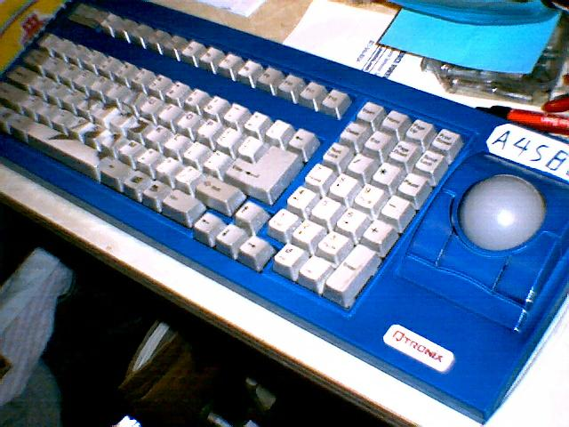
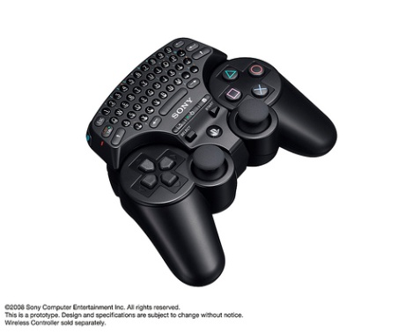
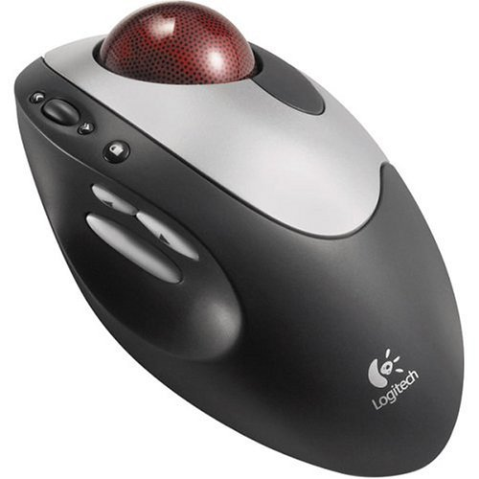
CHARACTERISTICS OF INPUT DEVICE

Slide 6
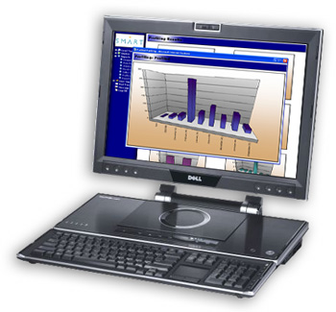
Task Performed using today system
To orient or position an object
To enter or manipulate data or information
To draw something free-form on the screen
To select the object or identify it as the focus at attention
To point at an object on the screen
To drag an object across the screen
To track or follow a moving object

Slide 7
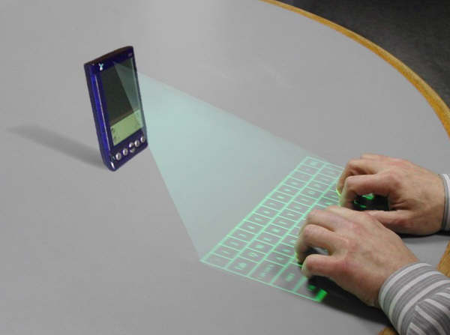
Factor of consideration
Discrete VS Continous
Direct VS Indirect
Factor Of Consideration
direction, distance, and speed of movement hand and corresponding pointer
Notes:
Direct VS Indirect
Discrete VS Continous
Relationship between movement of hand and corresponding pointer movement on the screen in terms of direction, distance, and speed

Slide 8
Trackball
Description
A spherical object (ball) that rotates freely in all directions in its socket. Direction and speed is tracked and translated into cursor movement.
Advantages
Direct relationship between hand and pointer movement in terms of direction and speed. Does not obscure vision of screen. Does not require additional desk space (if mounted on keyboard)
Disadvantages
Movement is indirect, in a plane different from the screen. No direct relationship exists between hand and pointer movement in terms of distance. Requires a degree of eye-hand coordination. Requires hand to be removed from keyboard keys. Requires different hand movements. Requires hand to be removed from keyboard (if not mounted on keyboard). Requires additional desk space (if not mounted on keyboard). May be difficult to control. May be fatiguing to use over extended time.

Slide 9
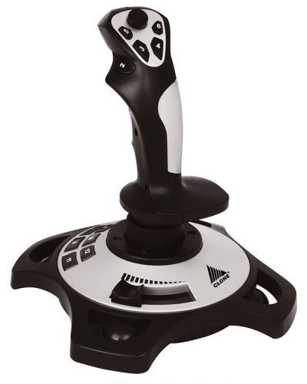
Joystick
Description
A stick or bat-shaped device anchored at the bottom. Variable in size, smaller ones being operated by fingers, larger ones requiring the whole hand. Variable in cursor direction movement method, force joysticks respond to pressure; movable ones respond to movement. Variable in degree of movement allowed, from horizontal-vertical only to continuous.
Disadvantages
Movement indirect, in plane different from screen. Indirect relationship between hand and pointer in terms of speed and distance. Requires a degree of eye-hand coordination. Requires hand to be removed from keyboard keys. Requires different hand movements to use. Requires hand to be removed from keyboard (if not mounted on keyboard). Requires additional desk space (if not mounted on keyboard). May be fatiguing to use over extended time. May be slow and inaccurate.
Advantages
Direct relationship between hand and pointer movement in terms of direction. Does not obscure vision of screen. Does not require additional desk space (if mounted on keyboard).

Slide 10
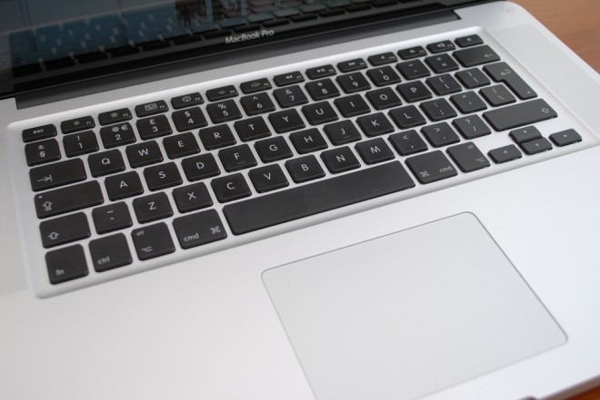
Graphic Tablet or Trackpad
Description
Pressure-, heat-, light-, or light-blockage-sensitive horizontal surfaces that lie on the desktop or keyboard. May be operated with fingers, light pen, or objects like a stylus or pencil. Pointer imitates movements on tablet.
Advantages
Direct relationship between touch movements and pointer movements in terms of direction, distance, and speed. More comfortable horizontal operating plane. Does not obscure vision of screen
Disadvantages
Movement is indirect, in a plane different from screen. Requires hand to be removed from keyboard. Requires hand to be removed from keyboard keys. Requires different hand movements to use. Requires additional desk space. Finger may be too large for accuracy with small objects

Slide 11
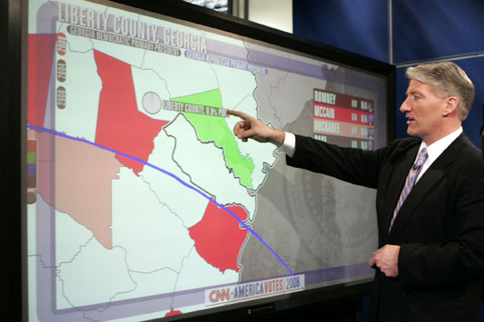
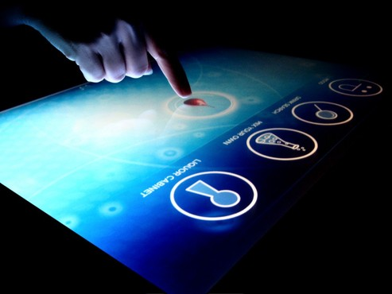
Touch Screen
Description
A special surface on the screen sensitive to finger or stylus touch.
Advantages
Direct relationship between hand and pointer location in terms of direction, distance,and speed. Movement is direct, in the same plane as screen. Requires no additional desk space. Stands up well in high-use environments.
Disadvantages
Finger may obscure part of screen. Finger may be too large for accuracy with small objects. Requires moving the hand far from the keyboard to use. Very fatiguing to use for extended period of time. May soil or damage the screen.

Slide 12
Touch Screen
Design Guidelines
Screen objects should be at least 3⁄4 × 3⁄4 inches in size. Object separation should be at least 1⁄8 inch. Provide visual feedback in response to activation. Auditory feedback may also be appropriate. When the consequences are destructive, require confirmation after selection to eliminate inadvertent selection. Provide an instructional invitation to begin using.

Slide 13
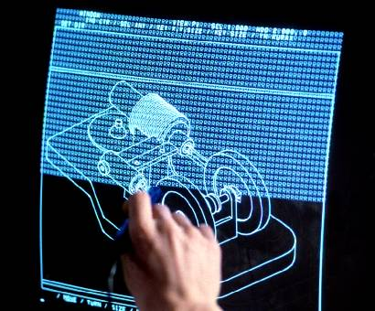
Light Pen
Description
A special surface on a screen sensitive to the touch of a special stylus or pen
Advantages
Direct relationship between hand and pointer movement in terms of direction, distance, and speed. Movement is direct, in the same plane as screen. Requires minimal additional desk space. Stands up well in high-use environments. More accurate than finger touching.
Disadvantages
Hand may obscure part of screen. Requires picking it up to use. Requires moving the hand far from the keyboard to use. Very fatiguing to use for extended period of time.

Slide 14
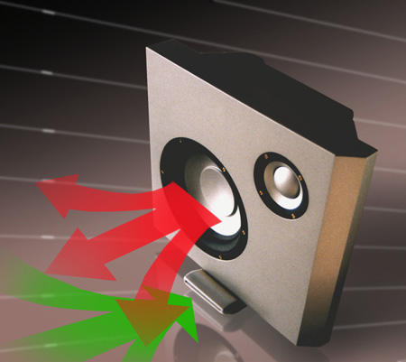
Voice
Description
Automatic speech recognition by the computer.
Advantages
Simple and direct. Useful for people who cannot use a keyboard. Useful when the user’s hands are occupied.
Disadvantages
High error rates because of difficulties in • Recognizing boundaries between spoken words. • Blurred word boundaries because of normal speech patterns. Slower throughput than with typing. Difficult to use in noisy environments. Impractical to use in quiet environments.

Slide 15
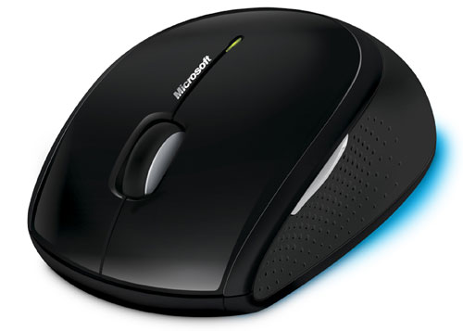
Mouse
Description
Arectangular or dome-shaped, movable, desktop control containing from one to three buttons used to manipulate objects and information on the screen. Movement of screen pointer mimics the mouse movement.
Advantages
Direct relationship between hand and pointer movement in terms of direction, distance, and speed. Permits a comfortable hand resting position. Selection mechanisms are included on mouse. Does not obscure vision of the screen.
Disadvantages
Movement is indirect, in a plane different from screen. Requires hand to be removed from keyboard. Requires additional desk space. May require long movement distances. Requires a degree of eye-hand coordination.

Slide 16
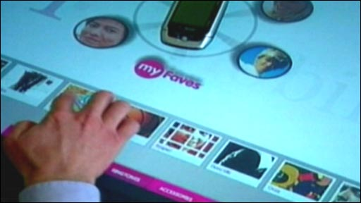
Mouse
Mouse Usage Guidelines
Provide a “hot zone” around small or thin objects that might require extremely fine mouse positioning. Never use double-clicks or double-drags as the only means of carrying out essential operations. Do not use mouse plus keystroke combinations. Do not require a person to point at a moving target

Slide 17
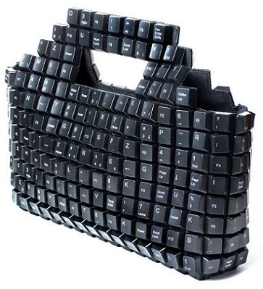
Keyboard
Description
Standard typewriter keyboard and cursor movement keys.
Advantages
Familiar. Accurate. Does not take up additional desk space. Very useful for • Entering text and alphanumeric data. • Editing text and alphanumeric data. • Keyed shortcuts — accelerators. • Keyboard mnemonics — equivalents. Advantageous for • Performing actions when less than three mouse buttons exist. • Use with very large screens. • Touch typists.
Disadvantages
Slow for non-touch-typists. Can be over-elaborate. Slower than other devices in pointing. Requires discrete actions to operate. No direct relationship between finger or hand movement on the keys and cursor movement on screen in terms of speed and distance.

Slide 18
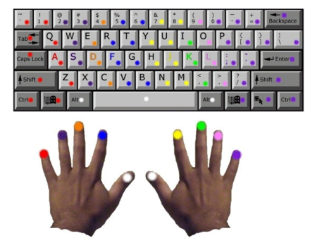
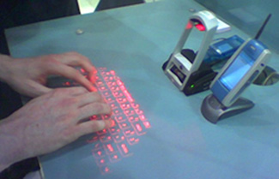
Keyboard
Keyboard Usage Guidelines
Provide keyboard accelerators. — Assign single keys for frequently performed, small-scale tasks. — Use standard platform accelerators. — Assign Shift+key combinations for actions that extend or are complementary to the actions of the key or key combination used without the Shift+key. Assign Ctrl+key combinations for • Infrequent actions. • Tasks that represent larger-scale versions of the task assigned to the unmodified key. Provide keyboard equivalents. — Use standard platform equivalents. — Use the first letter of the item description. — If first letter conflicts exist, use • Another distinctive consonant in the item description. • A vowel in the item description. Provide window navigation through use of keyboard keys.

Slide 19
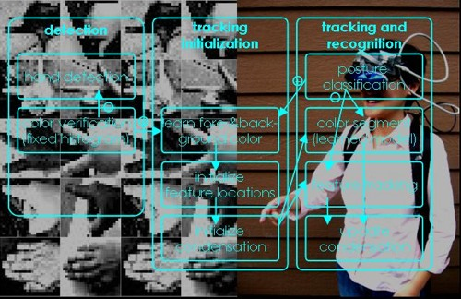
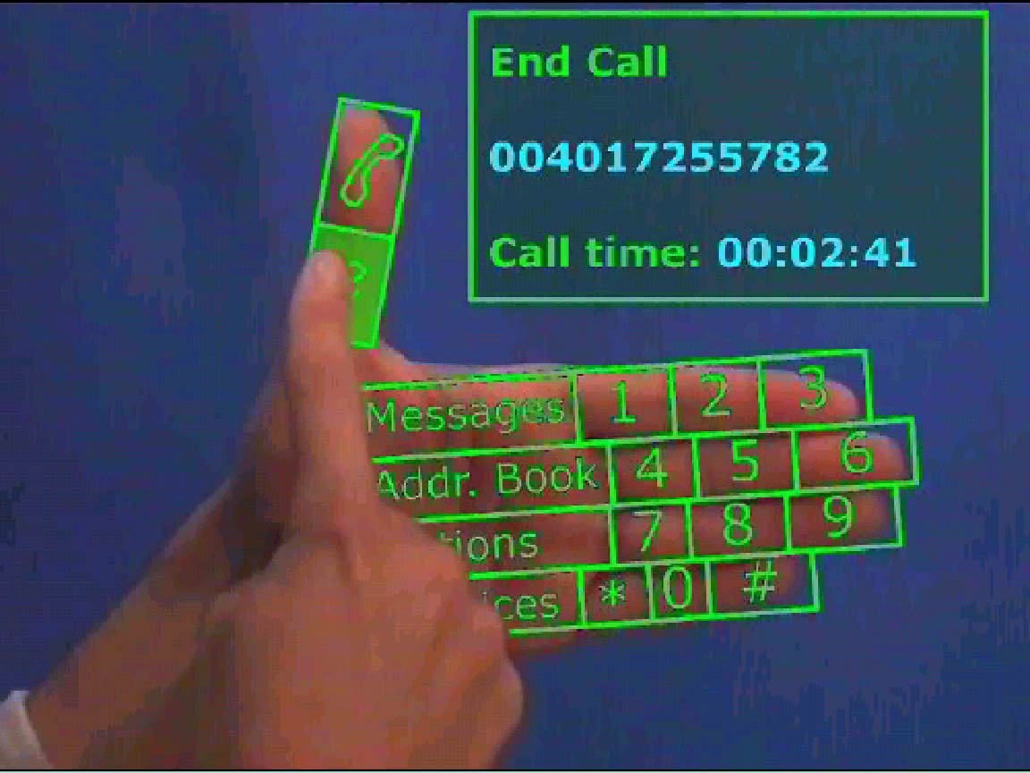
Other Input Device
Gesture Recognition Facial Expression Eye Tracking device Fingerprint Handwriting

Slide 20
SELECTING THE PROPER INPUT DEVICE

Slide 21
Panduan dalam memilih Input device yang sesuai
Karakteristik Task
Karakteristik User dan preferences
Karakteristik dari environment
Karakteristik dari Hardware
Karakteristik dari device dipandang dari aplikasi yang dibuat/digunakan
Fleksibilitas
Minimalisir pergerakan tangan dan mata
Notes:
Why do many skilled typists prefer a keyboard to a mouse? Speed is obviously one reason.
An experienced typist, through kinesthetic memory, has memorized the location of
keyboard keys. The keying process becomes exceptionally fast and well learned. The
mouse is slower, and it has a tendency to move about the desk. Its location cannot be
memorized. The keyboard keys always remain in the same spot.
Consider the following: When using the mouse, the time to move one’s hand from
the keyboard, grasp the mouse, and point at a screen object ranges from 1.5 to 2 seconds.
Avery skilled typist can type 13 to 15 characters in that amount of time; an average
typist can type 4 to 6 characters. No wonder the keyboard is often preferred.

Slide 22
Pointer Guidelines
Pointer :
➔ Harus selalu terlihat
➔ Harus kontras dengan background
➔ Harus memiliki ukuran yang konsisten ketika bergerak
➔ Area Hotspot harus mudah dikenali posisinya
User harus selalu bisa menentukan posisi pointer
Bentuk pointer
Pergunakan bentuk/variasi bentuk dari pointer secukupnya
Berikan kebebasan kepada user saat menggerakkan pointer di dalam layar
Animasi seharusnya tidak:
➔ membingungkan
➔ Mengurangi kemampuan untuk berinteraksi

Slide 23
Output Device
Screen
➔ Image
➔ Color
➔ Size
Speaker
Penggunaan Sound bisa berupa simple beep, speech, music dan sound effect.

